Slide 1
Bad Influence
Disinformation and Ethical Considerations of
Influencer Marketing Campaigns
on Social Media Platforms
Notes:
By the end of this lesson, students will be able to:
· Recognize their role as consumer and content creator and the responsibilities therein
· Articulate their own engagement with influencer marketing tactics
· Debate a variety of ethical issues surrounding misleading advertising
· Evaluate campaigns and sources to distinguish sponsored content and branding
What students should read BEFORE the session (short articles!):
Baker, Dillon. “No Filter: DJ Khaled and the FTC’s Snapchat Problem.” Contently, August 26, 2016. https://contently.com/2016/08/26/no-filter-dj-khaled-ftcs-snapchat-problem/
Ember, Sydney. “Cool Influencers with Big Followings Get Picky about Their Endorsements.” New York Times, August 2, 2015. https://www.nytimes.com/2015/08/03/business/media/cool-influencers-with-big-followings-get-picky-about-their-endorsements.html
“Find Top Ranked Detox Social Media Influencers.” Influence.co, accessed November 6, 2019. https://influence.co/category/detox.
Ives, Laurel. “Celebrity ads for diet aids should be banned, says top doctor.” BBC, February 2, 2019. https://www.bbc.com/news/health-47090374.
Lieber, Chavie. “Teatox party: How laxative teas took over Instagram, one $250,000 celebrity endorsement at a time.” Vox, April 27, 2016.
https://www.vox.com/2016/4/27/11502276/teatox-instagram/
Kerscher, Sophia. “No amount of money for posting a detox tea pic is worth the cost.” GirlBoss, January 30, 2019. https://www.girlboss.com/wellness/detox-tea-social-media.
→ For instructors who want to shift away from the diet aid content focus, other articles can certainly be used. For classes struggling to get going on reflective discussion, the PowerPoint slides that go along with this chapter include some sample social media posts; instructors can of course find and use their own to generate discussion, same as with the articles

Slide 2
Who are influencers?
This Photo by Unknown Author is licensed under CC BY
Notes:
See if you can get the students talking! Sharing what THEY think qualifies as an SMI!
Active social media users who:
Maintain a clear personal brand and vibrant relationship with other consumers
Have mastered self-presentation strategies
Reside on a sliding scale of influence (mega-, macro-, micro-, and nano-)
May have varieties of influence (as writers, authorities, spreaders)

Slide 3
What makes a successful influencer?
This Photo by Unknown Author is licensed under CC BY
Notes:
Now that you’ve got them talking, think about whether you’ve heard them indicate not just what makes and SMI but what makes a SUCCESSFUL influencer…
Pros: smart, ambitious, productive, poised
Cons: self-pitying, indecisive, easily frustrated, lacking meaning in life
The most powerful social media influencers (at any followership-level) should be perceived as
“accessible, believable, intimate and thus easy to relate to” (De Veirman, Cauberghe & Hudders, 2017)
Veirman, Marijke De, Veroline Cauberghe, and Liselot Hudders. “Marketing through Instagram Influencers: The Impact of Number of Followers and Product Divergence on Brand Attitude.” International Journal of Advertising 36, no. 5 (September 2017): 798–828. http://10.0.4.56/02650487.2017.1348035.

Slide 4
Ethics and the regulation of influencer marketing
FTC regulations
Governing rules vs. technological innovations
Time is an important factor
Who knows Kim Kardashian?
Who’s heard of Dislegis?
This Photo by Unknown Author is licensed under CC BY-SA
Notes:
Be prepared to talk some about the FTC regulations here – the FTC regulations circle back on Slide 7 too!
The FTC is given broad authority for rulemaking, investigating wrongdoing, and handing down enforcement actions related to, “unfair methods of competition in or affecting commerce, and unfair or deceptive acts or practices in or affecting commerce.”
2017 (Meyers): “Most influencers are not bothering to hashtag or label their posts as paid or sponsored by brands…few are being reported to the FTC.”
Advertising practices governed by Federal Trade Commission (FTC) rulemaking
Guidelines have been slow to keep up with technological innovation
Biggest changes came after Kim Kardashian posted misleading ad for Diclegis, pregnancy drug, in 2015:
Kardashian did not
disclose status as paid advertiser
include risk information for drug
Post-Kardashian: The FTC decided that it was time to publish official guidelines for influencers to follow, which would also mean that it could issue enforcement actions against those that do not abide by those rules.
In November 2019, the FTC created a new publication, Disclosures 101 for Social Media Influencers. The pamphlet revises previous guidelines for how influencers should best convey their monetary relationships with brands and advertisers. Instead, this new document gives clear, concise advice for influencers on how and when to disclose these “material connections.” However, these guidelines contradict earlier indications of what was passable in sponsored posts and endorsements on social media; for example, they now recommend against using shortened nicknames like spon for sponsored as they do not believe that it is clear enough to the consumer. This shows that social media influencers need to stay constantly alert as it is their responsibility—
not that of the advertiser or brand—to be sure they are compliant with FTC regulations. Federal Trade Commission, “Disclosures 101 for Social Media Influencers.”
Electronic Privacy Information Center. “Federal Trade Commission: Overview of Statutory Authority to Remedy Privacy Infringements.” Electronic Privacy Information Center, n.d. https://epic.org/privacy/internet/ftc/Authority.html.
Federal Trade Commission. “Disclosures 101 for Social Media Influencers.” Washington, DC, 2019. https://www.ftc.gov/system/files/documents/plain-language/1001a-influencer-guide-508_1.pdf.
Meyers, Cynthia B. “Social Media Influencers: A Lesson Plan for Teaching Digital Advertising Media Literacy.” Advertising & Society Quarterly 18, no. 2 (2017). https://doi.org/10.1353/asr.2017.0018.

Slide 5
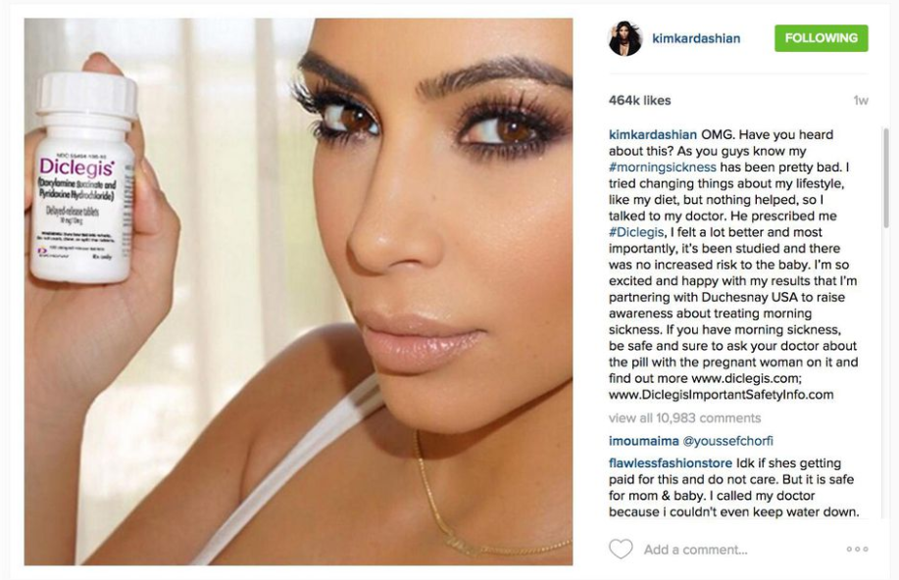
Diclegis ad before FTC crackdown

Slide 6
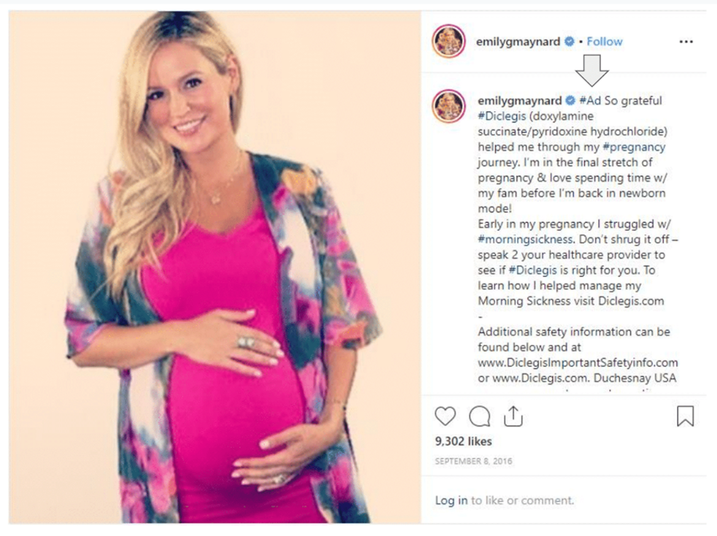
Diclegis ad after FTC crackdown
Notes:
Circled area reads…
Additional safety information can be found below and at…<<links to drug’s safety info and drug’s home page…>>

Slide 7
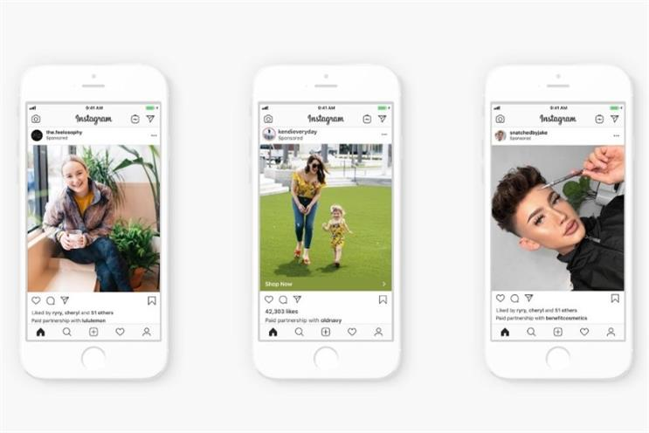
FTC regulations and recommendations
Full disclosure of paid status,
e.g. #ad, #advertisement, #sponsored
Former hashtags are no longer enough
e.g. #sp or #spon, #collab, #partner, #ambassador
Disclosure must be:
clear,
simple,
hard to miss,
…And the claims must be true!
Notes:
FTC guides for influencers (https://ftc.gov/influencers);
FTC Endorsement Guides for brands (https://www.ftc.gov/sites/default/files/attachments/press-releases/ftc-publishes-final-guides-governing-endorsements-testimonials/091005revisedendorsementguides.pdf)

Slide 8
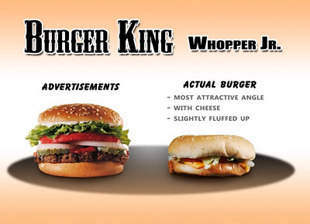
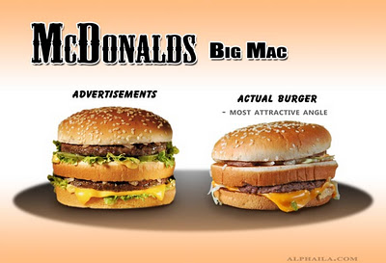
Why do we care? What’s our role?
“Persuasion knowledge model”
Consumer gains new skills:
skepticism
insusceptibility
This Photo by Unknown Author is
licensed under CC BY
This Photo by Unknown Author is
licensed under CC BY
This Photo by Unknown Author is
licensed under CC BY
Notes:
Probably a great section to partner on with the faculty member – making sure that the ideas here about media literacy / media disinformation connect with relevant subject area theory and concepts.
Persuasion knowledge model (PKM):
Developed by Marian Friestad (1994): “how people's persuasion knowledge influences their responses to persuasion attempts.”
“emphasizes a consumer's capacity to learn about persuasion over time, including how to manage their own psychological activities in persuasion episodes.”
“The Persuasion Knowledge Model presumes that people's persuasion knowledge is developmentally contingent. Within individuals, it continues developing throughout the life span.”
Overall, consider the food photos here – which would they rather eat?:
Consumers gain experience recognizing deception, better able to spot it in future
Consumer sees sponsored post with strong, clear visual markers → Recognizes telltale signs for all new incoming posts/ads
Friestad, Marian, and Peter Wright. "The persuasion knowledge model: How people cope with persuasion attempts." Journal of consumer research 21, no. 1 (1994): 1-31.

Slide 9
Reflection Time!
Does it matter to you if you know an influencer was paid for a given post?
Have you ever purchased a product you saw promoted through social media?
Would you ever agree to promote a product via social media for pay?
What would your biggest concern be regarding agreeing to promote a product via social media for pay?
What limits, if any, would you place on the amount of money an influencer should be able to be paid for product promotion?
When should social media influencers be held responsible for using ethical/honest hashtags alongside their post (e.g., “#paidpost” OR “#photoshop” OR “#buyerbeware”)?
Notes:
Boolean connections for this activity: Remember, Understand
ACRL Framework connections to this activity: Authority is Constructed & Contextual
Note: Faculty/Librarians working with online students could adapt these questions into a polling software of their choosing (e.g., Mentimeter, where polling and write in options co-exist). Ideally, students would be polled before the discussion board opens and results could be shared for additional opportunities for student reflection in the online-only setting. Can also set the questions to appear 1 by 1 using slide transitions, so that students can focus on each question being asked and reply to the poll accordingly.
If polling…
Q1: Yes/No
Q2: Yes/No
Q3: Yes/No
Q4 choices:
Size of the paycheck;
I actually like/use the product
I think it’ll get me more followers
The company who makes the product
Other
Q5 have them write in! (Not polling? Scratch paper!)
Q6 have them write in! (Not polling? Scratch paper!)

Slide 10
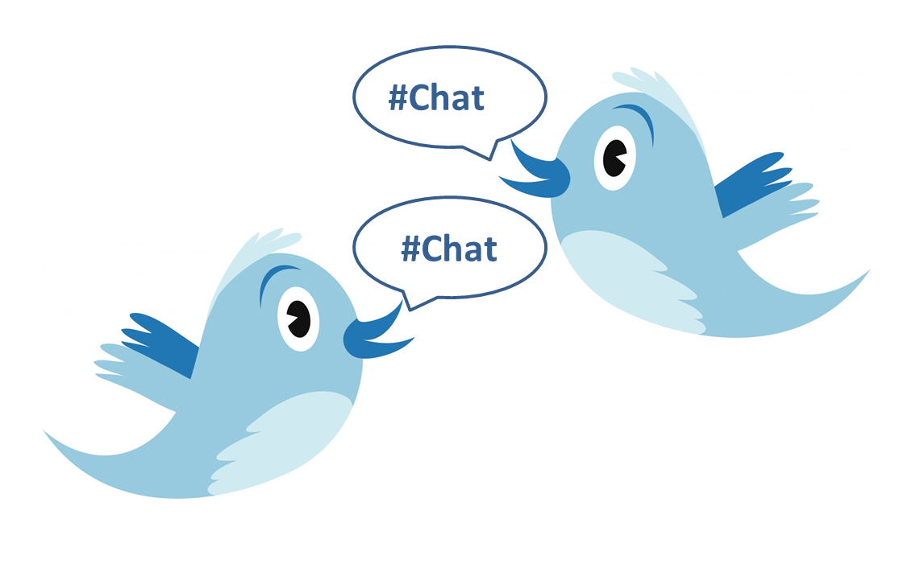
Pair & Share!
This Photo by Unknown Author is licensed under CC BY-SA-NC
Notes:
Boolean connections for this activity: Apply, Analyze
Note: Students will pair with the student next to them for about 5 minutes to discuss their responses, reactions, and reflections regarding the question prompts.
Same prompts as previous slide – but they’re discussing the results of the polls, their reflections, etc.:
Does it matter to you if you know an influencer was paid for a given post?
Have you ever purchased a product you saw promoted through social media?
Would you ever agree to promote a product via social media for pay?
What would your biggest concern be regarding agreeing to promote a product via social media for pay?
What limits, if any, would you place on the amount of money an influencer should be able to be paid for product promotion?
When should social media influencers be held responsible for using ethical/honest hashtags alongside their post (e.g., “#paidpost” OR “#photoshop” OR “#buyerbeware”)?

Slide 11
Pair & Share!
This Photo by Unknown Author is licensed under CC BY-NC-ND
Notes:
Boolean connections for this activity: Reflect, Analyze
ACRL Framework connections to this activity: Scholarship as a Conversation
How-to Ideas:
Open the floor for broad discussion (20mins).
Select (at least) two students to live-Tweet the discussion, using a specific hashtag.
Discussion prompts should include their reflections on the initial think/pair prompts above, but may also include conversation starters like:
Why might brands and influencers want to hide their paid relationship with their audience?
What do you think about the concept of banning celebrity promotion of diet aids? When might this be appropriate?
If you were an advertiser, what would you do to reach people like you? How would you get your attention?
What other ways might there be to “control” audience perception of social media influencer content (e.g., other than “#spon)?
Now that you’ve read more about the process and the industry, what surprised you from what you read?
Did any of the information change your perception of the ethics of company approaches and behaviors?
What is your opinion on the profitability attached to social media influencing work?
If you had a product to promote, what would your ethical considerations be for how you go about promoting your product?
If you were approached to be an influencer for a product, what would your ethical considerations be in making your decision to promote that product or not?
→ These questions could also be randomly handed out to students. Or students could have a # at their seats (1-9) so that they have someone near them to discuss their assigned question with. All sorts of modifications are possible to help students through the discussion!

Slide 12
Pair & Share!
This Photo by Unknown Author is licensed under CC BY-NC
Notes:
Note: Faculty/Librarians working with online or who want to choose to integrate technology in…could adapt these questions into a polling software of their choosing (e.g., Mentimeter, where polling and write in options co-exist). Ideally, students would be polled before the discussion board opens and results could be shared for additional opportunities for student reflection in the online-only setting. Can also set the questions to appear 1 by 1 using slide transitions, so that students can focus on each question being asked and reply to the poll accordingly.

Slide 13
Let’s Keep the Conversation Going!
For online discussion, choose an option:
Select a product
Advertise it! Create a sponsored post to share.
Select an influencer
Analyze their posts using today’s questions.
POST!
Then, engage:
Respond to at least 2 classmates
Ethical concerns?
How is their #ad or SMI analysis persuasive?
This Photo by Unknown Author is licensed under CC BY-SA
Notes:
Boolean connections for this activity: Create, Reflect
ACRL Framework connections to this activity: Information Creation as a Process
How-to:
Students will select a product to advertise and create a sponsored post to share with classmates on a course blog, wiki, or discussion board.
They should respond to at least two classmates to critically examine the effectiveness of the post and any ethical concerns they may have about the post, based on their readings and discussion throughout the learning activity.
→ Alternatively, students can select an influencer (from a list) whose posts and strategies they can reflect upon and analyze. In classmate responses for both these options, students should be sure to address the concept of persuasiveness.
Note: In this section of the activity, the instructor and librarian can participate in the discussion board sponsored ad creation activity and the effectiveness and ethics discussion as desired, based on their comfort level, if preferred/needed for time or class structure reasons.

