Slide 1
Searching as Strategic Exploration
BUA 490 Business Research Consultation
Grace Liu
6/19/2019

Slide 2
Hello!
Let’s have an introduction.
What is your strength in business research?
What business research project have you worked with before?

Slide 3
1.
Brainstorming
Business research in classroom vs. in workplace

Slide 4
“What are the differences between research project assigned in classroom vs. assigned at workplace?”

Slide 5
“How would you deal with the research request at workplace differently?”

Slide 6
“What are the differences between research project assigned in classroom vs. assigned at workplace?”
How would you deal with the research request differently at workplace?

Slide 7
The Dynamics of Research at Workplace
Research at workplace may not come with a detailed description or outline, you have to explore and constantly making decisions for the scope of your research.
The request may come with a scope that is broad or not quite clear or loaded with others’ assumptions. What are the underlying assumptions of your project topic? Could they be challenged? Would you include them into your research scope or not? Why? What other questions do you have for the scope of this research?

Slide 8
What are the underlying assumptions of your project topic? Would you include them into your research scope or not? Why? What other questions do you have for the scope of this research?
Sustainability Project
Center Store Project

Slide 9
After determining the initial scope of the task, we would use our imagination, think about who might care about this topic and would write something about it, and want to share it. If it is shared, where would the author share it and in what formats or platforms?
Who
Scholars
Organizations
Governments
Trade Associations
Companies
Consulting Firms
Publishers
Consumers
Formats
Articles
Books
Reports
Case Studies
Interview
Presentation Slides
Tweets
Data
Platform/Container
Book
Newspaper
Magazine
Journal
Database
Website
Social Media
Radio Programs
TV Programs
Youtube

Slide 10
Mapping Information Sources with the Tools to Find them.
Tools
Google (news/magazines/websites/social media/youtube)
Google Scholar (library setup)
(magazine, journals)
-----
Library Catalog (books)
Library Databases (full-text articles, reports, etc.)
OneSearch (not recommended)
Who
Scholars
Organizations
Governments
Trade Associations
Companies
Consulting Firms
Publishers
Consumers
Formats
Articles
Books
Reports
Case Studies
Interview
Presentation Slides
Tweets
Data
Platform/Container
Book
Newspaper
Magazine
Journal
Database
Website
Social Media
Radio Programs
TV Programs
Youtube

Slide 11
What is available in a library? What is not?
What is likely available in a library but often not available freely online?
What is often not available at a library, but more likely available online?
What would always be missing from your research?
Depending on Accessibility, Findability and Budget
Books
(systematic, in-depth)
Scholarly Articles
(more legitimate research methods, systematic reviews)
Open Access Scholarly Articles
Newspaper and
Magazine Articles
Consulting Reports
Trade Association Reports/Surveys
Professional Opinions
(practical, professional, timely)
Company Practices

Slide 12
2. Develop a Search Strategy
Design your searching as a strategy not a plan
Notes:
A plan is an arrangement, a pattern, a program, or a scheme for a definite purpose. A plan is very concrete in nature and doesn’t allow for deviation.
A strategy, on the other hand, is a blueprint, layout, design, or idea used to accomplish a specific goal. A strategy is very flexible and open for adaptation and change when needed.

Slide 13
Work with your team to develop a search strategy
What types of information are you looking for?
What search tools will you use?
Example:
Articles about best practices for sustainability communication - Google
Books for sustainability marketing - Library Catalog
How would you prioritize these task?
How would you collaborate for this task?

Slide 14
Assignments
Keep a record of how you conducted your search and we will discuss it in the next session.
Specific Research question? | Search Terms | Types of Information | Search Tools | Result/Evaluation
How to market sustainability to consumers? | Sustainability marketing Sustainability Communication | Book | Library Catalog | Find one relevant book; many resources on sustainability, but not marketing specific
What is the relationship between sustainability practices and market impact? | Sustainability Market impact/influence/reputation/branding | Surveys on businesses; theoretical analysis | Google Scholar Business Premium Collection | Too many results; hard to navigate
What is omni-channel retail and how does it relate to center store grocery retail? | omni-channel retail, center store grocery | Explanatory articles | Google | Too few results on center store

Slide 15
Key Takeaways
Business research is an open-ended exploration and engagement with information.
A question may appear to be simple but can be disruptive and critical to a business research.
Business Research needs mental flexibility and creativity.
Business information sources vary greatly in content and format and have varying relevance and value.
Business Research is a nonlinear and iterative process.
Ambiguity can benefit the research process; intellectual curiosity and persistence are valuable characteristics of business researchers.

Slide 16
Thanks!
Any questions?
You can find me at:
yan.liu1@maine.edu

Slide 17
Searching as Strategic Exploration
BUA 490 Business Research Consultation
Grace Liu
7/10/2019

Slide 18
Research Process
4. DEVELOP RESEARCH QUESTIONS
6. ENJOY YOUR TIME WITH SEARCH ENGINES
2. ANALYZE POTENTIAL SOURCES
Analyze who would care and where they would share information about this topic. Be imaginative and relevant.
Break down broad scope to specific research questions via concept mapping, logic, prior or new knowledge.
Understand simple and advanced search functions of search tools. Be understanding, reflective and responsive.
1. DEFINE RESEARCH SCOPE
3. MAP SOURCES WITH TOOLS
5. DESIGN SEARCH TERMS
Analyze your clients’ assumptions, clarify questions, keep your mind open for new discoveries.
Understand what is available in libraries what is not. When to use library catalog, databases or Google. Be organized with a search strategy.
Develop a system of keywords that help you start and continue the conversation with search engines. Just be patient.

Slide 19
RESEARCH PROCESS
CONTINUES
PREPARE REPORTS OR PRESENTATION
Keep your readers in mind; try to exceed their expectations. Add flavor to your reports with purposeful formatting and design.
EVALUATE YOUR FINDINGS
Evaluate currency, relevance, authority, accuracy and purpose of your sources and how the findings collectively support your arguments. Be skeptical and critical.
9
10
7
DECIDE TO STOP OR CONTINUE SEARCHES
8
Identify gaps in your research findings and evaluate the need to stop your searches or to start a new iterative process of researching.
EXPAND YOUR SEARCH
Understand citation tracking, pearl growing techniques and controlled vocabulary to expand your search.

Slide 20
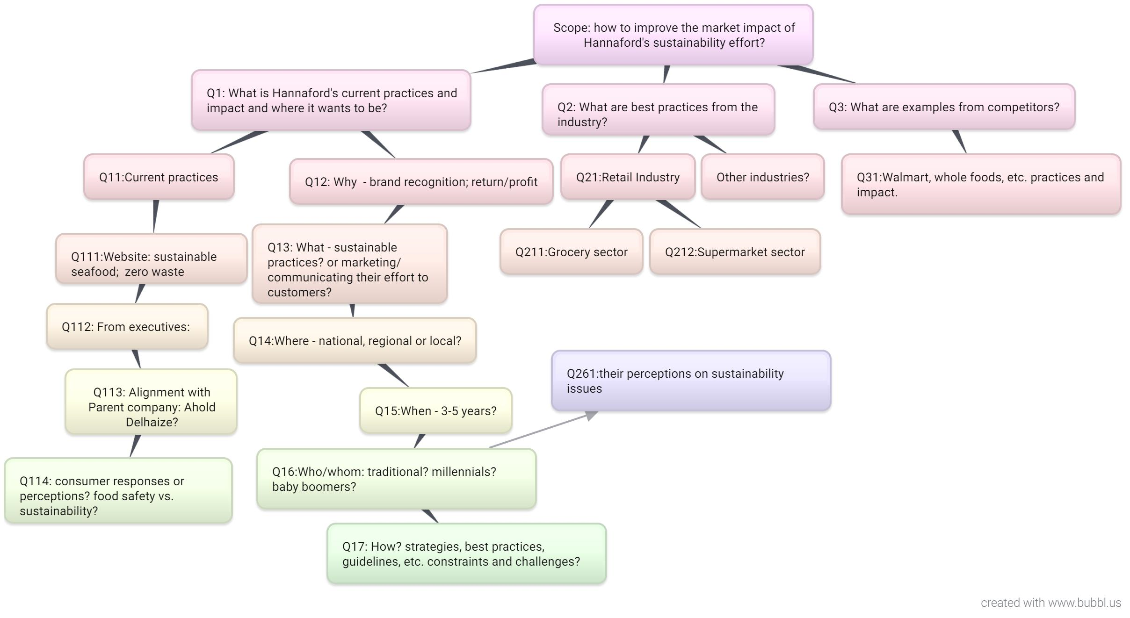
DEVELOP RESEARCH QUESTIONS
Techniques include: concept mapping, logical analysis, using prior knowledge and new knowledge developed throughout your research.

Slide 21
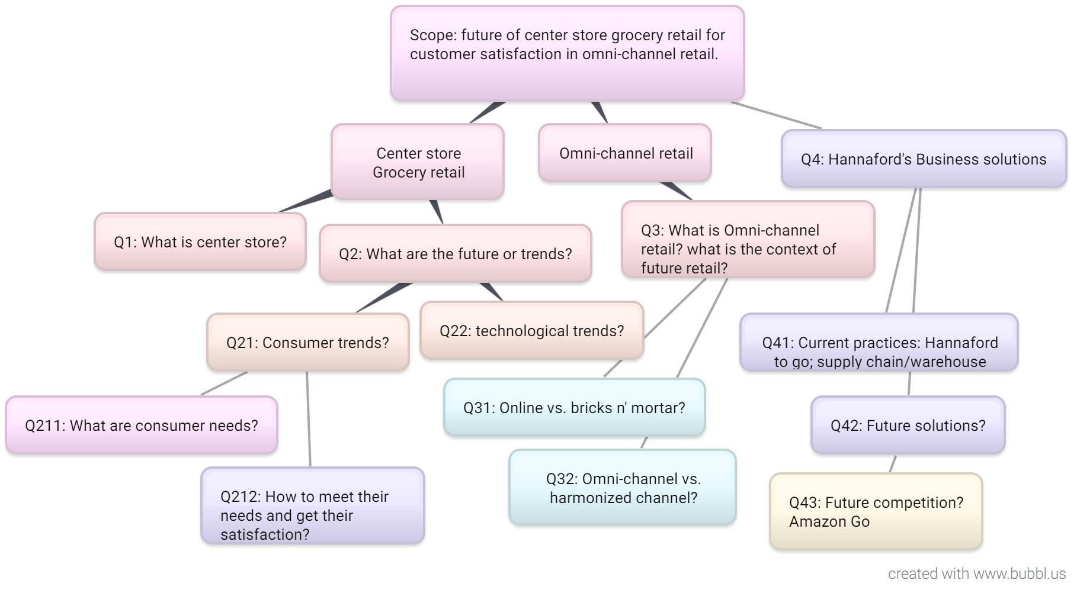
DEVELOP RESEARCH QUESTIONS
Techniques include: concept mapping, logical analysis, use prior knowledge and new knowledge developed throughout your research.

Slide 22
Design Search Terms
Topic Related Terms
Format Related Terms
Develop a system of search terms including synonyms, broader, narrower, related terms, variant spellings, abbreviations, acronyms and other different ways to express the same concept; study articles you find to gather more related terms.
Keep track of search terms used and keep the system evolve as you search.
Broader Term: Retail
Narrower Term: Center Store
Related Term: Grocery Store/Supermarket; Future/Trends/News /Forecast/Outlook
Distinguishable Terms: “Grocery Store”; Baby Boomers
Less Distinguishable: Retail, Consumer
Least Distinguishable:
What , if, are, that
Survey
Reports
Case Studies
Interview
Slides
Data

Slide 23
Understand search engines
Simple Search Advanced Search
Most search engines are still just able to do lexical search and find literal matches.
Semantic Search vs. Lexical Search: search with meaning vs. where the search engine looks for literal matches of the query words or variants of them.
Google:
Index of the web
Library Database
Default setup: some search index; some search full-text
Google:
Title, Domain, File type (PDF), Last Updated, etc.
Library Database:
Title, subject, abstract, author, date, publisher, etc
Proximity search

Slide 24
Respond to your Search Results
Too Few Results
Expand your results
Use broader search terms
Use less keywords
Use different expressions
Change word structure
Search in full-text
Read what you have found and identify more related terms
Too many results
Narrow your results
Use narrower concepts
Add more keywords
Add format terms
Use quotation marks to search phrases
Search in title or abstract instead of full-text
Use filter functions to narrow results by date, format, article type (scholarly, magazine or trade); subject
Results not so relevant
Increase Relevance
Use quotation marks to search phrase
Search keywords in title or in abstract instead of full-text
Search documents with nice format such as PDF
Use distinguishable search terms
Use other advanced search function including proximity search - search terms appear in a sentence or specific number of words

Slide 25
Try Following Searches
Google Search
“Sustainability Communication” Retail
“Communicating Sustainability” Retail
[how results are different if you search different phrase with the same meaning?]
“Communicating Sustainability” Supermarket
[how results are changed if replace a broader term Retail with specific term Supermarket?]
Supermarket "Communicating Sustainability" filetype:pdf
allintitle:sustainability marketing retail
[how results are changed if you use advanced search?]
Google Search
Center store technology trends
“Center store” technology trends
[how results are changed if you search a specific phrase with quotation marks?]
“Center store” technology site:https://www.grocerydive.com
[you have identified a website focusing on grocery store, use Google Advanced search to find articles within this site, how relevant the results are?]
“Center store” technology filetype:PDF
“Center store” filetype:PDF -Click Tools->updated last year
[how results are changed if you use advanced search?]

Slide 26
Expand your search
After you find some related articles, use following techniques to expand your search:
Use Pearl Growing Technique
Use the information from the article you’ve found to discover clues for related research.
Pay attention to other research, author, data sources mentioned in the article.
Use forward and backward citation tracking.
Use citations from the reference section of the scholarly article to find backward citations or Cited by function of Google Scholar or library database to find forward citations.
Forward and backward citations tend to discuss similar topics.
Use Controlled Vocabulary
Advanced library catalogs and databases use “subject headings” or linked index to help users quickly find articles by the same author, under same subject or from the same journal, etc. Use these links can help you expand your searches quickly.

Slide 27
Thanks!
Any questions?
You can find me at:
yan.liu1@maine.edu

