Slide 1
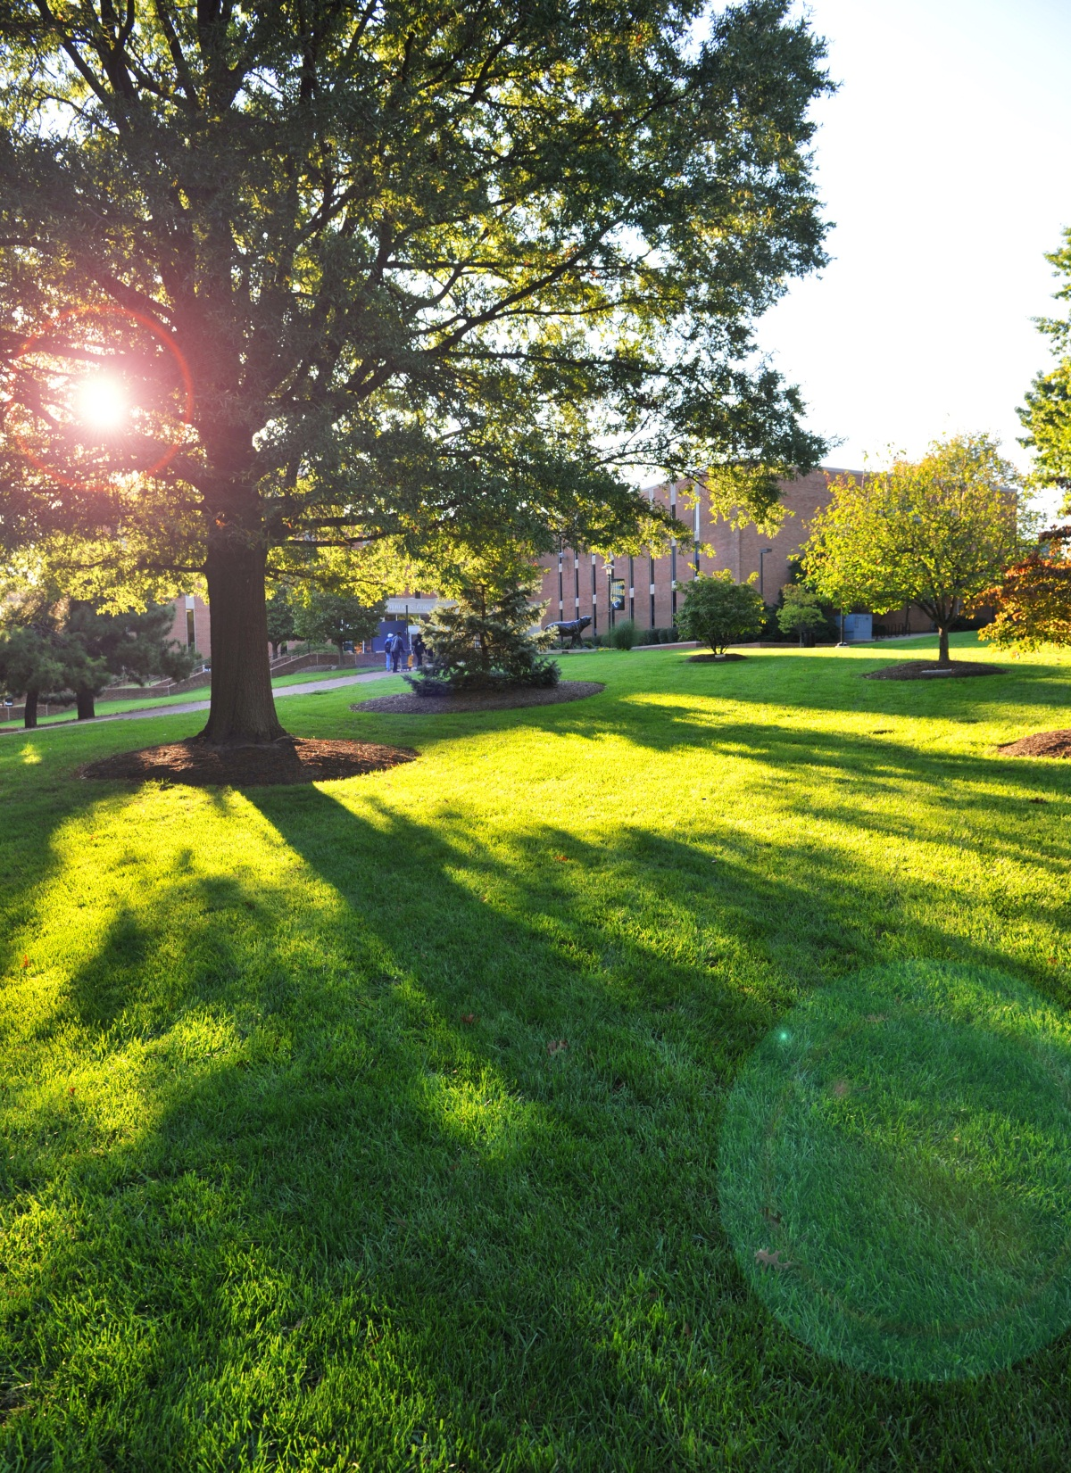
Sarah Gilchrist, MLS
sgilchrist@towson.edu
Research and Instruction Librarian
Albert S. Cook Library

Slide 2
Fostering Digital Citizenship

Slide 3
Learning Agenda
By the end of our activity, you will be able to:
Understand digital citizenship and information literacy in order to explain these concepts to your own students
Locate and use EBSCO’s Primary Search database in order to discover materials for your own lessons
Create lesson plans using information literacy and research skills in order to integrate Common Core State Standards into your classes

Slide 4
Common Core State Standards and the Framework for 21st Century Skills
Shared Areas of Alignment:
Critical Thinking and Problem Solving
Core Subjects/Content Knowledge
Communication/Comprehension/Critique
Information Literacy/Value Evidence
Self-direction/Independence
Global Awareness/Perspectives and Cultures
Information. Media and Technology Skills
Partnership for 21st Century Skills. (2011). P21 Common Core toolkit: A guide to aligning the Common Core State Standards with the framework for 21st century skills. Washington, DC: Author. Retrieved from http://www.p21.org/storage/documents/P21CommonCoreToolkit.pdf

Slide 5
Your OWN Research Experience
In your research classes you learned to:
Find reputable sources
Evaluate materials
Avoid plagiarism
Apply citation styles
Share information

Slide 6
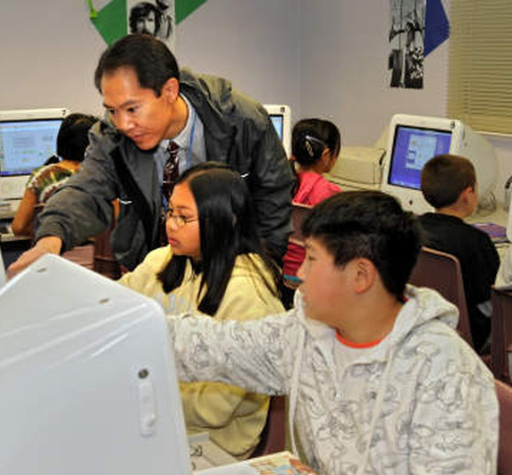
Share Your Experience
In your classes you help students. . .
Find reputable sources
Evaluate materials
Avoid plagiarism
Apply citation styles
Share information
. . . through the creation of information literacy and digital citizenship activities and lesson plans.

Slide 7
Scholarship AS Conversation
Research in scholarly and professional fields is a discursive practice in which ideas are formulated, debated, and weighed against one another over extended periods of time.
Experts understand that a given issue may be characterized by several competing perspectives
Association for College and Research Libraries (ACRL) Framework for Information Literacy for Higher Education

Slide 8
ISTC 301/501 Course Gateway
Course Gateway-
Cook Library Homepage;
Research tab; select Course Gateways
View all…; choose ISTC 301/501
Includes links to:
Research materials
Your Librarian
Help Guides
Recommended Websites
http://libraries.towson.edu/

Slide 9
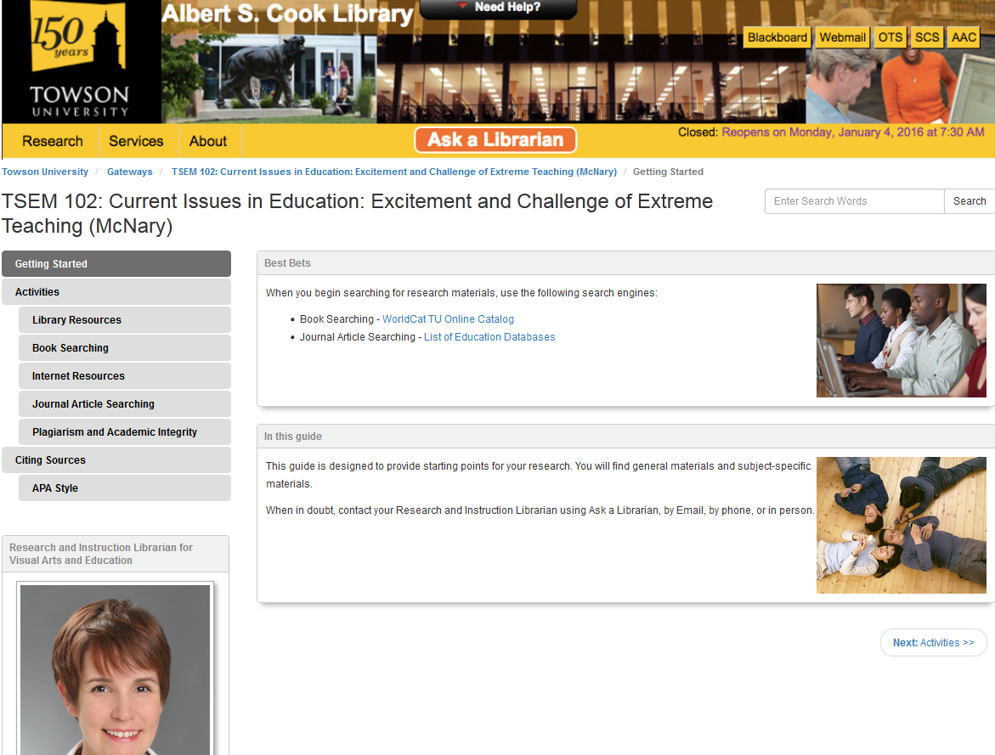
New Gateways - LibGuides
LibGuides are:
Easy to Update
List Liaison
Link to Databases
Present Alternate Sources
http://towson.demo.libguides.com/

Slide 10
Searching as Strategic Exploration
The act of searching often begins with a question that directs the act of finding needed information [using a combination of] inquiry, discovery, and serendipity.
Searching . . . is often nonlinear and iterative, requiring the evaluation of a range of information sources and the mental flexibility to pursue alternate avenues as new understanding develops.
Association for College and Research Libraries (ACRL) Framework for Information Literacy for Higher Education

Slide 11
Create an Activity
Group assignments include:
Grade 2 – Earth Space Science: Planets
Grade 2 – Life Science: Plant Life Cycle
Grade 2 – Life Science: Animal Life Science
Grade 3 – Earth Space Science: Geographic Features
Grade 3 – Social Studies: Peoples of the Nation and World
Grade 3 – Earth Space Science: Weather and Climate
http://mdk12.msde.maryland.gov/ instruction/commoncore/

Slide 12
EBSCO’s Primary Search Database
Includes links to:
Children’s magazines
Audio files for comprehension support
Background information
Vocabulary keywords
Materials may be sorted by Lexile level:
Grade 1 - 200 to 400 Grade 7 - 950 to 1075
Grade 2 - 300 to 500 Grade 8 - 1000 to 1100
Grade 3 - 500 to 700 Grade 9 - 1050 to 1150
Grade 4 - 650 to 850 Grade 10 - 1100 to 1200
Grade 5 - 750 to 950 Grade 11 - 1100 to 1300
Grade 6 - 850 to 1050 Grade 12 - 1100 to 1300
http://libraries.towson.edu/

Slide 13
Common Sense Media
Common Sense Media -
Digital Citizenship Scope & Sequence
Choose K-2; Unit 2; “Using Keywords”
Choose 3-5; Unit 1; “The Key to Keywords”
Once you find the lesson plan:
Read Keywords lesson plan
Search EBSCO’s Primary Search for content
Apply content to create your own lesson plan
Share findings with larger group visually, textually, and verbally
https://www.commonsensemedia.org/ educators/scope-and-sequence/

Slide 14
Learning outcomes Revisited
Understand digital citizenship and information literacy in order to explain these concepts to your own students
Locate and use EBSCO’s Primary Search database in order to discover materials for your own lessons
Create lesson plans using information literacy and research skills in order to integrate Common Core State Standards into your classes

Slide 15
Questions?
Feel free to contact us:
Sarah Gilchrist Claire Holmes Miriam DesHarnais sgilchrist@towson.edu cholmes@towson.edu mdesharnais@towson.edu Or any reference librarian:
Cook Library Reference Desk Fall Hours:
Monday to Thursday: 8am-10pm Friday: 8am-8pm
Saturday: 12pm-8pm Sunday: 2pm-10pm
Phone: 410-704-2462 Chat: Ask a Librarian Text: 410-774-1398
24! hours

