Slide 1
Searching as Strategic Exploration
WRT 200
Grace Liu
7/10/2019

Slide 2
Research Process
4. DESIGN SEARCH TERMS
6. PREPARE SYNTHESIS
2. EXAMINE VARIOUS TYPE OF SOURCES
What information can you expect from different types of sources such as books, newspaper and magazine articles, scholarly articles, trade publications?
Develop a system of keywords that help you start and continue the conversation with search engines. Use citation tracking and pearl growing strategy to expand your search.
Develop outline/structure of your main arguments; adding supporting and disagreeing sources to the structure; identify and then fill the gaps.
1. DEVELOP A GOOD RESEARCH QEUSTION
3. MAP SOURCES WITH TOOLS
5. EVALUATE SOURCES
Does your research question fit the assignment requirement - not too broad or too narrow? Does the question offer a good argument?
What research tools are available? Use library catalog to find books (WCU catalog, E-ZBorrow), use library guide to find article databases for specific subject; use library search everything and Google scholar to find articles across disciplines.
Evaluate the sources based on its appearance, CRAAP (currency, relevance, authority, accuracy, and purpose) test, lateral reading, critical analysis and your own reflection.

Slide 3
Various Types of Information Sources
Books
Scholarly Articles
Trade Publication
Newspaper/Magazine
Books provide a holistic and systematic review of a topic. The content is often written by experts and reviewed by editors. Since it takes 1-2 years to publish a book, be mindful of the timeliness of the content.
Newspaper or magazines have more timely reports on incidents, issues and policies and would offer analysts’ opinions. The analysis may not be very in-depth and may only have limited reference to different perspectives.
Scholarly articles tackle a narrower topic but would examine different views with a relatively objective stance. It may discuss the implications of the issue and provide suggestions based on rich evidences and arguments. It is often lengthy with references to many other sources.
Trade publication are often written by professionals in the field/industry with the purpose of informing other professionals or stakeholders in the field. Articles are often practical and relevant to the industry but may be in favor of their own perspectives/interest.

Slide 4
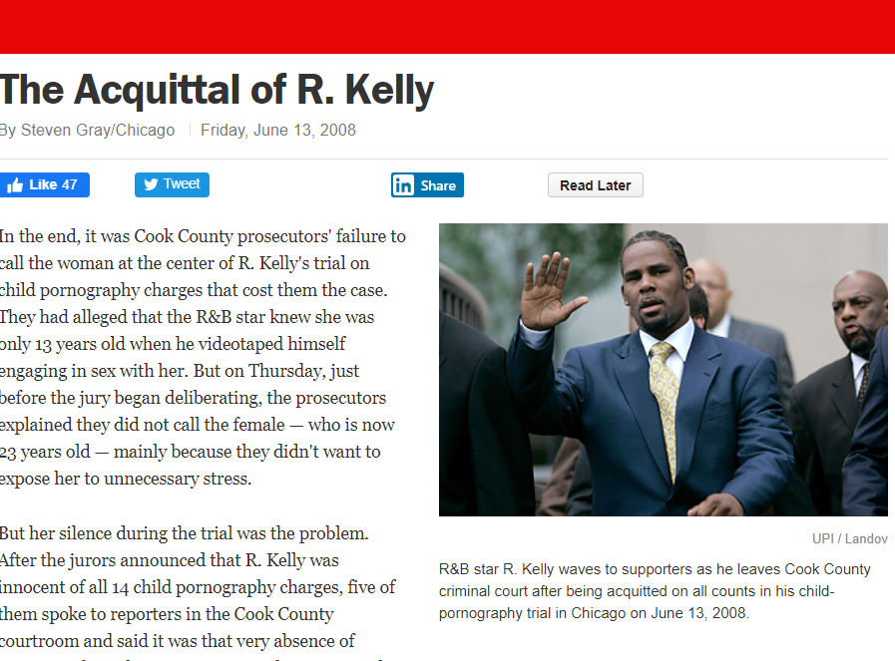
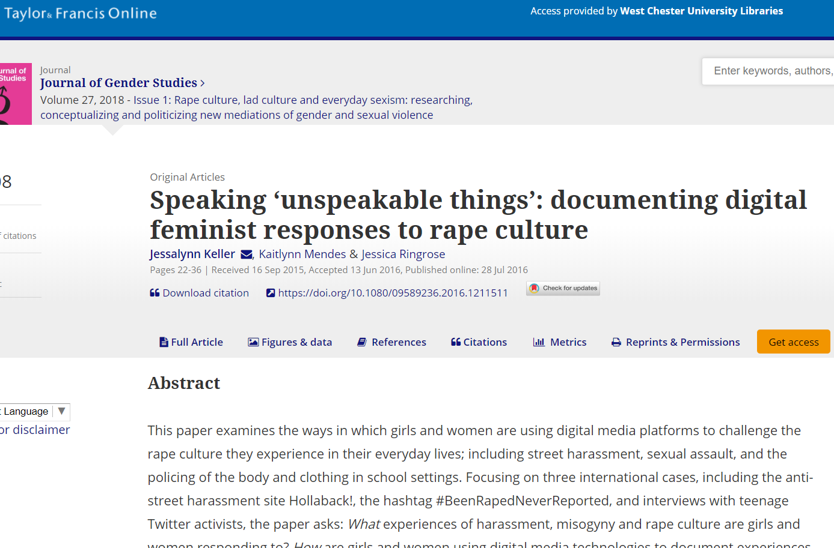
Various Types of Information Sources
Books
Scholarly Articles
Trade Publication
Newspaper/Magazine
Books provide a holistic and systematic review of a topic. The content is often written by experts and reviewed by editors. Since it takes 1-2 years to publish a book, be mindful of the timeliness of the content.
Newspaper or magazines have more timely reports on incidents, issues and policies and would offer analysts’ opinions. The analysis may not be very in-depth and may only have limited reference to different perspectives.
Scholarly articles tackle a narrower topic but would examine different views with a relatively objective stance. It may discuss the implications of the issue and provide suggestions based on rich evidences and arguments. It is often lengthy with references to many other sources.
Trade publication are often written by professionals in the field/industry with the purpose of informing other professionals or stakeholders in the field. Articles are often practical and relevant to the industry but may be in favor of their own perspectives/interest.

Slide 5
RESEARCH PROCESS
CONTINUES
PREPARE REPORTS OR PRESENTATION
Keep your readers in mind; try to exceed their expectations. Add flavor to your reports with purposeful formatting and design.
EVALUATE YOUR FINDINGS
Evaluate currency, relevance, authority, accuracy and purpose of your sources and how the findings collectively support your arguments. Be skeptical and critical.
9
10
7
DECIDE TO STOP OR CONTINUE SEARCHES
8
Identify gaps in your research findings and evaluate the need to stop your searches or to start a new iterative process of researching.
EXPAND YOUR SEARCH
Understand citation tracking, pearl growing techniques and controlled vocabulary to expand your search.

