Slide 1
Understanding Subject Headings for Black Studies Research

Slide 2
Learning Objectives
Use subject headings to search for information using databases
Know how to find materials across disciplines
Understand how subject headings are created and assigned
Question terms based on need, circumstance, and type of inquiry

Slide 3
How do you find Information?
Where do you go? What do you say, type, or read?

Slide 4
Searching Google vs. Databases
Google = Uses natural language to interpret your search based on its algorithms and your search history. It will typically provide you with a lot of results.
Databases = Use a controlled vocabulary. Your search results are based on keywords entered. Databases typically don’t make educated guesses. They only show you what you asked for.
Notes:
Google utilizes natural language, interprets your words, uses algorithms and search history, plenty of results to weed through, AKA it guesses what information you want.
This doesn’t work with databases, though.
Databases use controlled vocabulary, based on keywords, fewer results, ONLY shows you what you asked for.
Example: What president had an crocodile? vs. What president had an alligator? Google will show you the same answer for either question–John Quincy Adams. It is guessing what you’re looking for (pet alligator) instead of looking at the actual words you’re using (crocodile).

Slide 5
Searching Google vs. Databases
Controlled vocabulary: Controlled vocabularies are structured and standardized collections of words and phrases used to consistently describe data. Metadata creators use these vocabularies to assign terms, enhancing the retrieval of information. Typical types of controlled vocabularies include subject heading lists, authority files, and thesauri.
Notes:
Google utilizes natural language, interprets your words, uses algorithms and search history, plenty of results to weed through, AKA it guesses what information you want.
This doesn’t work with databases, though.
Databases use controlled vocabulary, based on keywords, fewer results, ONLY shows you what you asked for.
Example: What president had an crocodile? vs. What president had an alligator? Google will show you the same answer for either question–John Quincy Adams. It is guessing what you’re looking for (pet alligator) instead of looking at the actual words you’re using (crocodile).

Slide 6
1
Definitions
Library terms you need to understand to go deeper in your searches

Slide 7
Concepts to be covered in today’s class
Database
An electronic collection of information organized for searching and retrieval.
Knowledge organization system (KOS)
Used here to refer to the activities of document description, indexing, and classification that serve to provide systems of representation and order for knowledge and information objects.
Subject Headings
A subject heading is like a tag, or a label, which describes what the item (book, article, etc.) is about. Allow multiple points of subject access to the same work.
Notes:
Use simple language for the students.

Slide 8
Subject headings are useful because they provide a consistent way of describing the subject matter of the item. When an item is added to a database, an indexer will decide which topics are covered by the article, and choose several subject headings to apply. (Library Services, UCLA, 2024)
Notes:
The subject headings used are selected from a standardised list, or thesaurus; this is known as a ‘controlled vocabulary’. This means that all items about a particular subject would be tagged with the same, standard subject heading, regardless of the words and phrases the author used in the title or abstract.

Slide 9
More on subject headings
Subject Headings are selected from a standardized list, or thesaurus; this is known as a ‘controlled vocabulary’.
This means that all items about a particular subject would be tagged with the same, standard subject heading, regardless of the words and phrases the author used in the title or abstract.
Notes:
https://docs.google.com/presentation/d/1Upz0J0OJqKC-RN-Uvj9Ql_vj9OHWahnd/edit?disco=AAABTVvw3w8

Slide 10
Demo a search using subject headings
After providing the students with an overview of subject headings, the librarian can effectively showcase a database search by comparing the official subject heading "Sundown Town" with the term "Gray Town." This hands-on demonstration will help solidify their understanding.
Additionally, the librarian might select other relevant terms from the Additional Documents Black Studies Headings file to enrich the students’ learning experience further.

Slide 11
2
Biases in Subject Headings
Subject headings are imperfect. They show biases as well.

Slide 12
Words matter in the digital world: Libraries, like other institutions, are produced in systems marked by racism, patriarchy, and other forms of oppression…Critical librarianship and archival practice seek to uncover how library structures codify cultural norms, and in doing so, have immense power in upholding or disrupting systems of oppression. Our catalog records, finding aids, and classification structures are themselves technologies of power by privileging certain ways of knowing over others (University of Washington Libraries).
Notes:
https://sites.uw.edu/libstrat/2021/09/07/words-matter-critical-cataloging-and-archival-description-at-the-university-of-washington-libraries/

Slide 13
Knowledge organization systems (Classification systems, subject headings, and indexes) present information users with the following problems: lack of consistency in word choice, dated terminology and “the tendency of presenting historically marginalized people as fundamentally different from white heterosexual men”
(Howard and Knowlton, 2018).

Slide 14
Library of Congress Subject Headings
Library of Congress Subject Headings are the most used standardized vocabulary in the United States.
They were developed and are maintained by the U.S. Library of Congress since 1898.
Other Example of Standardized Vocabularies: Demographic group terms.
Notes:
Use illegal aliens.
https://www.ala.org/news/member-news/2021/11/ala-welcomes-removal-offensive-illegal-aliens-subject-headings
Demo easiest way to find LCSH.
Demo Black Town vs Freedom Colonies

Slide 15
Biases in LCSH
The way information is organized often reflects the prejudices of those that create the system. The Library of Congress, the organization that develops subject headings, has used many outdated and offensive terms to refer to groups of people. Some have been updated, while others remain.
A good example of this is an absence of a subject term for Afro-Latinos - books or other material often use two separate subject headings: Hispanic Americans and Black people--United States.
Notes:
Another example is the use of the terms: “Aliens” and “Illegal aliens” (which has been cancelled) to refer to Noncitizens

Slide 16
Outdated and current subject headings
Outdated | Current
Illegal Aliens | "Noncitizens" and "Illegal immigration"
Blacks | Black people
Slaves | Enslaved persons
Indians | The subject heading is still “Indians”, though there is work underway to look at alternatives.
Updated terminology on Black and African American experiences
Afrofuturist fiction— Black wall streets— Colorism
Notes:
Refer to Black Studies Subject Headings vol. 1 and 2 for more examples.

Slide 17
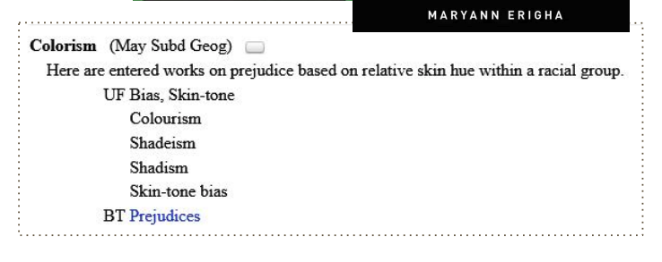

Slide 18
What does this mean for you and your research?
Considerations
Use multiple search terms.
Search multiple databases.
Consider how information is organized in a database and adjust accordingly.
Identify databases that center the experiences of the communities you want to learn more about.

Slide 19
What does this mean for you and your research?
Do lateral reading. Don’t just analyze a source using the source itself. Search around the source. How does the author identify themselves? What is the political perspective of the publication within which an article is published?
If you’re comfortable doing so, speak up if you find triggering language or images.

Slide 20
3
Black Studies Databases
Where to locate them. Which ones should you start with.

Slide 21
Black and Africana Studies

Slide 22
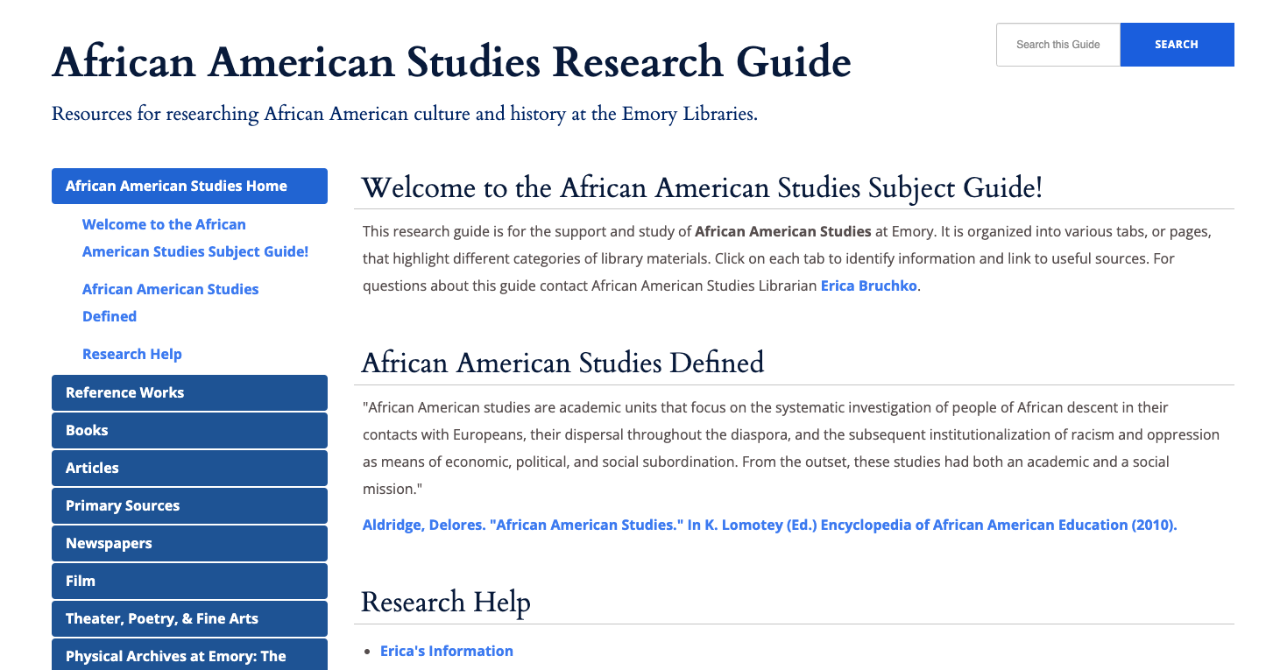
African American Studies

Slide 23
Any
questions?

Slide 24
References
Alvin, G., Bruchko, E., Cooper, J., Cronquist, M. & Thompson, D. (2023, March 15–18.). There’s no Library of Congress Subject Heading for the Middle Passage or the Great Migration?: African American Subject Headings & the Remediation of LCSH [Powerpoint Slides]. ACRL 2023. https://www.canva.com/design/DAFaeQsZ7FE/UmofhQwZNdFT8lSVQGYimw/edit
American Library Association (ALA). (2022, June 27). Cataloging Tools and Resources: Subject Headings. Resource Guide. https://libguides.ala.org/catalogingtools/subjects
Howard, S.A., & Knowlton, S.A. (2018). Browsing through Bias: The Library of Congress Classification and Subject Headings for African American Studies and LGBTQIA Studies. Library Trends 67(1), 74-88. https://dx.doi.org/10.1353/lib.2018.0026.
Library of Congress. (n.d.). African American Subject Funnel Project. https://www.loc.gov/aba/pcc/saco/aframerfun.html
Ross, S. and Cronquist, M. (2021, July 18). Black Subject Headings in LCSH: Successes and Challenges of the African American Subject Funnel Project [Powerpoint Slides]. D-Scholarship @Pitt. https://d-scholarship.pitt.edu/41826/
Shiri, A. and Chase‐Kruszewski, S. (2009), "Knowledge organisation systems in North American digital library collections", Program: electronic library and information systems, Vol. 43 No. 2, 121-139. https://doi.org/10.1108/00330330910954352
University College London Library. (2024, September 20). What are subject headings?. LibrarySkills@UCL: Searching for information. https://library-guides.ucl.ac.uk/searching-information/subject-headings
Notes:
Demo easiest way to find LCSH.
Demo Black Town vs Freedom Colonies

Slide 25
Credits
Special thanks to all the people who made and released these awesome resources under a sharing license:
Content by:
Alessandra Otero Ramos, Research Instruction Librarian, SUNY Geneseo
Erica Bruchko, African American Studies and U.S. History Librarian, Emory University
Caterina Reed, Academic Engagement Librarian, Stony Brook University
Presentation template by SlidesCarnival

