Slide 1
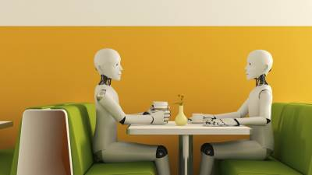
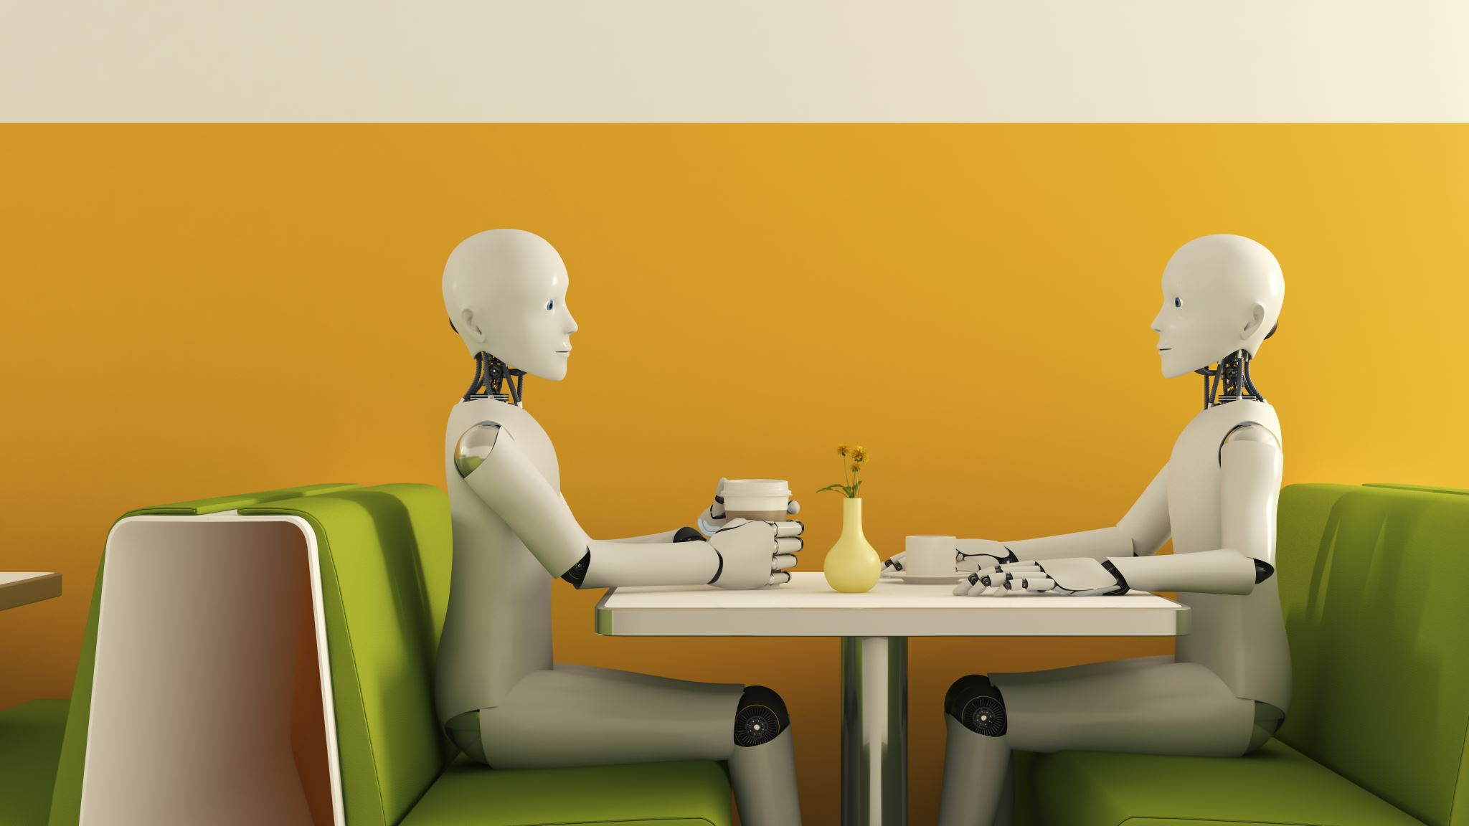
AI Literacy at Lunchtime Overview and Critical Examination
Erin Burns, Brian Quinn, Jenni Jacobs, Josh Salmans
February 2024
Notes:
Introduce all the moderators/panelists

Slide 2
Today’s Agenda
What this series is
Discuss what Generative AI is and isn’t
Discussion questions on Jamboard and in room
Critically Examine AI as a technology
Demo your (and our!) favorite tools
Notes:
This series is based in learner-centered pedagogy. This means that we center the learner (that means you the attendees) where you can help direct your own learning. This series covers generative AI literacy and will be discussion based, and we are happy to have your participation here today. Address online folks specifically – links being provided in Zoom chat and also available on our workshop Libguide.
Information from the power points will be on our workshops libguide and available after the session
Also– think of this series like making pie. Today we will find the ingredients and also perhaps play with some of them. Next week we can focus on what makes a good pie a great pie, etc.

Slide 3
What is Generative AI?
It is a large language model (LLM) that is "trained" on a large amount of data and GENERATES statistically probable text.
ALGORITHMS
Can “hallucinate” (make up wrong information)
This could be correct or incorrect information
Text from the internet (Wikipedia, public forums, Twitter, Reddit, code documents, etc) gets processed in a neural network
Good Wired article for more information
Notes:
What makes generative AI different from other AI like Siri, Alexa, Google Translate, etc?
Large Language Models are also considered a "deep learning" algorithm,
Deep Learning
•Deep learning is a type of machine learning that runs inputs through a biologically inspired neural network architecture. The neural networks contain a number of hidden layers through which the data is processed, allowing the machine to go “deep” in its learning, making connections and weighting input for the best results.
•Large Language Model is a type of Deep Learning
A machine learning algorithm is fed data by a computer and uses statistical techniques to help it “learn” how to get progressively better at a task, without necessarily having been specifically programmed for that task.
ML algorithms use historical data as input to predict new output values.
To that end, ML consists of both supervised learning (where the expected output for the input is known thanks to labeled data sets) and unsupervised learning (where the expected outputs are unknown due to the use of unlabeled data sets).

Slide 4
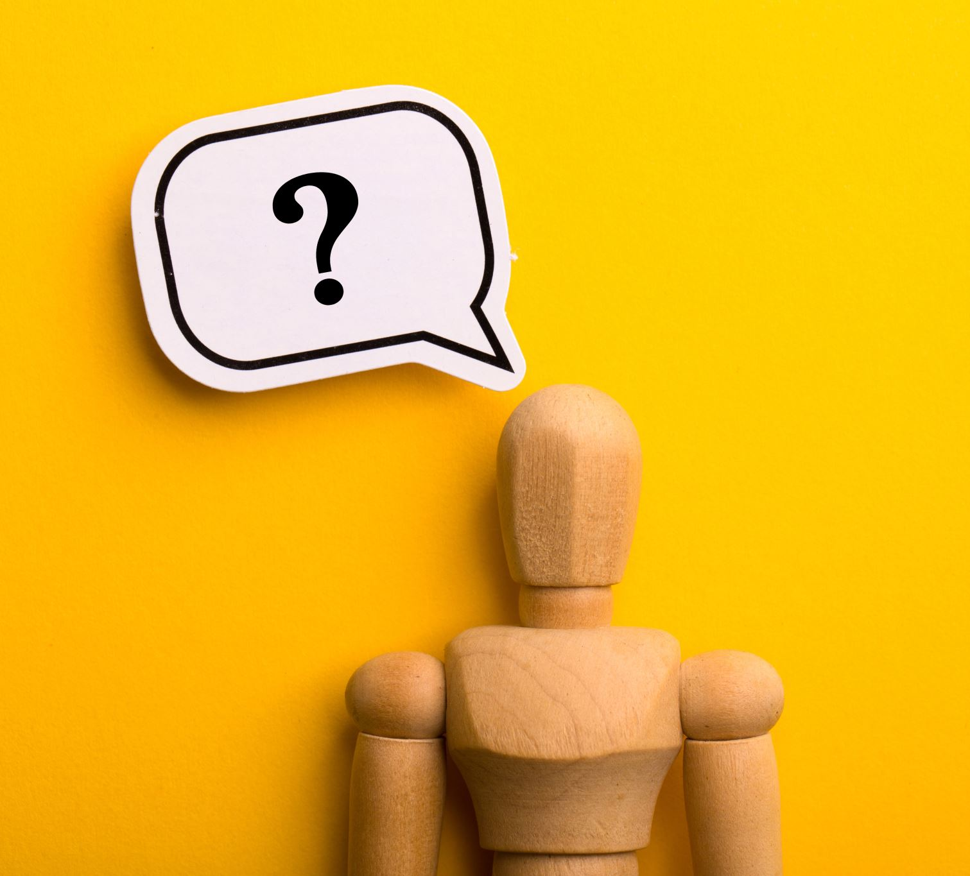
What isn’t Generative AI?
NOT A SEARCH ENGINE
NOT free from Bias
Notes:
“In the tools of the future, we are actually locking in the mistakes of the past.” Damon T. Hewitt, President and Executive Director Lawyers’ Committee for Civil Rights Under Law

Slide 5
Larger Scope Examination
Evaluating the tools
Digital Citizenship
Notes:
How we evaluate these tools we'll discuss more in-depth over the next few weeks

Slide 6
AI Literacy
AI literacy involves having the skills and competencies required to use AI technologies and applications effectively.
Think Critically
Understand Context
Question design and implementation
Discern Benefits and challenges to the tech
https://www.datacamp.com/blog/what-is-ai-literacy-a-comprehensive-guide-for-beginners
Notes:
This is also similar to the research process….
Within Libraries we have what's called the ACRL Framework, which covers learning dispositions of people who are learning the skills to ideal
Frames include the broad topic areas as follows: "Authority is constructed and contextual", "Information creation is a process" "research as inquiry" "information has value" "scholarship as conversation" and "searching as strategic exploration"
Part of the reason we are doing this series is that this topic falls within information literacy and digital literacy realm.

Slide 7
Technochauvinism and Technoableism
Technochauvinism
The belief that technology is always the solution, and the algorithmic sexism that is inherent in such technology being developed
Book: “Artificial Unintelligence,” Meredith Broussard (2018)
Technoableism
"Disability is often appealed to as a justification for technological development, and as a moral imperative toward investment in technological research. This is technoableism …“
Book: “Against Technoableism: Rethinking Who Needs Improvement,” Ashley Shew (2023)
Notes:
https://blog.petrieflom.law.harvard.edu/2023/09/25/technoableism-disability-ashley-shew/
https://www.judiciary.senate.gov/committee-activity/hearings/the-new-invisible-hand-the-impact-of-algorithms-on-competition-and-consumer-rights
From “Against Technoableism” book: “We need to be wary of technoableism– technological development and marketing that makes it seem like disability is a big bad thing that needs to be downplayed or eliminated. Most of our supported experts about disability are nondisabled people, who don’t know what its like to be the object of ableism, of design made at you rather than for you, of future imaginings that snuff you out of existence, of scrutiny towards every one of your choices, your behavior, and your being. This is why we need to look at intersectional, cross-disability communities for expertise– creative visions of a future that cuts no one out. We need to make the world more hospitable to ways of being and existence– not just by heeding disabled expertise but by loosening our ideas about what “the right stuff” is and insisting there is no wrong stuff. We should be actively anticipating all the stuff– and planning in a vein to mitigate damage already done in our disabled ecologies and prevent making our planet even more uninhabitable for some or for all.” (p131)

Slide 8
New Jim Code
New Jim Code definition: “the employment of new technologies that reflect and reproduce existing inequities but that are promoted and perceived as more objective or progressive than the discriminatory systems of a previous era.” (p5-6) Ruha Benjamin, “Race After Technology”
in her notes she mentions that this is based on Michelle Alexander’s New Jim Crow, and Algorithms of Oppression by Safiya Noble, Meredith Broussard’s “technochauvinism” and other related concepts.

Slide 9
Padlet

Slide 10
Keeping Up with A.I.

Slide 11
Resources
What is Generative AI and How Does it Work? Mirella Lapata, The Royal Institution, Alan Turing Institute (September 2023) (YouTube)
Wired – How ChatGPT works
DataCamp – What is AI Literacy
Books:
Race After Technology, Ruha Benjamin
Against Technoableism, Ashley Shaw
Artificial Unitelligence, Meredith Broussard

