Slide 1
Sound Science or Fake News?
Evaluating and Interpreting
Scientific Sources

Slide 2
The scientific method
Charles Molnar and Jane Gair, Concepts of Biology - 1st Canadian Edition (Houston, Texas: Rice University OpenStax College, 2013), https://opentextbc.ca/biology
Concepts of Biology – 1st Canadian Edition is licensed under a Creative Commons Attribution 4.0 International License

Slide 3
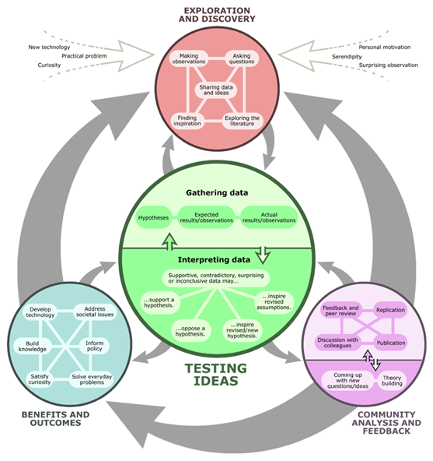
A more complex picture of scientific research
“The real process of science.” Understanding Science. University of California Museum of Paleontology. 7 July 2020. https://undsci.berkeley.edu/article/0_0_0/howscienceworks_02.
©2020 by The University of California Museum of Paleontology, Berkeley, and the Regents of the University of California. Used with permission.

Slide 4
An example of problematic scientific research
https://www.thelancet.com/journals/lancet/article/PIIS0140-6736(97)11096-0/fulltext

Slide 5
Evaluating the Wakefield article
What elements make this article seem scientifically credible?
What elements make this article seem not so credible?

Slide 6
Scientific research makes its way into popular media and social media
Your group will examine one of the following sources related to vaccines:
A magazine article
A website
A Facebook page
A series of tweets
Answer these questions:
What is the main point the author (or authors) is trying to get across?
Does the author refer to scientific research studies to support this point?
What elements make the source seem more credible / less credible?

Slide 7
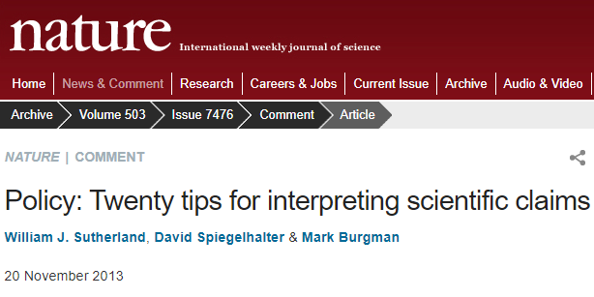
Tips for evaluating scientific claims
https://www.nature.com/news/policy-twenty-tips-for-interpreting-scientific-claims-1.14183

Slide 8
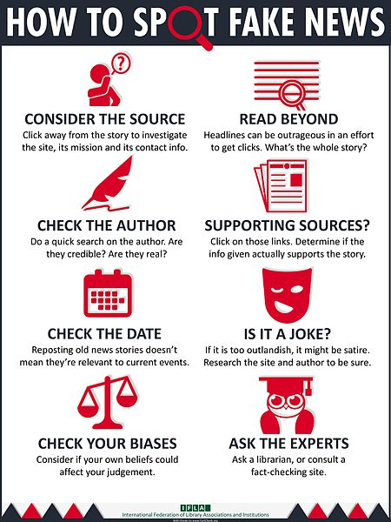
Tips for evaluating all sorts of claims
Source:
https://www.ifla.org/publications/node/11174 licensed under the Creative Commons Attribution 4.0 International license.

