Slide 1
https://trends.google.com/trends
Search terms might include product/service categories, your company/product/service, or competitors.
Created by Ben Richards

Slide 2
You can use Google Trends to…
Measure Google search trends over time and across regions
Identify seasonal and historical search trends
Compare search interest between two or more search terms
While search interest does not equate to purchase motivation or sales metrics or even positive interest, it can still be a useful indicator in marketing questions. Google Trends does not break out any results by user demographic criteria.

Slide 3
The top frame allows you two or more search terms. Here you can also specify what region to focus on, what time frame, and narrow search results by category of keywords and search platform among several Google properties.
Choose location
Choose timeframe
Choose search category
Choose search property

Slide 4
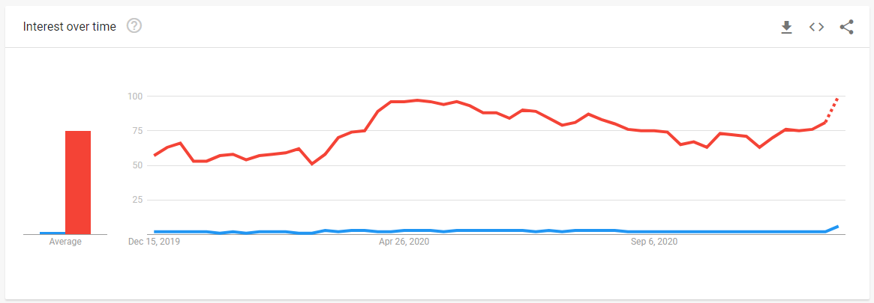
Google Trends shows one or more search terms’ popularity over time on a normalized index of 0-100.
Chart can be exported to spreadsheet

Slide 5
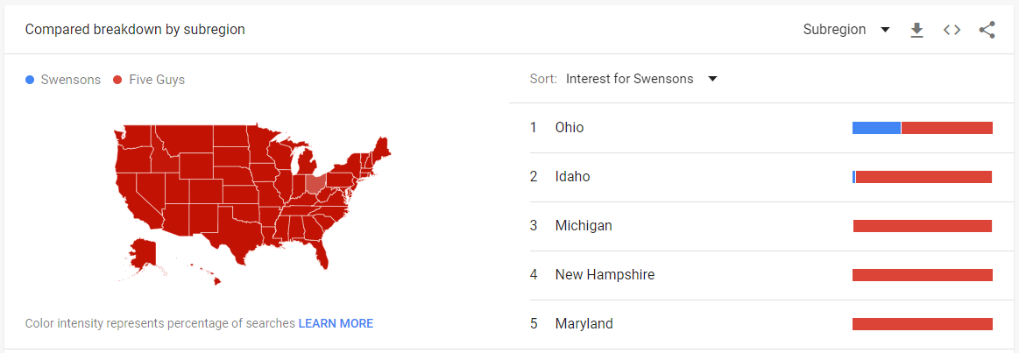
Google Trends also compares search interest across subregions; from the country level down to cities in some cases.
Click a region to drill down further

Slide 6
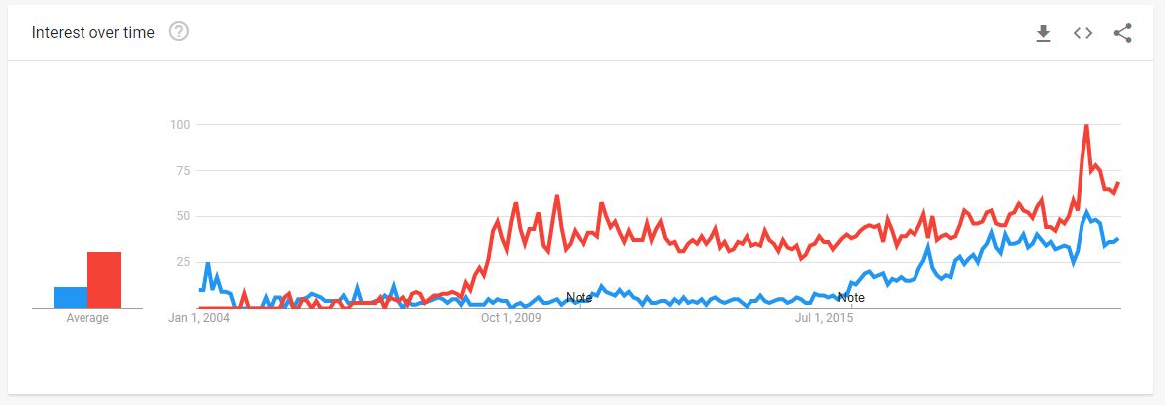
Results will change based on the region and time frame selected

Slide 7
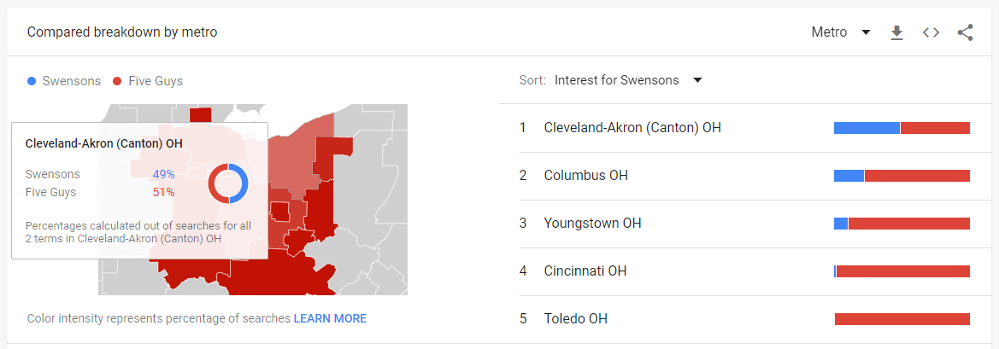
Results by subregion can be exported to spreadsheet.
Hover over region to see details.

