Slide 1
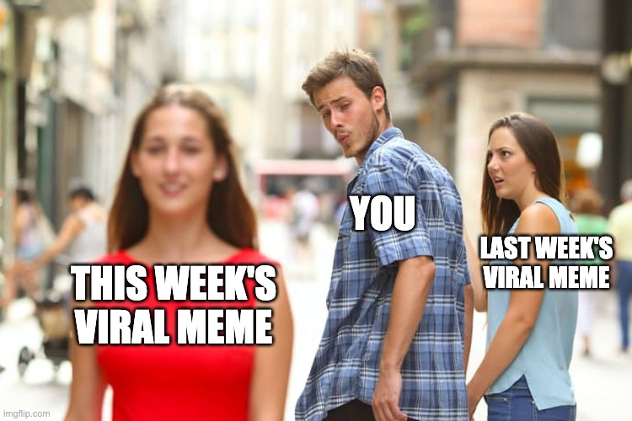
MEMES are not fact! [Your title here]
Instructor Information Here

Slide 2
LEARNING OUTCOMES
We will define memes and internet memes
We will be able to identify the informational elements contained in a meme
We will be able to analyze the purpose and impact of the information or misinformation contained in memes

Slide 3
History of Memes
In his 1976 book “The Selfish Gene”, Richard Dawkins coined the word ‘meme.’
Dawkins defines memes as “units of culture that spread from person to person by means of copying or imitation.”
Keith Henson, defines them as “replicating information patterns: ways to do things, learned elements of culture, beliefs or ideas.”
Memes can come in a variety of forms, images, text, phrases, stories, and now video and audio clips.
Examples of memes can be found long before the Internet
“Kilroy was here”
“What, me worry?”

Slide 4
Internet Memes
Online memes have been in the conversation around the Internet since it first came onto the scene in the early 1990s.
Internet memes take various forms - from new words, spellings, and phrases (lolcats) to images (Willy Wonka leaning on his hand, the cat and the woman screaming at each other), to animated gifs (Forest Gump waving), to short videos (Rickrolling, anyone?) these small pieces of culture are perfectly designed for the electronic environment.
They are no longer organic ideas that are transmitted culturally, but they are now manufactured intentionally by people or organizations attempting to control what you think.
These memes are appearing on every social media platform, from Instagram to Pinterest to Reddit! Not just on Facebook!

Slide 5
Activity (20-25 minutes)
Break into groups of 2-3
Each group gets a print/digital copy of a meme [folder of sample memes available to use]
Each group gets a list of questions to answer about their meme
What is the meme claiming as ‘fact’ - what information is it trying to impart?
Who might have made this meme?
What motives would they have had in making it?
Who might share this meme and why?
What parts could you fact-check about the meme?
If the meme is misleading or untrue, does that matter?
Each group reports out about their findings

Slide 6
Fact-Checking (Optional-Round Two)
Take the facts your group identified from your meme
Fact-check Questions
What did you search for?
Where did you search?
List the sites you used to fact-check
Why you use those sites to verify the facts in your group’s meme
Rate the meme
Accurate
Mixed
False
Group reports findings back to the class

