Slide 1
Slides for search comparison “jigsaw” activity
Created by Megan Fitzgibbons, Concordia University Library, April 2023. This work is licensed under a Creative Commons Attribution-NonCommercial 4.0 International License.

Slide 2
Which have you used?
Google Scholar
Sofia Discovery Tool
JSTOR
Academic Search Complete
ChatGPT
Bing AI
Others?
Notes:
Using your preferred polling software or simply do a show of hands
Edit to what is relevant for your session

Slide 3
Tip: Use more than one!
There isn’t a single search tool that finds everything
Each search tool has a different scope, way of retrieving items, and algorithms
The same search terms will retrieve different results in different tools
Notes:
There isn’t a single database that can retrieve all possible publications ​
​
Sometimes different tools are more relevant to YOU depending on where YOU are in your process. (Are you just starting out and don’t know the topic? Are you very focused on specific materials that you need to find? Do you need to browse? Etc.)

Slide 4
Selecting search resources
Where are you in the process? That determines what to choose!
Before using a resource, consider:
What types of documents are in this database?
Which journals, etc. are covered?
Only journals from one publisher?
Am I searching full text or just abstracts?
Languages? Date coverage? What are the advanced search options?
How can you browse or search by certain fields?
Notes:
Read “laterally” in your search tools to understand what they include and how to search
E.g., check subject guide, help files.
Example of JSTOR

Slide 5
Example: overlapping content
Sofia Discovery Tool
IEEE Xplore
(Library Database)
Engineering Village
(Library Database)
Google Scholar
Grey literature (e.g. government documents, NGO reports, working papers, newsletters, preprints)
Slide by Chloe Lei, Concordia University

Slide 6
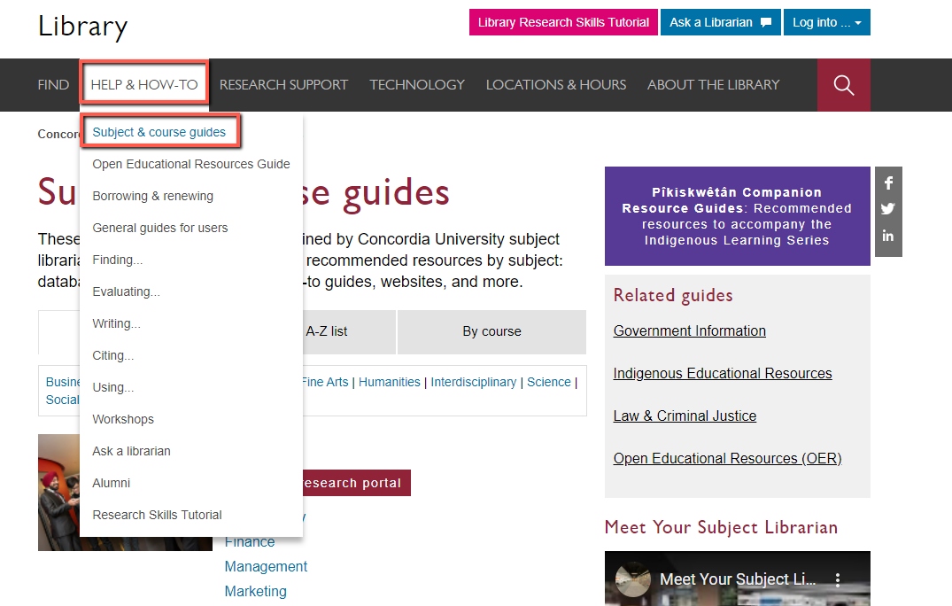
Reminder! Use subject guides to find databases

Slide 7
Generative AI and AI-assisted search
Use Large Language Models
Training datasets: unknown scope
Beware “hallucinations”!
Huge privacy concerns
ChatGPT: not a search tool—puts together words based on training data
Elicit: searches for and summarizes academic articles
Also has brainstorming features
Other emerging tools: Bing AI and Google’s Bard. Are chatbots but also integrate search results / sources

Slide 8
Activity: Which one to use?
Open the search tool assigned to your group.
Conduct a search for peer-reviewed journal articles on the topic of:
the role of social media in perpetuating climate change denial
Discuss the evaluation questions on the worksheet as a group.
Assign one person in the group to share their screen to show your search results and report your findings to the class.
(20 minutes)
5. Each group reports back on their discussion.
(15 minutes)
Notes:
Adjust time as relevant

Slide 9
Which will you use for this class?
Google Scholar
Sofia Discovery Tool
JSTOR
Academic Search Complete
ChatGPT
Bing AI
Others?
Notes:
Using your preferred polling software or simply do a show of hands
Edit to what is relevant for your session

Slide 10
Summary
Different search tools are useful depending on your needs and where you are in the process.
Pro tip: at a minimum, try Sofia, Google Scholar, and a subject-specific database.
AI research tools can be useful for brainstorming a topic or better understanding a source, but they are not (currently) substitutes for other academic search tools.
(Also, ask your instructor about rules for using AI tools in this course!)
Photo by Mitchell Luo on Unsplash
Notes:
Image from

