Slide 1





QUESTION EVERYTHING!
[Insert Name]
Notes:
Welcome to today's presentation on Question Everything! My name is [insert name] and I am the [title librarian].

Slide 2





Today’s Schedule
1
Library Must-Knows (5 min)
2
What is authority and objectivity? (15 min)
3
Activity - Source Evaluation (15 min)
4
Discussion (10 min)
Notes:
This is today's schedule. I will quickly share a few Library Must-Knows [optional] and then we'll spend about 15-20 minutes talking about what is authority and objectivity. Once we have a base line for that, I'll split you up into groups, preferably 3-4 students and you'll have the opportunity to evaluate 3 sources that I have selected for you. Then, we'll take about 10 minutes to do a group share out so please be prepared to share.
Does this sound okay to everyone?

Slide 3




Learning Outcomes
By the end of this session, you should be able to…
  Define different types of authority such as subject expertise (e.g. scholarship), societal position (public office or title), or special experience (e.g. firsthand knowledge)
  Develop awareness of the importance of assessing content with a skeptical stance and with a self-awareness of your own biases and worldview
Notes:
These are the learning outcomes for today's session. My hope is that by the end of today's class, you should be able to (read outcomes on slide).
Any questions?

Slide 4
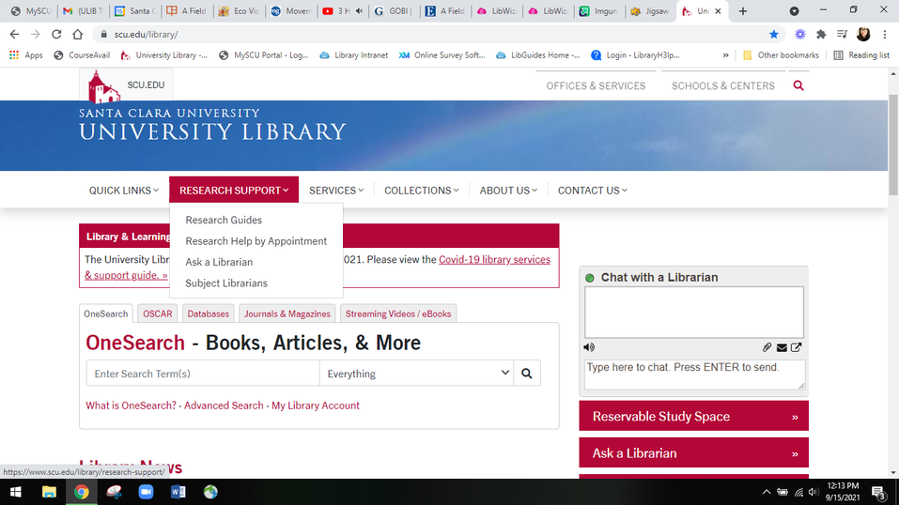
Library Must-Knows
  Ask a Librarian Chat Service
  Database by Subject
  Use Interlibrary Loan
  Check out our events
EMAIL ME: [contact info]
Question Everything © 2024 by Anna Yang is licensed under CC BY-NC-SA 4.0
Notes:
[This is an optional slide to briefly introduce students to the library. Oftentimes, this is the first time they are having a library instruction session so I tend to take 5-10 minutes to do a “Library Must-Knows”]
These are my 4 must-knows about the library.
1. We have an amazing chat service called 'Ask a Librarian'. [shows student the chat service on the library's homepage]. Has anyone in class used this? [pause for student response]
2. The other must-knows is that the library has access to many sources. Your best bet is to probably navigate some of these database or resources by "subject". [shows students the A-Z database list and also searching by subject - Biology]
3. Now that we've seen the databases, I want you to know that there is way more types of resources out there that we just don't have access to. As you are searching for articles or books and realize that the library does not have access to it, please use interlibrary loan or link+ to get these items. [show students briefly interlibrary loan services and link+ page]. Has anyone used this service? [pause for student response]
4. The library isn't just a place to study and check out books. We have events! Check out the different events and workshops that are hosted by the library. It's right on the library's homepage and you can scroll through that. (I would highlight 1 or 2 things happening that month)
5. And lastly, thee most important thing - my email. Contact me if you have any questions, comments, or suggestions. It doesn't have to be about this class, specifically. It can be about other classes, other projects, really anything.

Slide 5


What is authority?
Merriam-Webster defines authority as:
1
  2
  3
an individual (such as a specialist in a given field) who is the source of conclusive statements or testimony
a citation (as from a book) used in defense or support of one’s actions, opinions or beliefs
Power to influence thought and opinion: intellectual influence
Notes:
Alrighty, enough about how amazing the library is. Let's briefly talk about authority and objectivity. And to do that, I'm going to give you the very basic Merriam-Webster's definition of "authority" - there's actually 3 instances:
1. authority is defined as a citation (as from a book), which is used in defense or support of one's action, opinions or beliefs. Basically, it's when you're reading an article or book and then you see that citations, that's the author telling you, "hey, this is where I got that information on." It's not just about giving credit to another person, it's about pointing to the authority of that citation, that reference.
The second instance of authority is an individual, such as a specialist or expert in that field, who is the source of conclusive statements or testimony. For example, your professor. They are experts in their field. They provide authority on the subject that they are studying. And you, yourself. You may have authority on certain subjects or tools. Anyone in here use TikTok or Instagram? [can insert social media platforms with anything else e.g. video games, sports]. So, if I need help setting up an account, you'd probably be able to help me?
3. And lastly, authority means the power to influence thought and opinion. And I think this is the most important because when someone has the power to influence you, it can affect how you handle information. Think of people who hold the power to influence others, even though they are not specifically, experts in that field. Does anyone come to mind? [pause for student response] These can be public officials, motivational speakers, the President. It can also be talk show hosts or people you listen to on podcast or youtube. Hold that thought as we transition....

Slide 6

Education
Experience
Notes:
So when we take a look at the definition of a person's authority, especially in the sciences, we mean a person's education and their experiences. What gives them the authority to talk about a particular subject?

Slide 7
What is authority?
Education
Experience
Degrees
  Bachelors, Masters, PhD
Certificate/Certified
  Programming, Automotive, Skills Trainings
Fellowships, Residency, Internships
  summer internships that is part of class
Time spent in the field
  1 year vs. 10 years
Internships
  school related/or not, after graduation
First-hand knowledge
  Experience in real life
Notes:
In terms of education, we are talking about how far in their education, did they go? Do they have a bachelors, masters, or doctorate? And if so, what is their specialty. As you climb the ladder of education, the focus of your study gets more narrow, much like when you are writing a paper. You start broad and then you narrow it down to a focused research question.
There are other types of education as well. Not everyone will get a masters or doctorate. One might be certified or license to do something. For example, I did my undergraduate in history and then got my masters in library and information science, but I have many certificates and trainings in various things such as how to conduct a systematic review, searching and dissecting scientific literature, instructional design, SQL and so forth. If you want to be a scientist, eventually, you’ll want to get into a fellowship, residency or internship. This is the part where you get some hands-on experience but with the guided element of instruction or an experienced advisor. [pose question to faculty] Your professors, for example: “did you do a fellowship, residency or internship that is related to your current profession?” [double check with faculty if you can ask this question!]
And now we move onto the “experience” part of authority which is to say, you have physical experience in that particular field. Things to consider in regards to hands-on experience is also the amount of time someone spends in the field. Imagine, you start a new job at a coffee shop. Your boss tells you to start making coffee right away. Two people come up to you, one person has been there for 2 months. The other person has been there for 3 years. They both give you conflicting tips on how to make coffee. Who would you listen to? [pause for student to answer – if they do, ask them “why”]. That’s right. You may want to listen to the more seasoned veteran. Time spent in he field can be incredibly important, especially in the sciences but don’t let this be the only thing you use to define authority. A person can be in the field for a very long time but they may not actually be an expert.
And then there are other things like continued internships or volunteer work that is outside of school. There is also the “first-hand knowledge”. It’s the “real life” experience types of authority that you can also rely on to help understand different aspects around a topic. You can see this in a lot of motivational talks, speeches, TED talks, etc. It’s people who have lived experiences, not necessarily education. An example of someone who has authority on a covid because of first-hand knowledge, could be someone who actually caught covid. They experienced all the symptoms of covid and had to go through all the treatment or therapy around it. They can speak on how they felt, how horrible the situation was, and whether or not, the treatments worked for them.
I know I took a longwinded way to give you examples of authority but I wanted you to see that authority is not reserved just for academic scholars but that it depending on the topic or situation, education and experience can lend credit to forming authority on a topic. What you have to ask yourself when you come into contact with information being presented by people who claim authority, is to ask “what type of authority are they using to support their claims?”

Slide 8

What is objectivity?
Merriam-Webster defines objectivity as:
1
2
Expressing or involving the use of facts without distortion by personal feelings or prejudices
The quality, state, or relation of being objective
Notes:
Now that we have stressed authority to the point of no return, we now come to “what is objectivity?”
Well, Merriam-websters dictionary defines objectivity as “the quality, state, or relation of being objective”. Great! Objectivity means to remain objective. So, what does it mean to be objective? It means, to express or involve the use of facts without distortion, this is the very important part, by personal feelings or prejudices. Basically, it means you’re looking at the facts without any bias.
First off, let me state that there is no such thing as a truly unbias published piece of literature. No such thing. There will always be points of view or perspective but your job as the student, is to ask yourself, are there any red flags to what I’m reading, watching, consuming?

Slide 9


Question Everything
Ask yourself these questions as you encounter information:
1
Does the author, publication, or institution have a particular point of view in relation to this topic?
2
Does the author make an effort to present a balanced point of view in order to account for bias?
3
Are there data or statistics used in the article? Where did the statistics come from?
4
Is there a funding source named for the research? Is there a statement about conflict of interests?
Notes:
And with that, it brings us to the main part of our session – Your job is to “Question Everything”. Don’t take things at face value, even if it’s a scholarly article. And so, these are some of the questions that you should ask yourself as you consume information? [read the 4 questions]

Slide 10

In-Class Activity
[insert link to activity if it’s online using LibGuides, Padlet, Google Document]
Notes:
[this slide is a place holder to let the students know it’s their turn]
And, I’m a huge proponent of hands-on experience! So, it’s time to get into your teams, preferable 3-4 people [I have classrooms with 50-60 students]. And now, you’re going to come up with a team name so take 10-15 seconds to do that. If you don’t want to come up with a team name, you can go basic and say “Team 1” or “Team A” but the important part is that when you are completing the activity on the Padlet, you write down your team’s name. Please, be prepared to share your team’s answer.
[Read the 3 prompts to the students] In this activity, you’re team will evaluate 3 types of sources based on authority and objectivity. We only have 15 minutes so I don’t want you to spend those 15 minutes reading that 20 page article or watching that 30 minute video. Instead, I want you to use the great art of Skimming. Just in like in real life, you make decisions to choose something through skimming (sometimes). And how you want to tackle the evaluation of these 3 sources is up to your team. You can split them up or have everyone skim. It’s a democracy here so you decide. The only thing I ask is that you share with your teammates, your findings.

Slide 11

Discussion
Source 1 - What did your team decide on in regards to the authority and objectivity of this article?
1
2
Source 2 - What did your team decide on in regards to the authority and objectivity of this news article?
3
Source 3 - What did your team decide on in regards to the authority and objectivity of this video?
Notes:
[Pull the class back for the discussion]
We only have a few minutes left so let’s go through all the 3 sources. Every team should be prepared to answer at least once so if I don’t get any volunteers, I will choose randomly.
For source 1, what did your team decide on, in regards to the authority of the authors? [let students answer] now, another team. What did you think in regards to the objectivity of the article? Now, I know you didn’t have time to read through the whole thing but think about the tone of the article, it’s citations and references? [pause for students]
For source, what did your team decide on in regards to authority? [pause for student]. And now, what about the objectivity of the news article? Did you think it was objective? [pause for student]. So, in looking at both the scholarly article and the news article, which one did you think was easiest to “understand”? [you can make a point about the tone and voice of scholarly articles and investigative journalism if you have time]
And lastly, source 3. What did your team decide on in regards to the authority of the speaker? [pause for student]. And for those who skimmed the video, did you feel that the speaker was trying to remain objective?

Slide 12


Key Takeaways
  Make sure the author/creator is credible
  Authority and Objectivity is your friend
  Question Everything
  Contact me if you have questions!
Notes:
These are my key takeaways for you.
Make sure that the author or the creator, is credible. And when we talk about being credible, we mean, do they have the authority to speak on that topic, right? Do they have education to back it up? Do they have first hand experience? And if they don’t have any of these things, are they remaining objective? Do they provide a balance point of view? Do they point to facts or have references? Because really, science literacy 101 is that authority and objectivity is your friend. You have to question everything you come into contact with because anything can be published online. You always want to make sure that you remain curious but vigilant as you swim through the sea of information.

Slide 13
Sources
  Merriam-Webster. (n.d.). Authority. In Merriam-Webster's unabridged dictionary. Retrieved January 28, 2021, from https://unabridged-merriam-webster-com.libproxy.scu.edu/unabridged/authority
  Merriam-Webster. (n.d.). Objectivity. In Merriam-Webster's unabridged dictionary. Retrieved January 28, 2021, from https://unabridged-merriam-webster-com.libproxy.scu.edu/unabridged/objectivity
  Merriam-Webster. (n.d.). Objective. In Merriam-Webster's unabridged dictionary. Retrieved January 28, 2021, from https://unabridged-merriam-webster-com.libproxy.scu.edu/unabridged/objective
Question Everything © 2024 by Anna Yang is licensed under CC BY-NC-SA 4.0
Notes:
These are my sources around the definitions.
[have a contact page at the end if you’d like]

