Slide 1
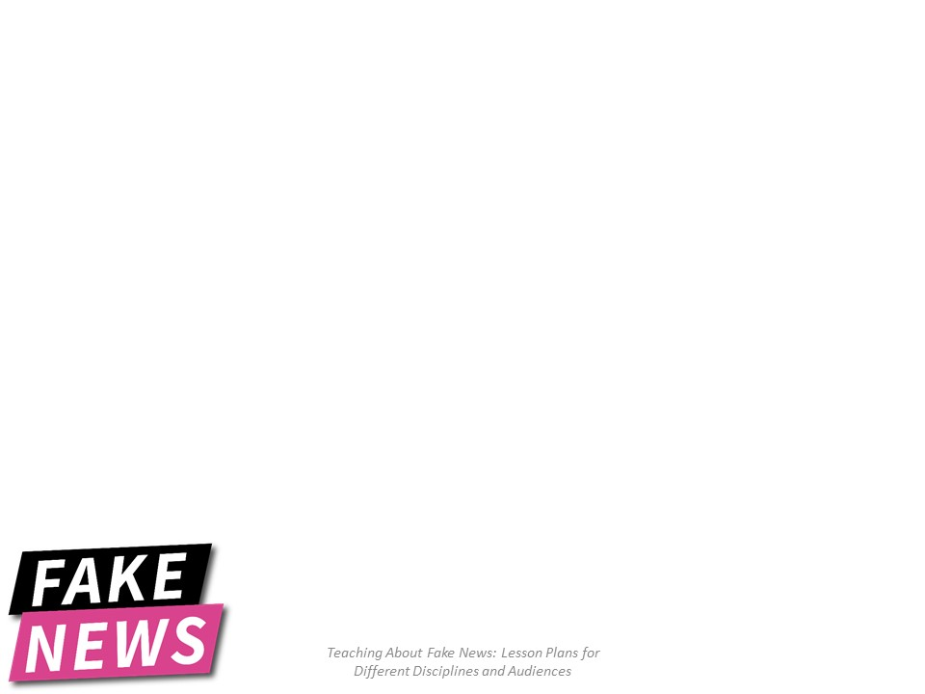
Art History Memes: a good laugh for the inner critic and a lesson on appropriation
Rebecca Barham
Art, Dance and Theatre Librarian
University of North Texas, Denton
Notes:
The students will learn about Appropriation by examining memes that appropriate art history images.

Slide 2
Appropriation
Appropriation in the art world is defined as the use of imagery from a pre-existing artwork without permission from the artist, with varying levels of transformation to create a new artwork. (Heartney, 37-38)
An example of appropriation:
https://www.louvre.fr/en/oeuvre-notices/une-odalisque
https://www.nga.gov/collection/art-object-page.139856.html
Notes:
Share definition of appropriation with the students.
Show an example of appropriation by clicking on the first link (the original artwork), and then the 2nd link (the appropriated figure integrated into a new artwork.
Background info on the appropriation:
The Guerilla Girls appropriated the female nude from artist Jean-Auguste-Dominique Ingres' painting Le Grand Odalisque (1814 Louvre), added a guerilla mask over her head and inserted her into their artwork entitled Do Women have to be Naked to Get into the Met Museum (1989 National Gallery of Art)
Mention that not all appropriation is legal.

Slide 3
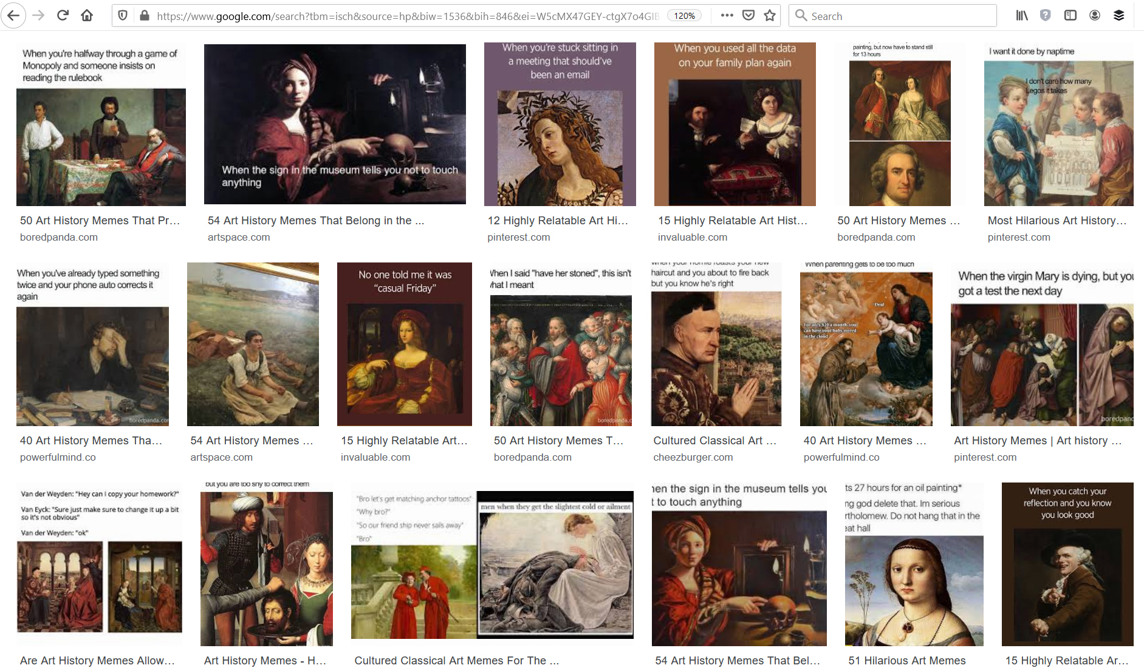
Appropriation of Art History Images for Memes
Notes:
Appropriation is also vigorously used in the creation of memes.
Sources of appropriated meme imagery extends beyond works of art to include photos from news sources, magazines, social media sites, etc..
Text phrases are also often appropriated.
In this learning activity we will gain an understanding of appropriation by examining memes that appropriate or re-use art history images.

Slide 4
Pair in groups of 3-5

Slide 5
Find Your Art History Meme
Google Image search: https://images.google.com
Search for: Art History Memes
Notes:
Go to one of these sites to pick a meme that appropriates an art history image
Google Image search: https://images.google.com
https://tinyurl.com/ybd6jwlr
https://tinyurl.com/y9cbvzyy
https://tinyurl.com/y6v6taka

Slide 6
What does it Meme?
Take 3 minutes to talk about your art history meme with your group.
What do you think it means?
How does it make you feel?

Slide 7
Submit Your Meme to TinEye
How to do it:
1. Go to TinEye: https://tineye.com/
2. Right click your meme
3. Choose "copy“
4. Click in the TinEye search box
5. Choose "paste" or Control + V keys

Slide 8
What did you Find?
How many appropriations of your art history image did you find?
Now look among the appropriation/results in Tineye to find an image that reveals the name of the original art work or artist. This will usually be the museum that owns the artwork.
Notes:
Also mention that Tineye can be used to find appropriations of any image, including photos that have been used on various websites in the past that have been re-used to create fake news.

Slide 9
Find out more about the original art work used in the meme and the artist who made it
1. Search for the painting.
Example: Mona Lisa
2. Search for the artist.
Example: da Vinci, Leonardo (last name, first name)
Notes:
1. Help the students navigate to one of the databases listed below:
Grove Art Online
Art & Architecture Source
Art, Design and Architecture Collection
2. Open the database on your computer with projection screen.
Now demonstrate how to search for the name of the art work and the artist’s name (last name, first name).

Slide 10
What does it Meme?
Take 5 minutes to talk about the original artwork with your group
Did you learn something interesting?
Did the meaning of the artwork change in the meme?
If so, how?
How are the meme and the original artwork different?
Notes:
Action 1: Have the students discuss what they think and feel about the artwork and meme now that they know more about the artist’s original intention and meaning, by asking questions like these:
Did you learn something interesting?
Did the meaning of the art work change in the meme?
If so, how?
How are the meme and the original artwork different?
Action 2: Have each Group Share Their Findings with the entire class
Reflection: Learning Outcomes
1. Students will learn how meme imagery is appropriated and stripped of original meaning to create a new meaning or subvert the original meaning of the artist, author or photographer.
2. Students will learn that the new meaning memes create is over-simplified, can be taken out of context of the larger meaning, is shallow, or has an agenda.
3. Students will learn that once the original context, background, or narrative of an artwork is known, then the meaning becomes richer, deeper and more connected with our humanity.
Reflection: Note
We interpret what we see through the lens of our experience. Most of these art works were made in another century and we have a hard time relating to them if we have not studied art history or history in general. So, we create memes that comment on the dramatic expressions and actions of the people in the artwork, or the different hair styles or clothes, based on our contemporary world experience.

