Slide 1
Using Altmetrics to Evaluate Pseudoscience News Media
What can online engagement reveal about a source?

Slide 2
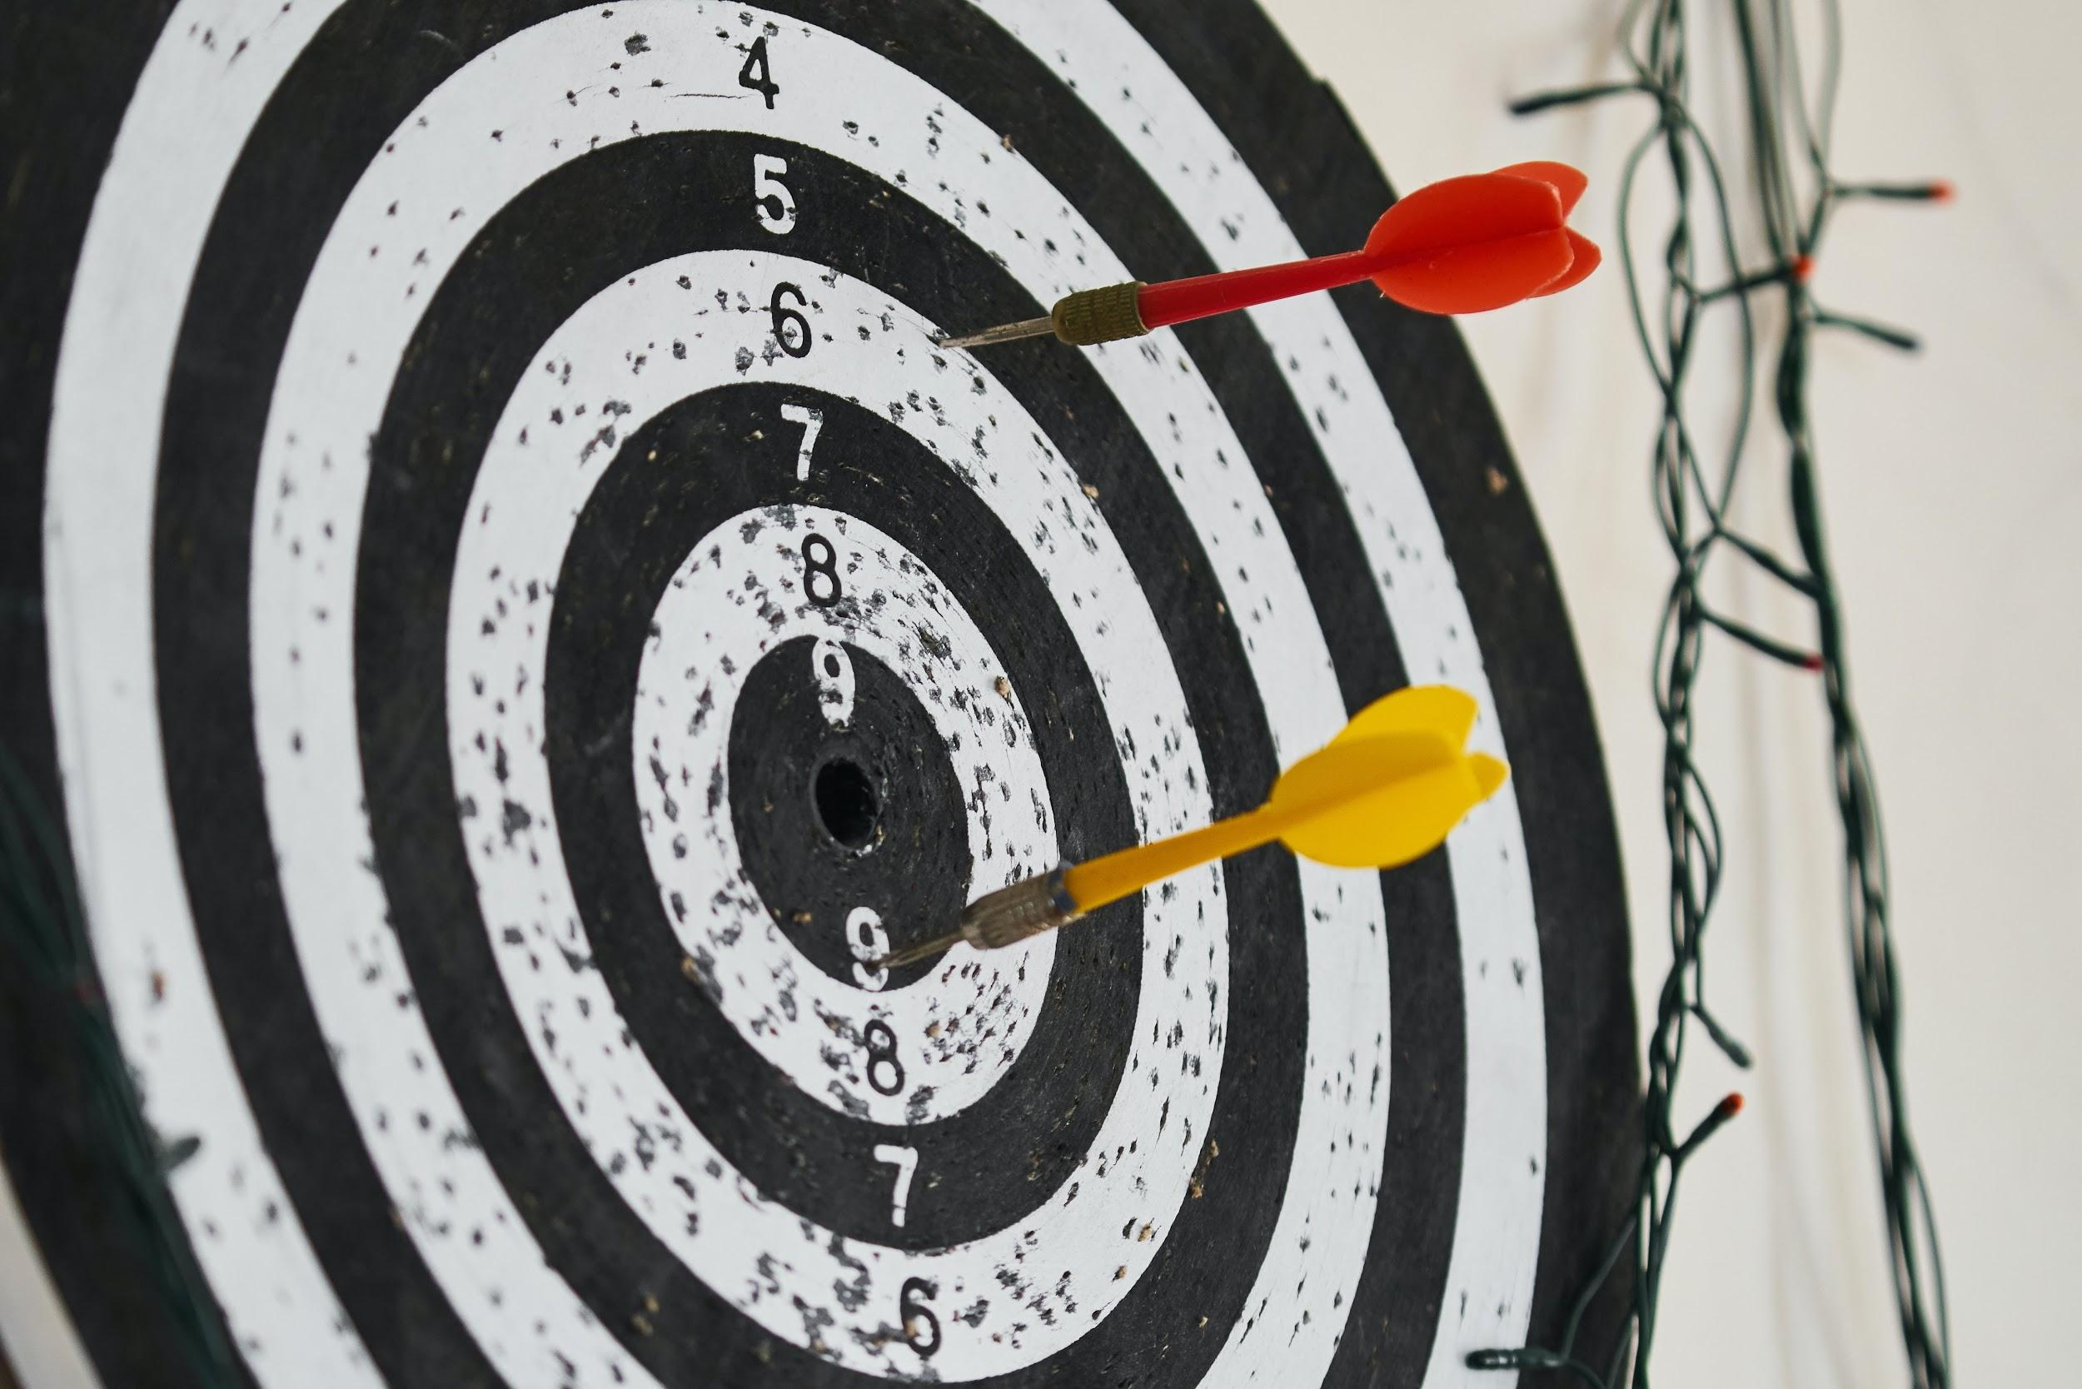
What are today’s goals?
During the session, we will:
Locate original research
Explore diverse perspectives
Analyze online engagement
Photo by engin akyurt on Unsplash
Notes:
Today, we are going to look at an example of original research alongside a social media video post regarding the research in that media. All types of research and journalism is shared via social media. I hope this exercise will help you put your evaluation skills into practice using a new tool, altmetrics. Together, we’re going to:
Locate the original research article (e.g., Wakefield’s study) mentioned in the video using an online metrics tool (e.g., Dimensions (free), Plum Analytics (subscription), or Altmetric Explorer for Institutions (subscription))
Intentionally explore diverse perspectives that mention the original research output (e.g., Wakefield’s study) within an online metrics tool; online attention to research explored can include other scholarly as well as popular sources
Critically analyze the online engagement of the original research article (e.g., Wakefield’s study) and the other outputs/perspectives explored to determine the video’s relevance, accuracy, purpose, and bias based on what you’ve just explored
Note: It is likely you will want to select one specific metric tool for students, so the tool can be demoed in class.

Slide 3
What is an original research article?
Original research articles:
Make original contributions to a field
Contain methodologies, findings, and results
Further understanding of a topic
Notes:
Optional slide. Depending on the class, you may not need to include a discussion of original research. However, I placed it in here because the concept original research article is fundamental to this learning activity.

Slide 4
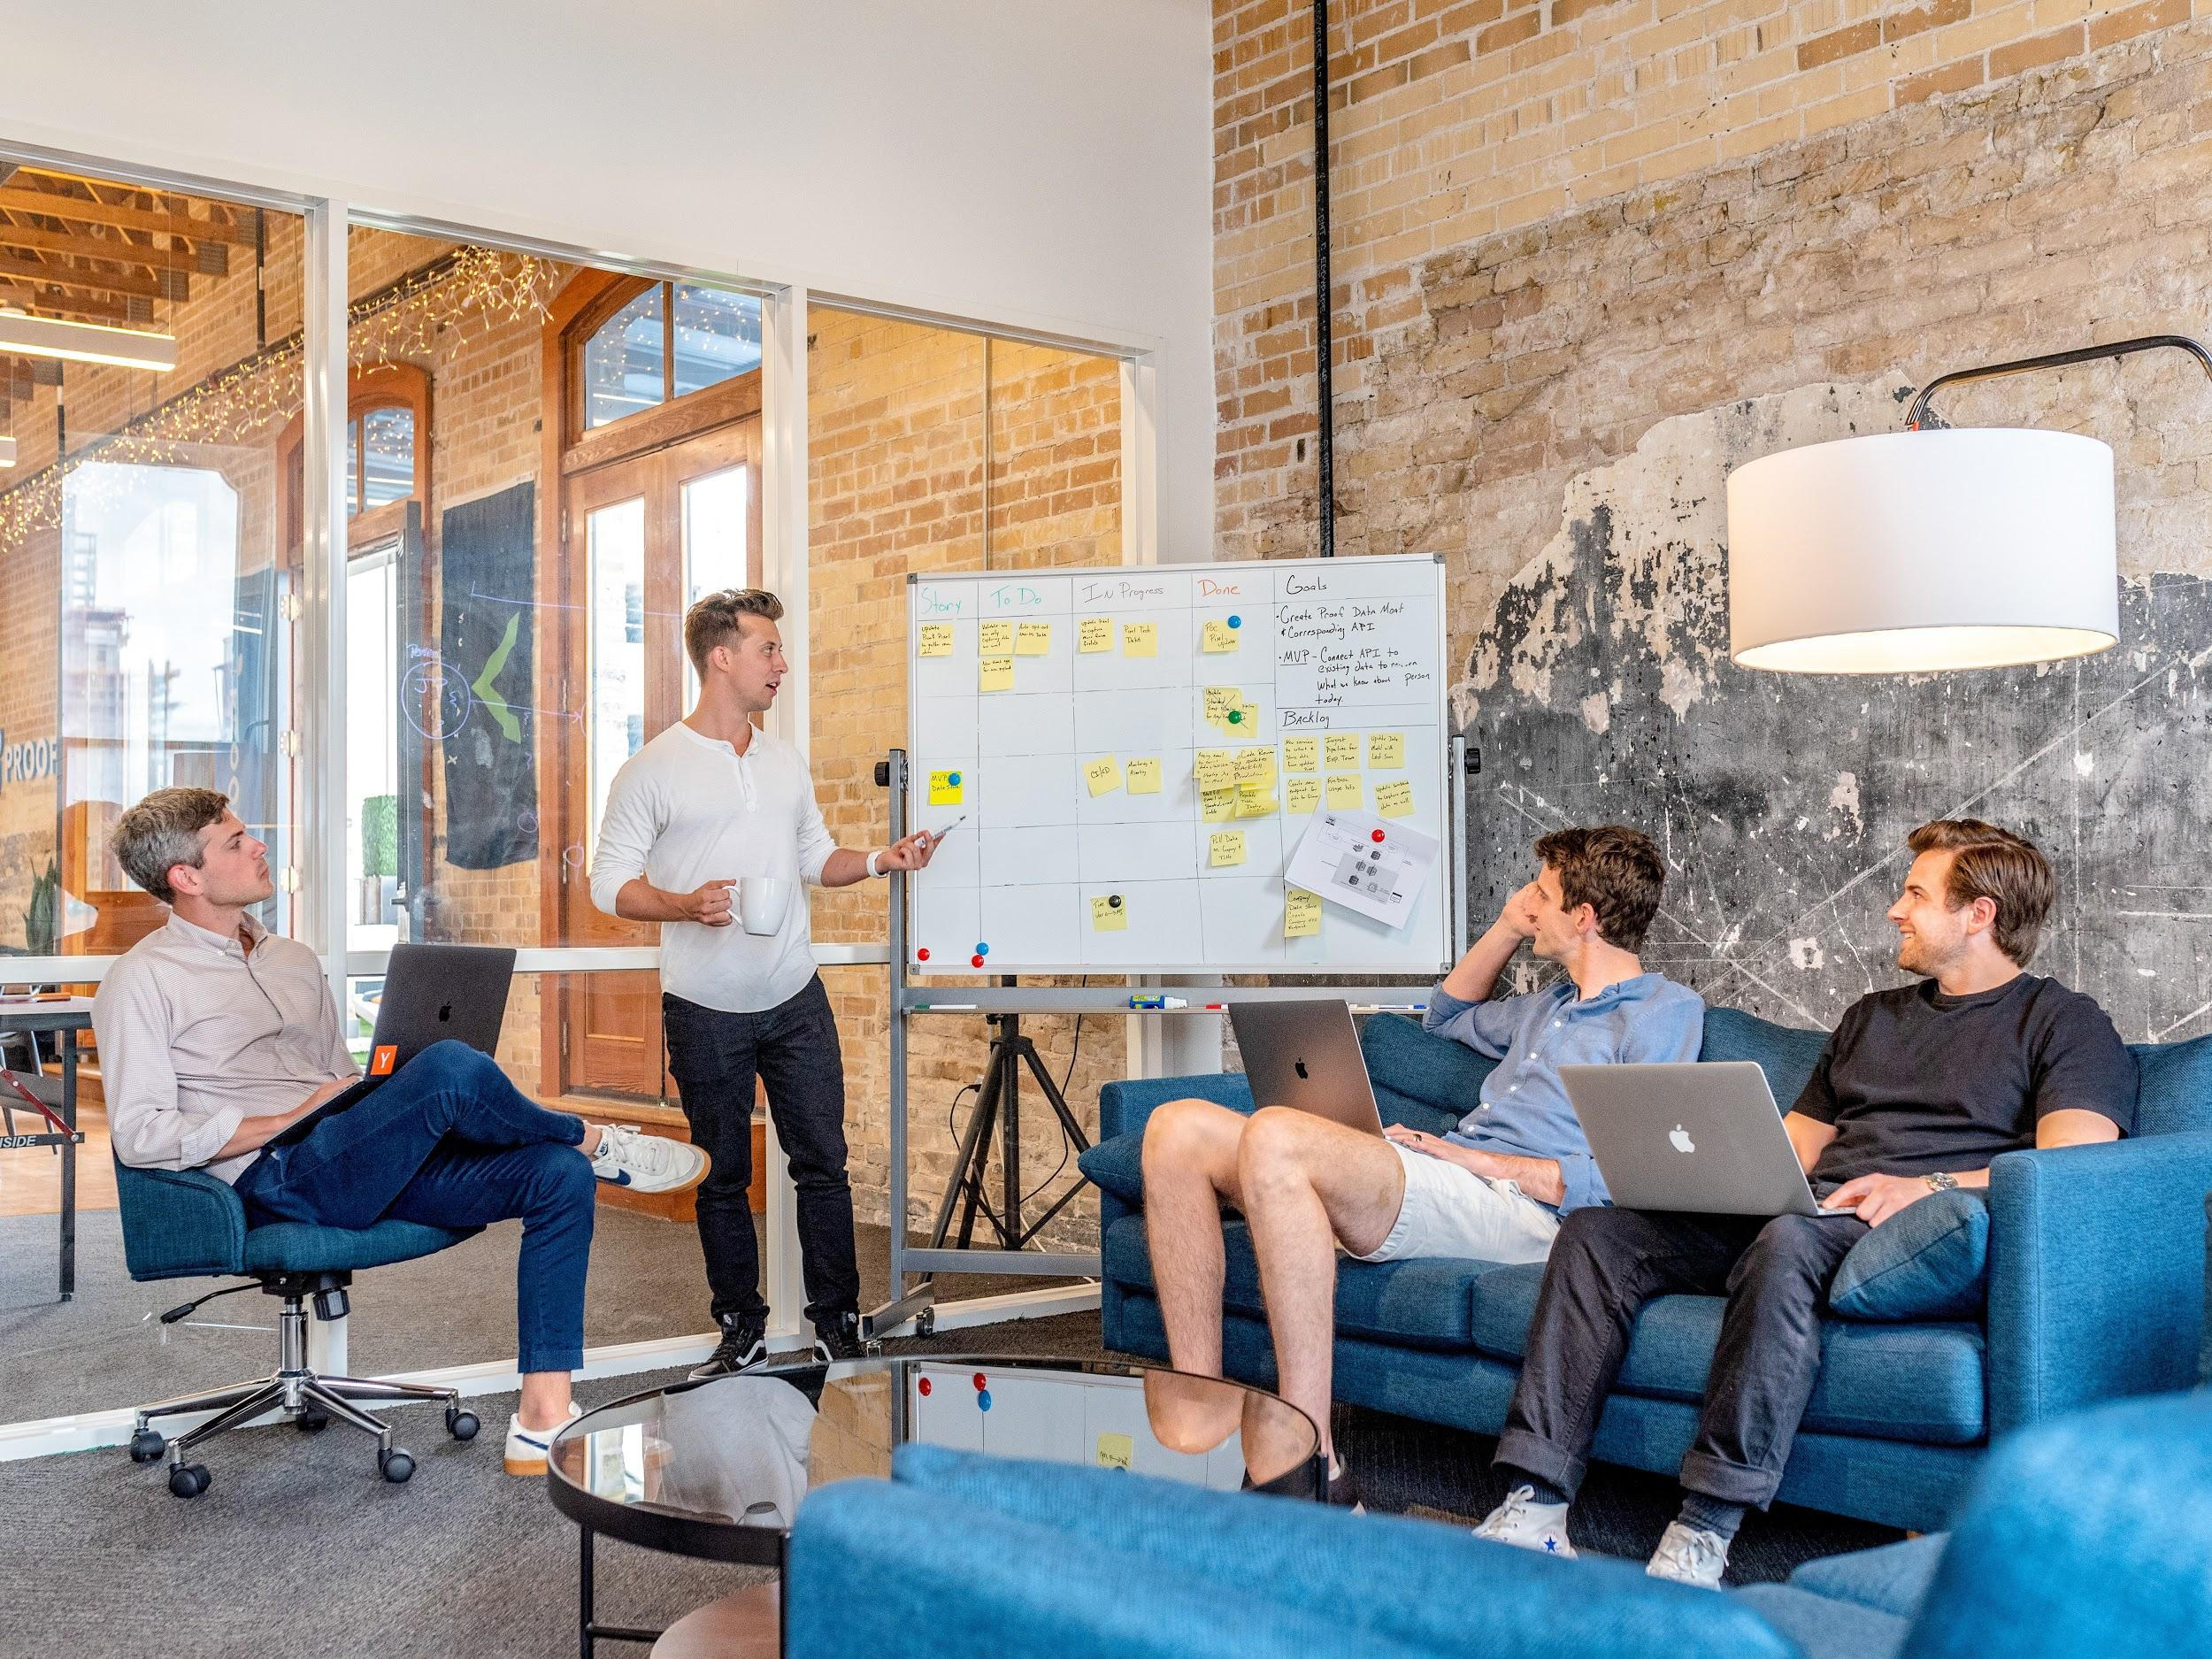
What is the scholarly conversation?
According to the Framework:
“Communities of scholars, researchers, or professionals engage in sustained discourse with new insights and discoveries occurring over time as a result of varied perspectives and interpretations.”
Photo by Austin Distel on Unsplash
Notes:
Optional slide. Your students may already be familiar with this concept. There are also several good videos on this topic that you may choose to include instead of a photo and a definition, if they aren’t familiar.

Slide 5
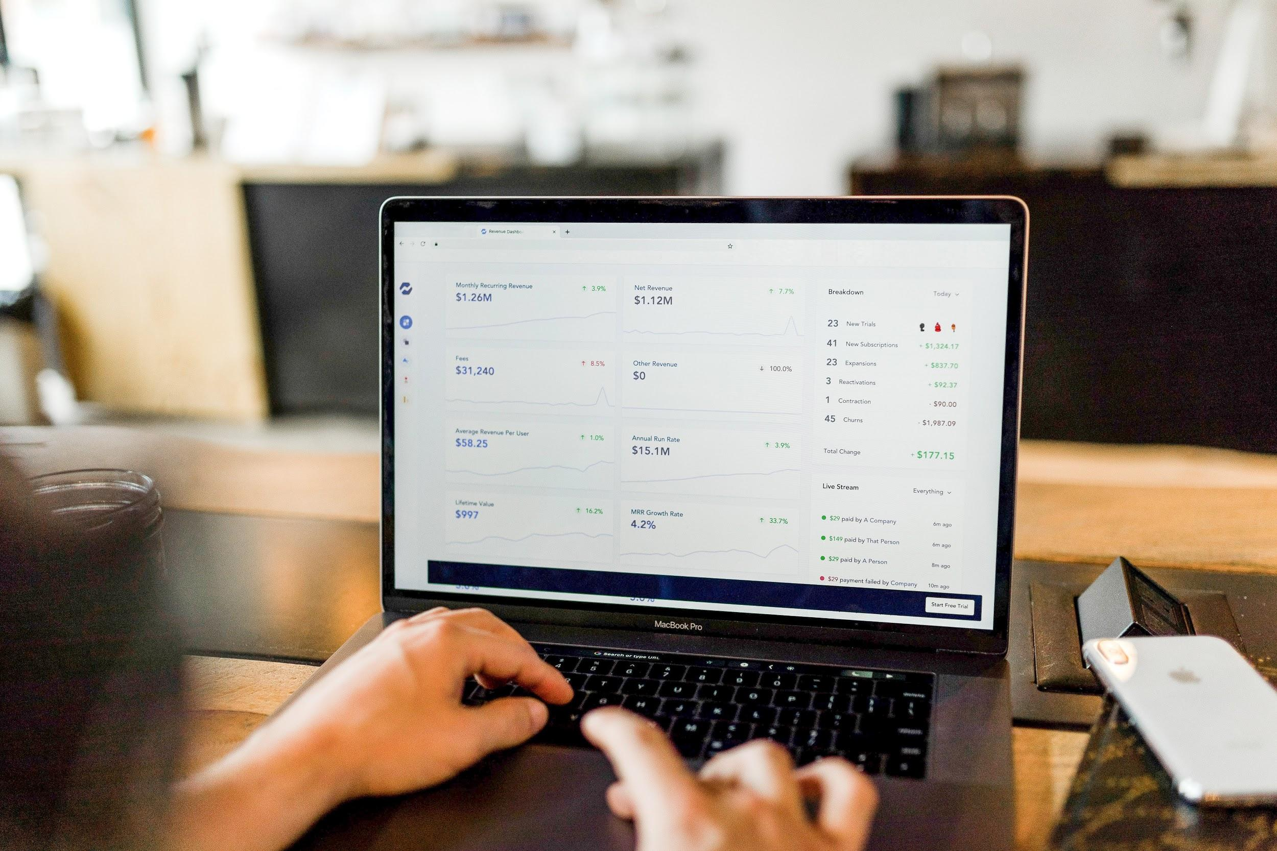
What are altmetrics?
What are altmetrics?
Indicators of online engagement
What can altmetrics tell us?
Discussions surrounding a source
How do we find them?
Altmetric Explorer for Institutions
How can they lead us to articles?
Search results reveal a variety of sources
Photo by Austin Distel on Unsplash
Notes:
Note: If you are planning to have students search in a different place other than Altmetric Explorer for Institutions, you’ll want to note your altmetrics tool of choice on this slide too.

Slide 6
What’s the connection?
How are altmetrics, original research, and the scholarly conversation connected?
Remember altmetrics = online engagement
Online engagement = the conversation surrounding the source
Today, we don’t care about the altmetrics score!!
Use the database to find the conversation
What are other sources telling us about the source

Slide 7
What is our evaluation criteria?
Relevancy
Accuracy
Purpose
Bias
Photo by Glenn Carstens-Peters on Unsplash
Notes:
Reminding students how evaluation criteria can be really helpful, as it will guide them through watching the video, taking note of the sources, and exploring the sources further when using altmetrics and the tracking mechanism. You can develop evaluation criteria as a class, you could set the criteria for the class, or you could follow a more standard evaluation approach, such as the CRAAP test.
I would consider posing questions for the students to consider with each evaluation criteria you plan to cover.
Relevancy
Do the sources cited in the video seem relevant to the topic at hand?
Accuracy
Does the information in the video and cited sources appear accurate? If you’re not sure, how can you verify? [The answer should be through the scholarly conversation they’ll explore when they’re employing the tracing mechanism and reading new sources.]
Purpose
What is the purpose of this video? Of the sources included?
Bias
Does the video to persuade or favor a particular side/issue of a story? If so, does it do so in a fair/partial way or in an unfair/impartial why?

Slide 8
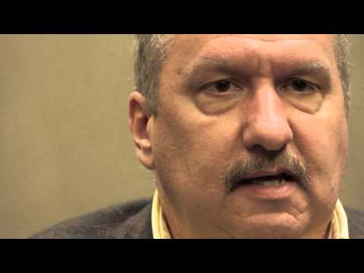
Watch this video and take notes:
https://www.youtube.com/watch?v=sGOtDVilkUc&t=9s
Notes:
This video is almost 10 minutes long. Now that we’ve just discussed the evaluation criteria, watch this video carefully. Take note of any cited sources and points that seem related to the evaluation criteria.
As noted in the learning activity, this example may not be relevant to all courses. Selecting an example that has been sensationalized and is relevant to the class content and cites or contains information regarding an original piece of research is ideal.
Note: This video was example was found via social media networks. When showing examples that have the potential for students to disagree, it can be a helpful reminder that all of their evaluation of this video should be based on research and online engagement they explore, not opinions or feelings.

Slide 9
Altmetrics Explorer for Institutions
Demo:
Navigate to the database
Locate the original research article
Using title
Using identifier
Review the highlights tab
Attention breakdown
Select the original research article
Explore the scholarly conversation
Select the News tab
Read articles from a variety of sources
Notes:
Original research article title showcased in the video:
“Ileal-lymphoid-nodular hyperplasia, non-specific colitis, and pervasive developmental disorder in children”
Related identifiers:
http://dx.doi.org/10.1016/s0140-6736(97)11096-0
https://www.ncbi.nlm.nih.gov/pubmed/9500320
The highlights tab is a nice view that can provide students with a breakdown based on their search. Upon selecting the option for the original research article, you’ll see a summary of the source. The summary provides information regarding the altmetrics donut and all the various types of online engagement regarding the source. For novice researchers, I usually recommend selecting the News tab to explore the online engagement occuring in the news regarding the source and encourage students to explore several news articles from various sources to ensure a broad view of the scholarly conversation.
Altmetric Explorer for Institutions is a subscription database. I prefer to use it in classes because it provides another chance to students to practice accessing databases. It does require users to create an account prior to access, so if you want to opt to use this database in class, allow for time to assist them in account creation. You may also prefer to use one of the free tools mentioned in the chapter and in the learning activity.

Slide 10
In-class Activity
Take 7 minutes to:
Locate 3-5 news articles
Ensure all articles are from different sources
Note any important findings
Remember our evaluation criteria
Goal
Evaluating the video and associated research
Prepare to share your findings

Slide 11
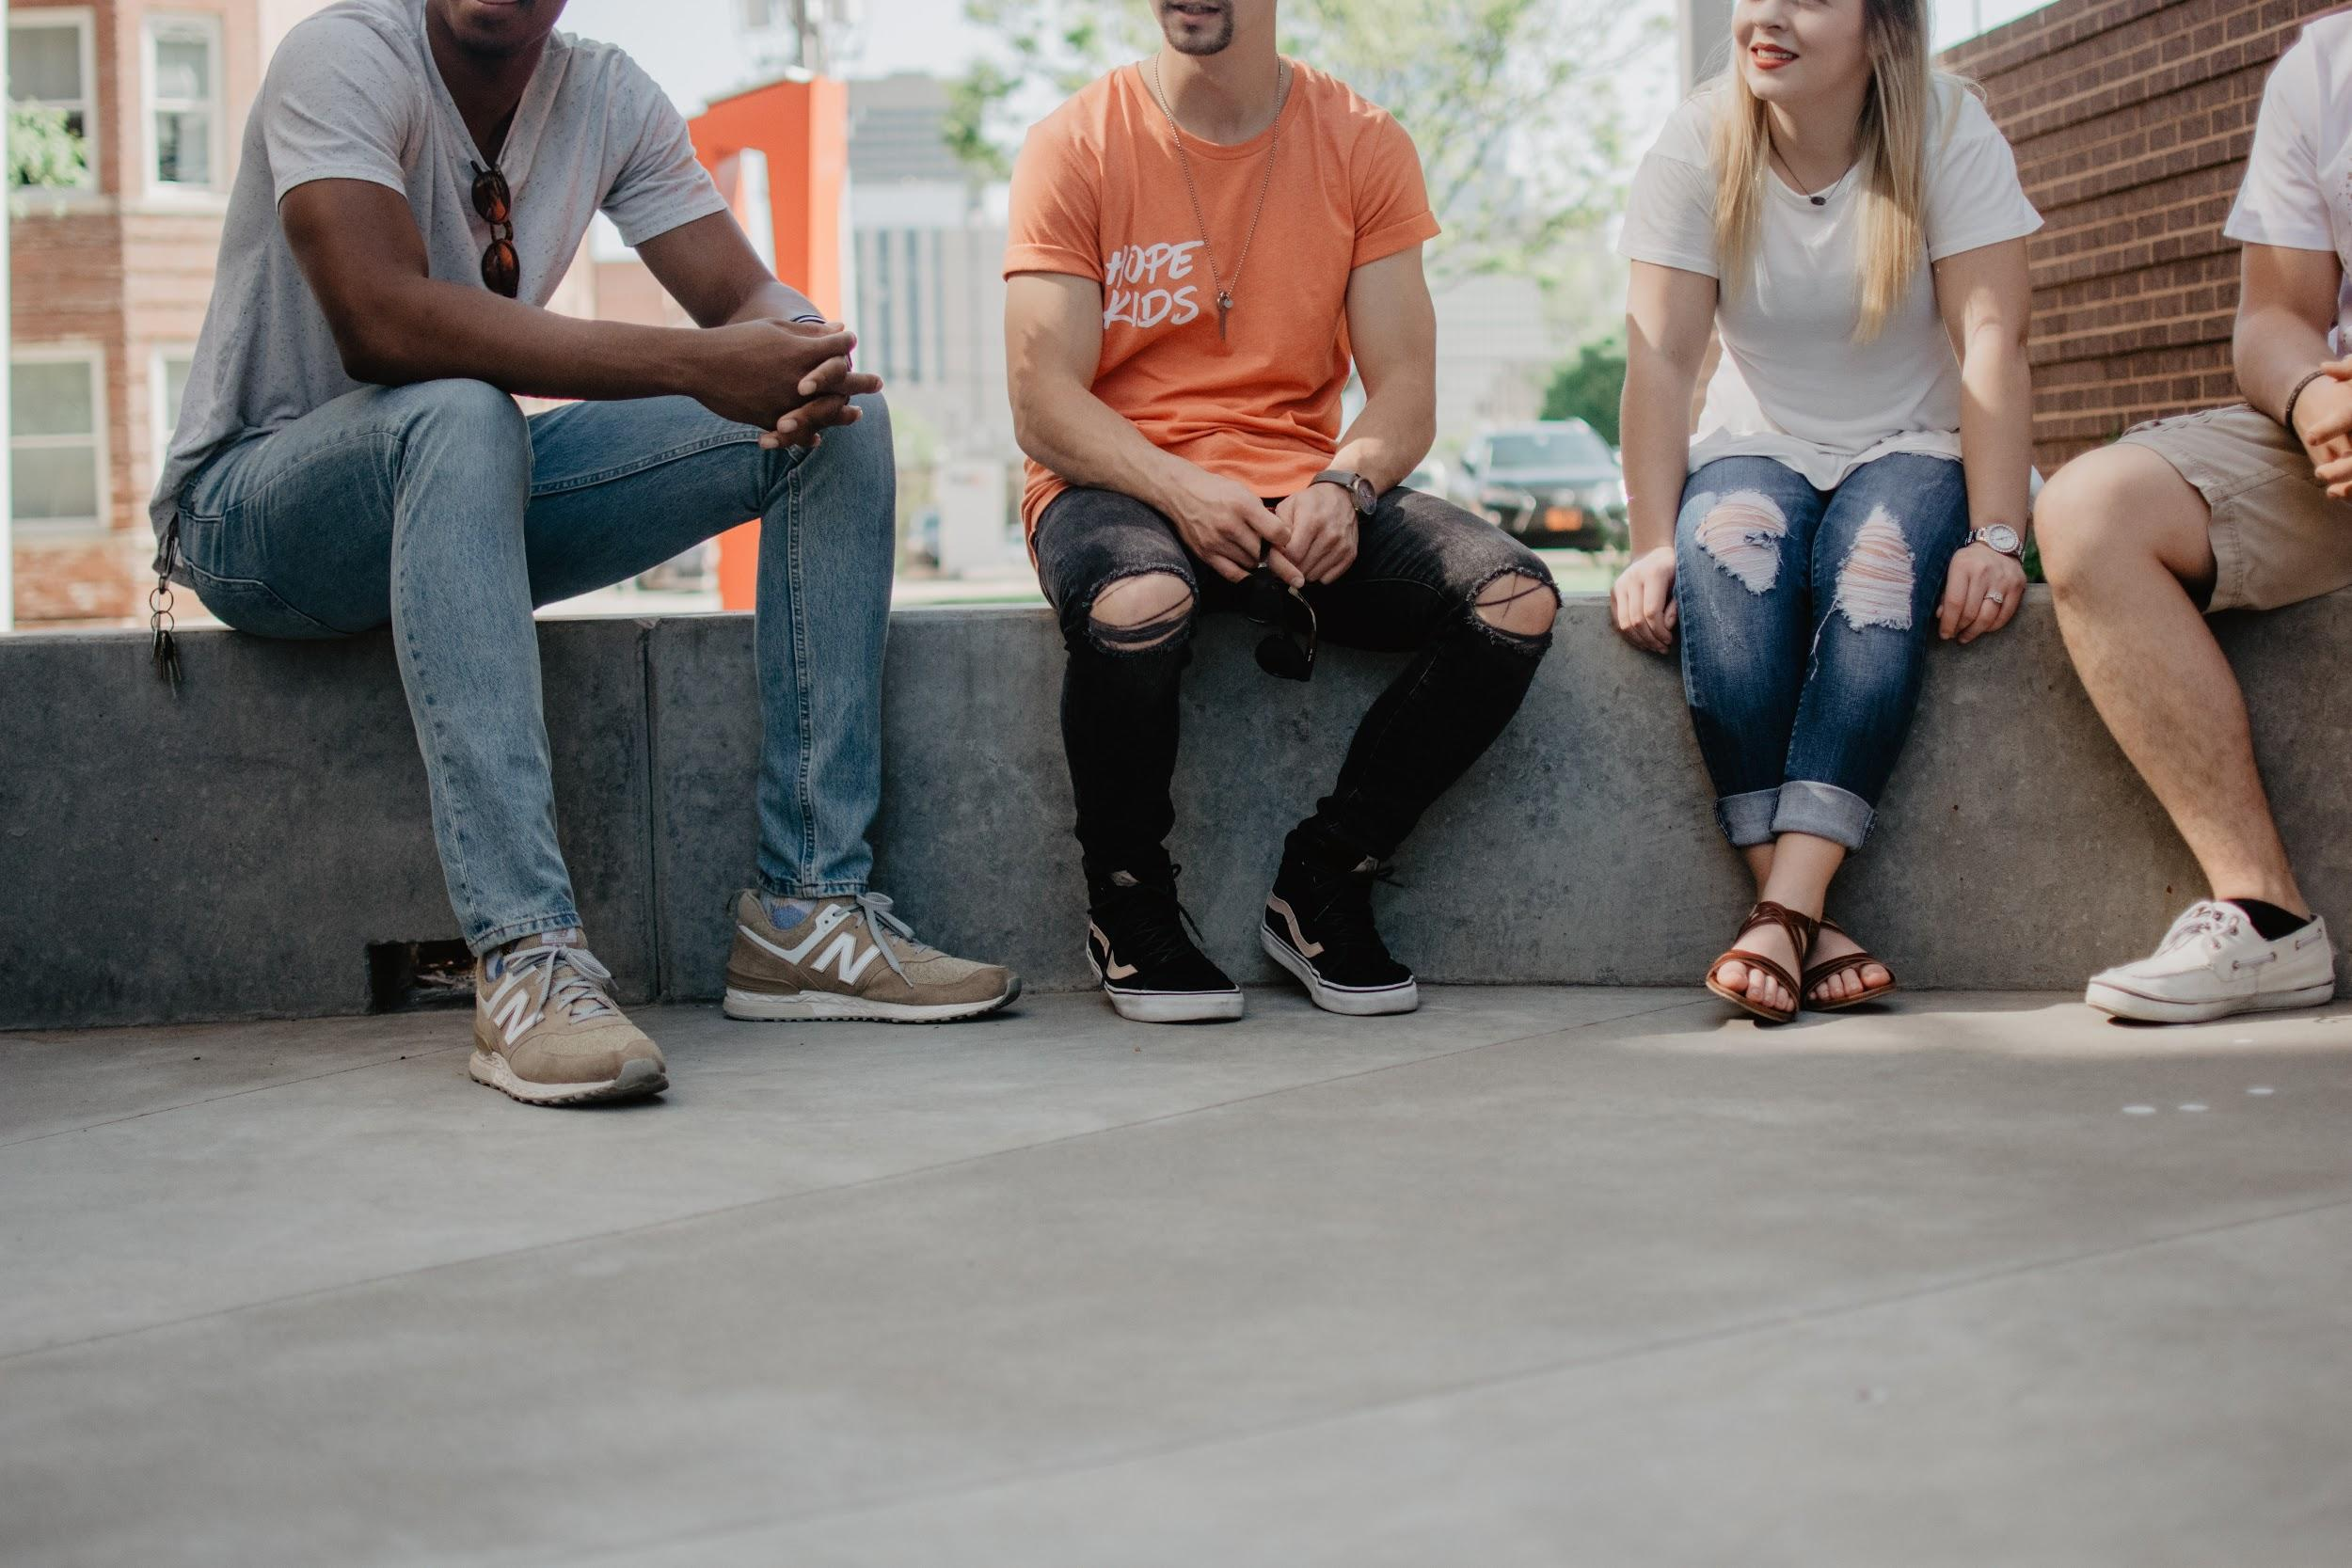
Group Discussion
Take 5 minutes to:
Share your evaluation
Point to news sources for justification
Evaluate the source as a group
Prepare to share your evaluation
Photo by Kate Kalvach on Unsplash
Notes:
Here we are asking students to work in small groups and share their individual evaluation of the source based on the news and online engagement they found via altmetrics. Students should acknowledge the news sources when explaining their evaluation of the research.

Slide 12
Class Discussion
What does video tell us?
What does the original research tell us?
What does the online engagement tell us?
Can we make a final evaluation on the video now?
Photo by Taylor Wilcox on Unsplash
Notes:
I usually steer away from having the class make a final determination together when the topic has potential for conflict unless there are glaring problems with the source example. Instead, I ask students questions to help them synthesize all of the research we explored during the class session and to come to a research-based evaluation on their own.

Slide 13
Reflection
Did your evaluation of the video change before and after this activity? If so, how?
Photo by The Climate Reality Project on Unsplash

