Slide 1


Anticipating a Post-Disaster Supply Chain Disruption
Carlos Baldo and Tammy E. Parece

Slide 2
Scenario - Background
You currently work for a major retailer in the United States with > 4,000 US stores
Recent data shows: >40% of the US population regularly buys from your stores
Due to your complex network of stores, and the need to maximize distribution and satisfy demand, your organization uses distribution centers
With this network, the company reduces costs by purchasing large amounts of goods and distribute smaller quantities as required by demand in stores
Using Walmart in Florida within this scenario

Slide 3
Scenario – Problem Statement
Your organization receives information that a potential hurricane will impact Dade, Broward, and Palm Beach counties.
Your organization wants to ship inventory for high-demand items (water, milk, diapers, batteries, flashlights, and first aid supplies) to these counties.
Each Florida store (even those outside the designated counties) will keep a high level of stock and not share their inventory with the potentially affected counties.
The hurricane trajectory model shows the state of Georgia may be impacted so you cannot use distribution centers in Georgia.

Slide 4
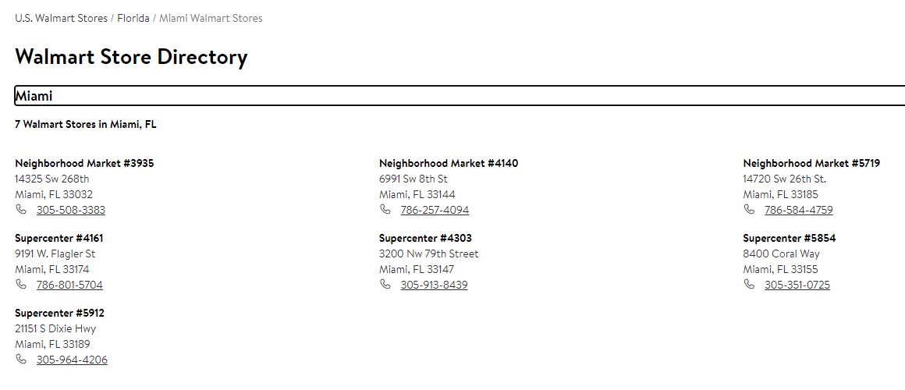
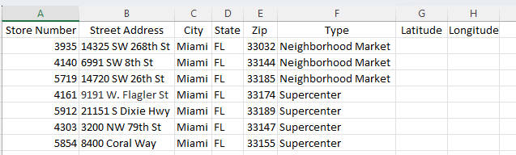

Identifying Stores at Risk – Building the Database
Search online for Walmart Stores for each Florida county. Start with Dade.
Add each store to an Excel spreadsheet, including the address and type of store. Then do the same for the other 2 counties.
Notes:
Be sure to tell students that they need to do this for each of the Counties – Dade, Broward and Palm Beach
Remind students to save their files on a regular basis, so they don’t lose the information. Also caution them to know where the files are located. They will need to know this when adding to ArcGIS Online.

Slide 5
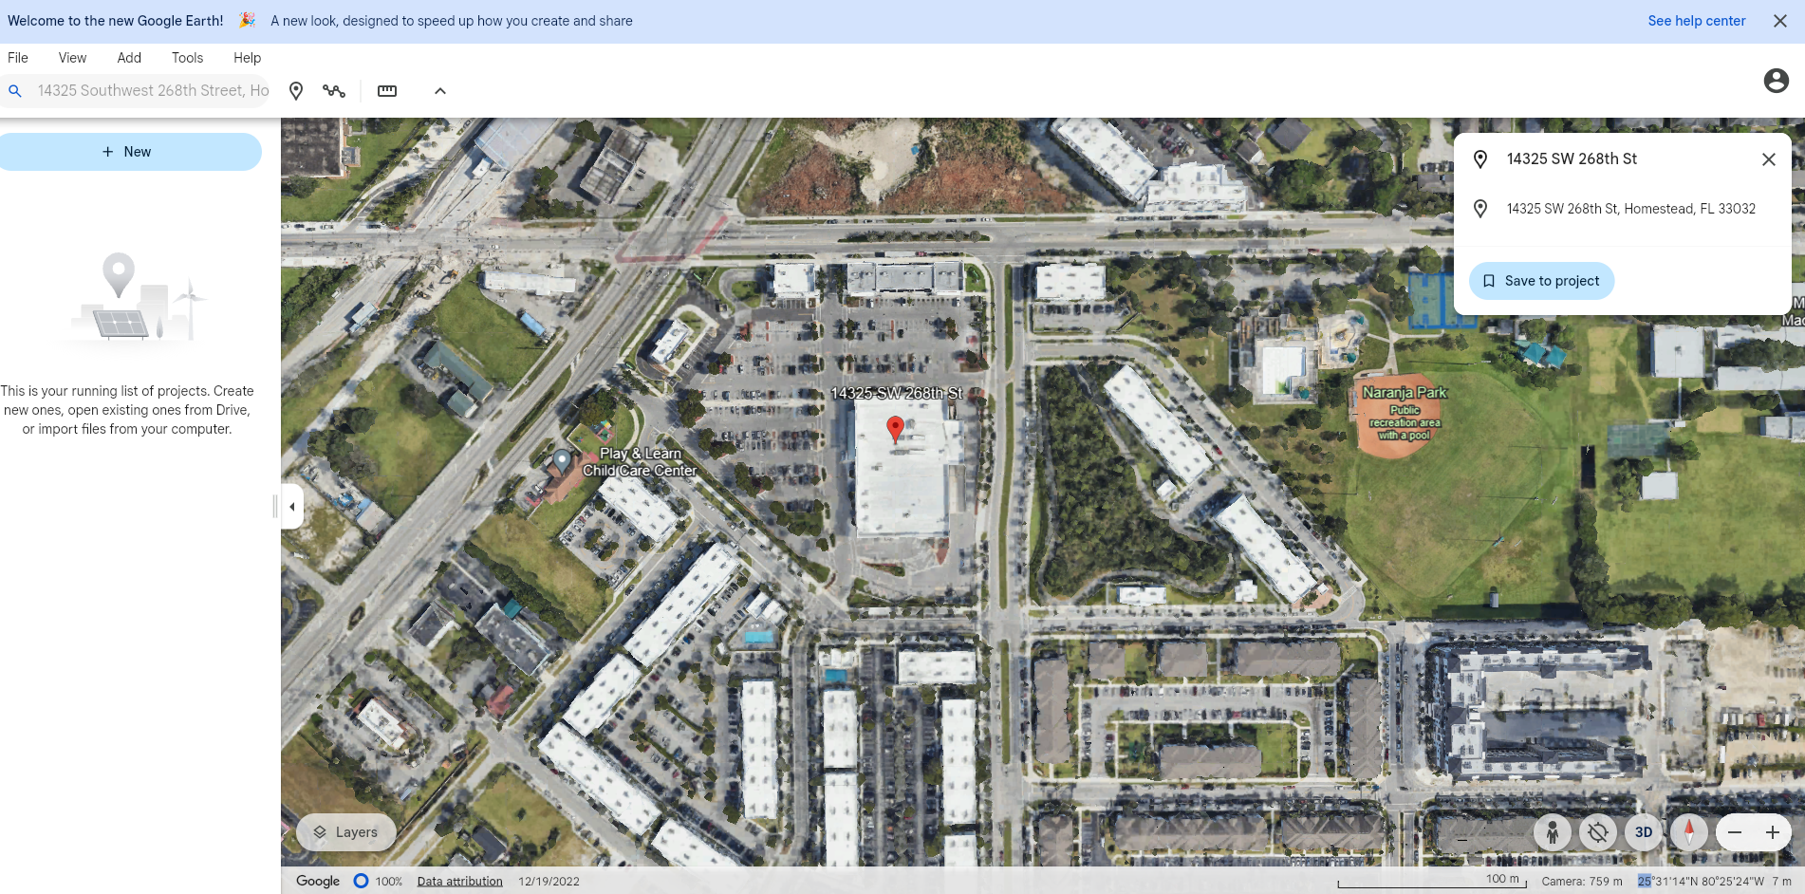
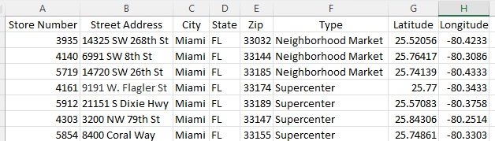
Identifying Stores at Risk – Absolute Location
type Address here, hit enter and it zooms to location
Get latitude and longitude from Google Earth and add to the Excel
Latitude and Longitude is found here
Notes:
The latitude and longitude needs to be in decimal degrees. We provided an initial Excel for both stores and distribution centers. These files are not complete.
Conversion formula is Degrees + (minutes/60) + seconds/3600)
Be sure the longitude is negative

Slide 6
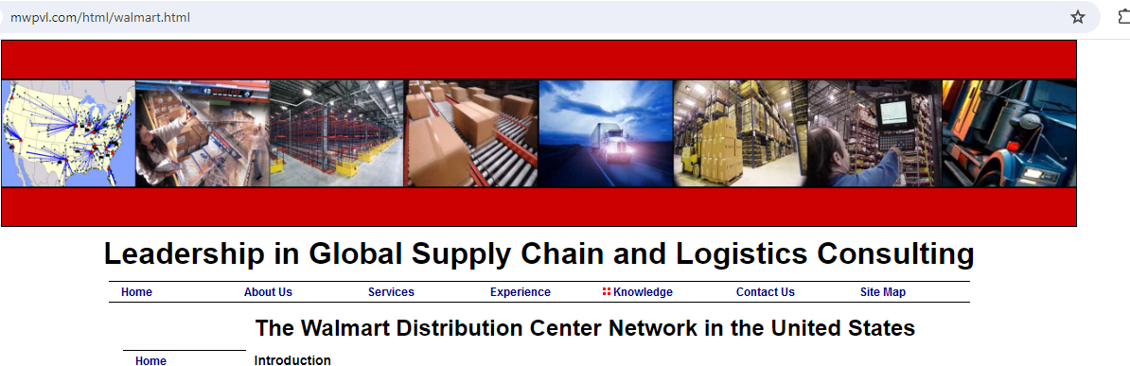
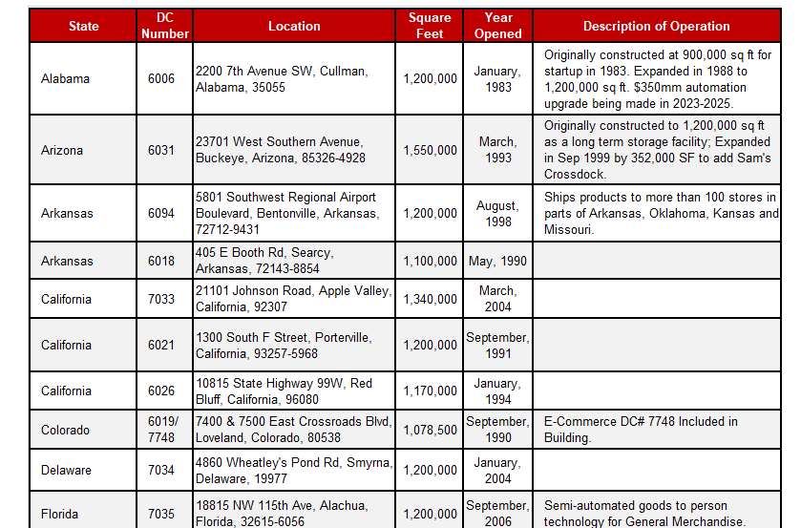
Identifying Distribution Centers
Search online for Walmart Distribution Center Locations
Read the website for which centers provide what kind of products.
Page down to get locations.
Include type of product.

Slide 7
Identifying Distribution Centers
Once the centers are identified, enter into a new Excel spreadsheet.
Add latitude and longitude as you did for the store locations
Notes:
It does not matter which column has latitude and longitude
Be sure the students know where they have saved their excel files. This is usually the part that student lose track of.

Slide 8
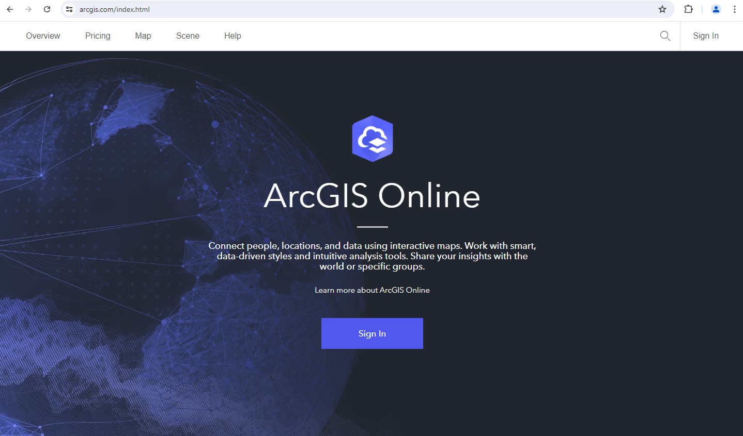
Opening ArcGIS Online
Search for ArcGIS Online
Click on the Sign In button
Notes:
ArcGIS Online is an online program and students do not need to download any software
ArcGIS Online works best in the Chrome browser, however, ArcGIS Online works on any PC, Apple Computer and on Ipads!

Slide 9
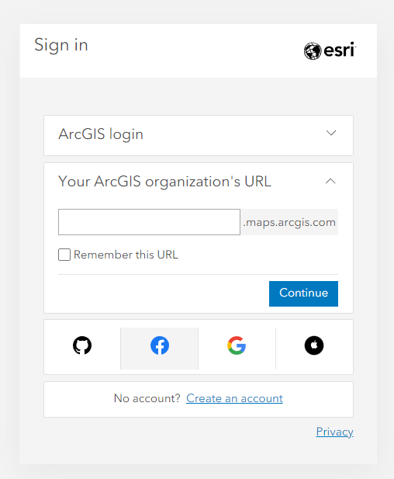
Sigining In
Notes:
This is where you need to check with your Esri Administrator at your school for students sign-in credentials and your school’s organization url.
They will provide you with the organization’s name and how your individual students should sign in. Once you have that information, I recommend that you edit this slide so you can instruct the students on how to sign in.

Slide 10
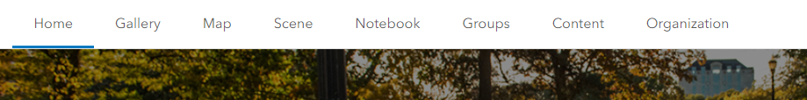
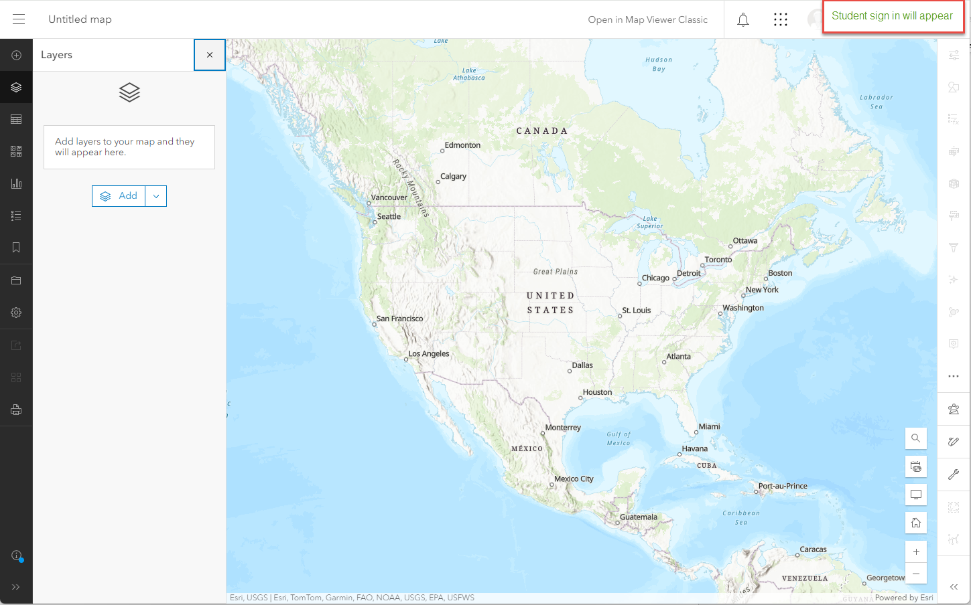
ArcGIS Online Platform
Once signed-in,
Click on Map
An untitled Map document will open
Student information

Slide 11
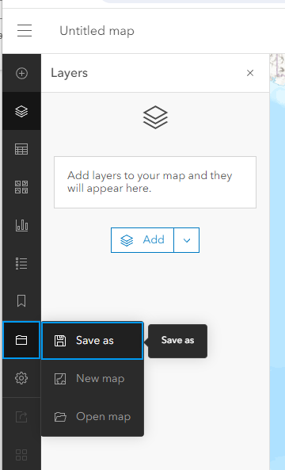
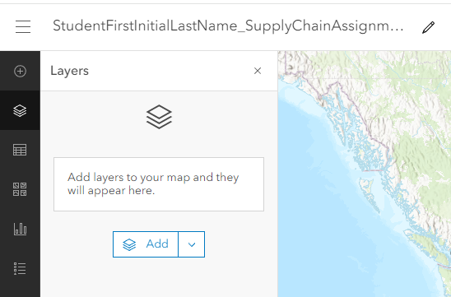
ArcGIS Online Platform – Saving Your Map
Left side of the computer screen
Notes:
Before adding any data, have students save their map. And then remind them to hit the save button every time they add or change something on the map
The example for the map name can be anything that you want. But be sure that each student saves it with a unique name. It is saving to your organization’s file cache and so each map must have a unique name.

Slide 12
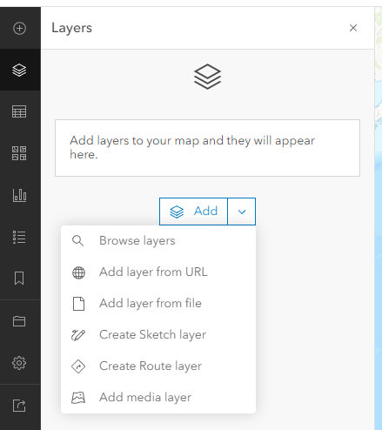
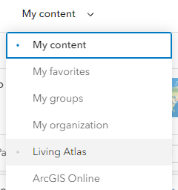
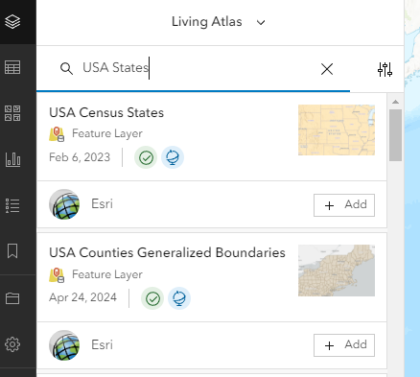
2. Click on the down arrow next to My content and choose Living Atlas
Setting up a Map – adding US state outlines
1. Click on the down arrow next to Add
Search for USA States
Click on Add next to USA Census States
Notes:
This is optional. It shows how students can add the state outlines to the map.
As an instructor, it is your decision if you want to add these. This is slightly difference than the book chapter because of changes in the ArcGIS Online platform.

Slide 13
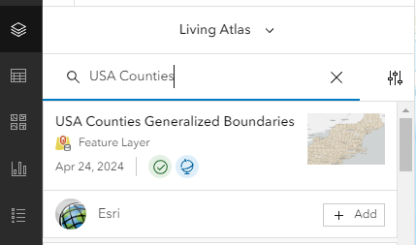
2. Click on the down arrow next to My content and choose Living Atlas
Setting up a Map – adding US county outlines
1. Click on the down arrow next to Add, choose Browse layers
Search for USA Counties
Click on Add next to USA Counties Generalized Boundaries
Notes:
This is optional. It shows how students can add the county outlines to the map.
As an instructor, it is your decision if you want to add these. This is slightly difference than the book chapter because of changes in the ArcGIS Online platform.

Slide 14
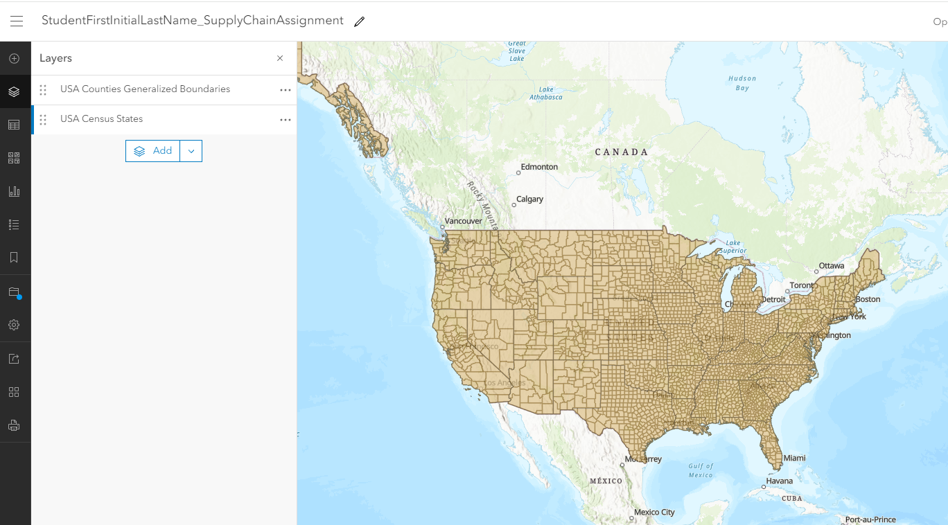
The state outlines are in the map but hidden by the counties. In the next two slides, you will learn how to display the states boundaries and only the Florida counties
Setting up a Map – State and Counties Results
Notes:
This is optional.

Slide 15
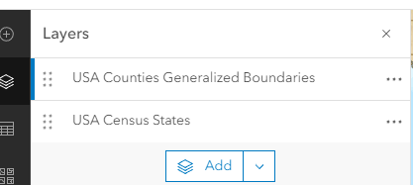
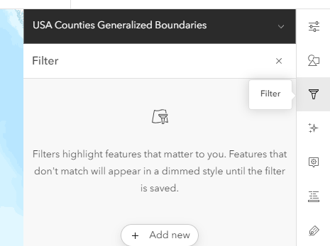
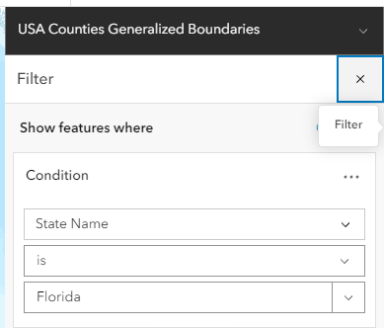

Click on the USA Counties layer, so it shows blue on the left
On the right side of the screen click on Filter
Click on Add new
Enter the information as shown
Click on Save at the bottom
Setting up a Map – only showing Florida counties and state outlines
Notes:
This is optional.

Slide 16
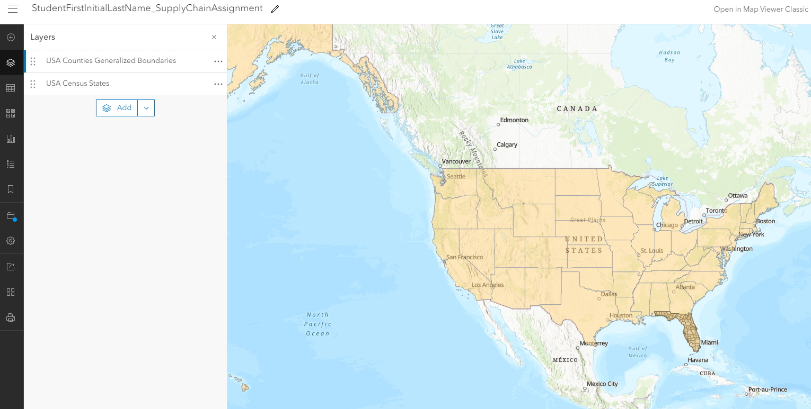
Map shows States and Florida counties
Setting up a Map – State and Counties Results
Save!
Click on the button on the left – the blue dot shows that there are changes that are not saved.
Notes:
This is optional.

Slide 17
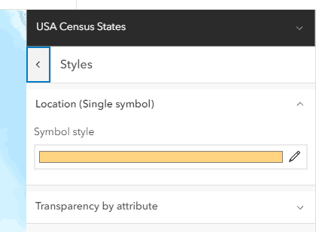
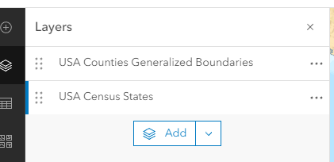
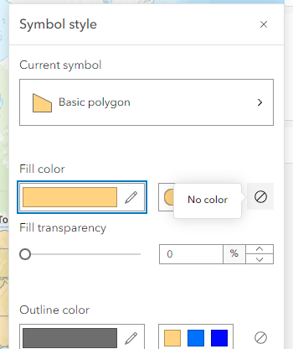
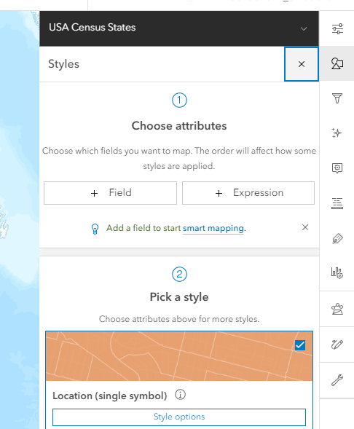

3. Click on the pencil at the end of the colored line
1. Click on USA Census States
Setting up a Map – Changing symbology to display outlines only
2. On the right, click on the Styles button
4. Click on the No color button
5. Click on done at the bottom
Notes:
This is optional.

Slide 18
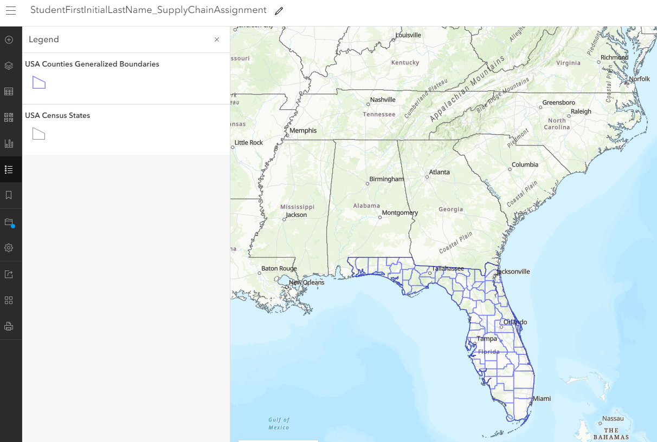
Now do the same thing for the Florida counties, to make them hollow, but choose a different color.
Setting up a Map – Changing Symbology
Click on the Legend button to see the styles for each layer
SAVE!
Notes:
This is optional.

Slide 19
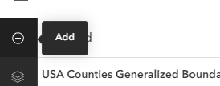
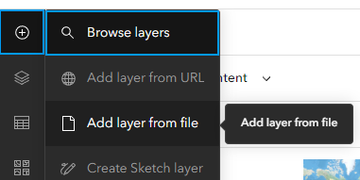
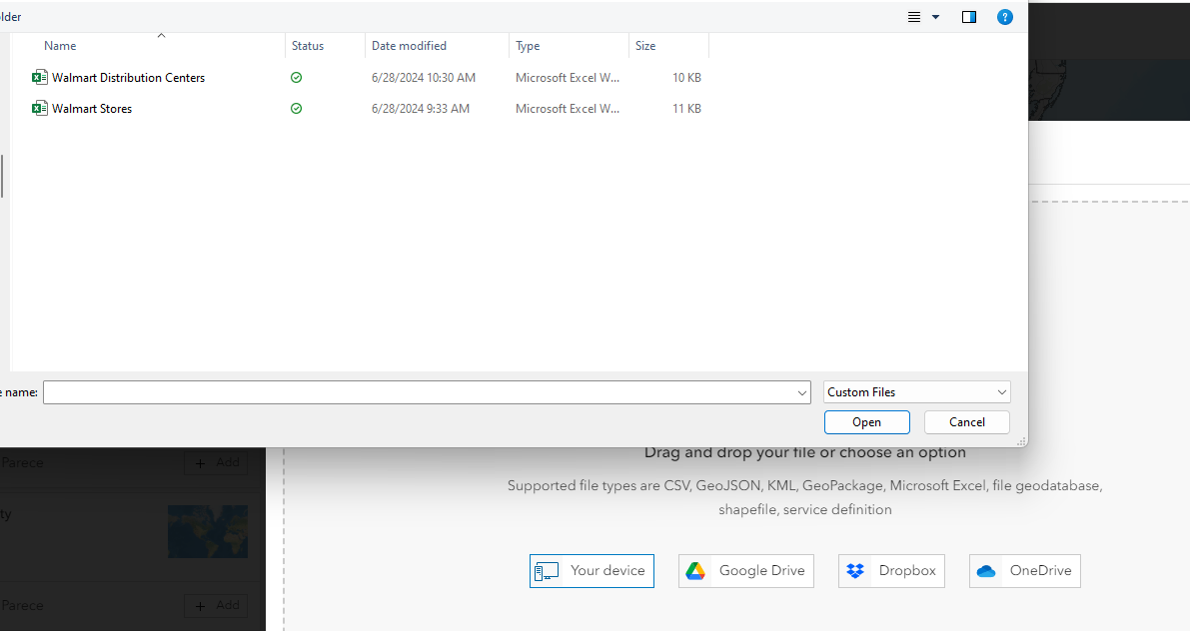
Adding Store and Distribution Center Locations to the Map
Click on the Add button (upper left)
Click on Add layer from file
3. Click on Your device and navigate to where you saved the Excel files

Slide 20
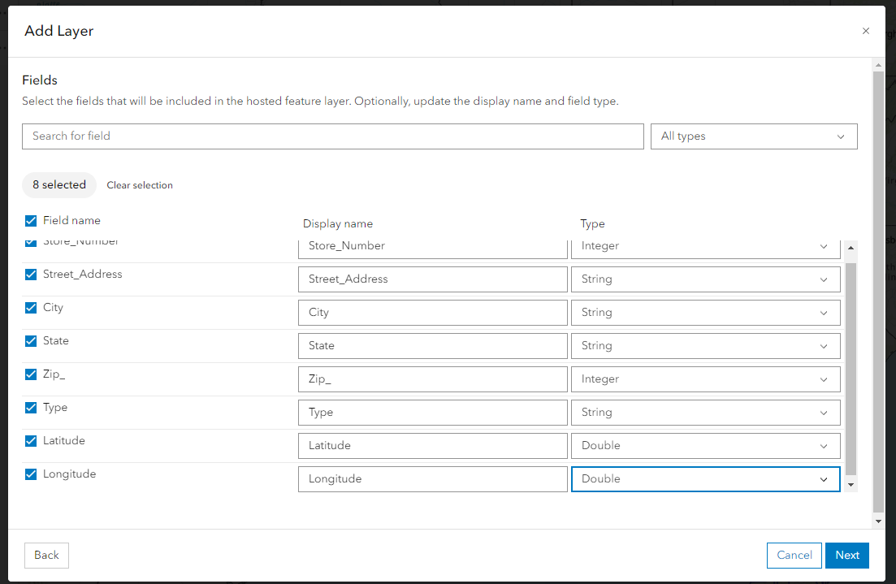
This box opens and all the fields from the Excel will show. Change the Latitude and Longitude type to Double!
Adding Store and Distribution Center Locations to a Map
Then click on Next
Notes:
If students forget to change the latitude and longitude fields to double, it will place the locations in the Atlantic Ocean!

Slide 21
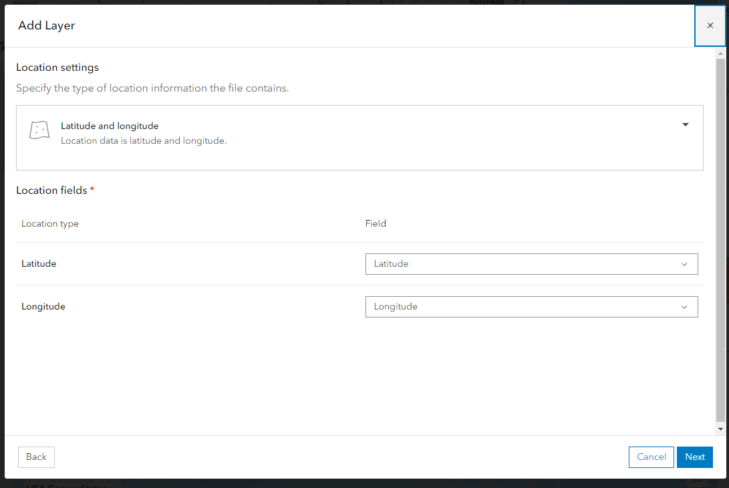
This box opens, verify it is correct and click on Next.
Adding Store and Distribution Center Locations to a Map

Slide 22
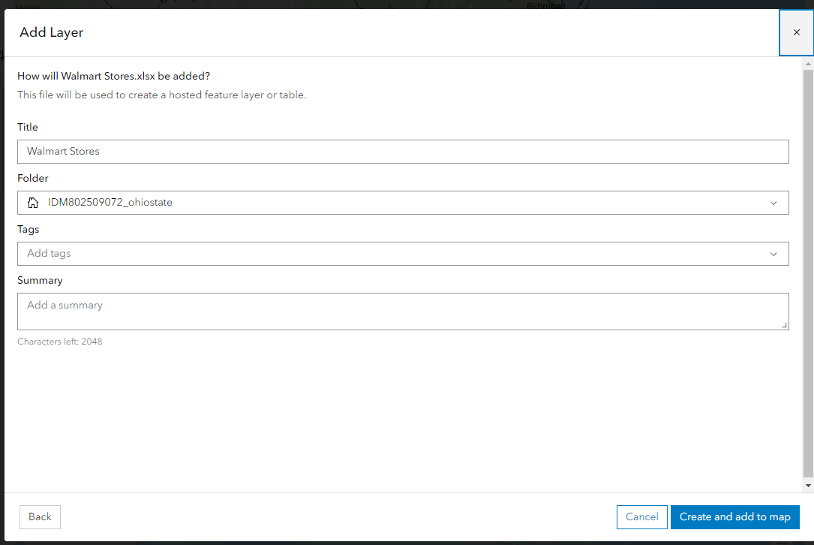
Enter the Title and then click Create and add to Map
Adding Store and Distribution Center Locations to a Map

Slide 23
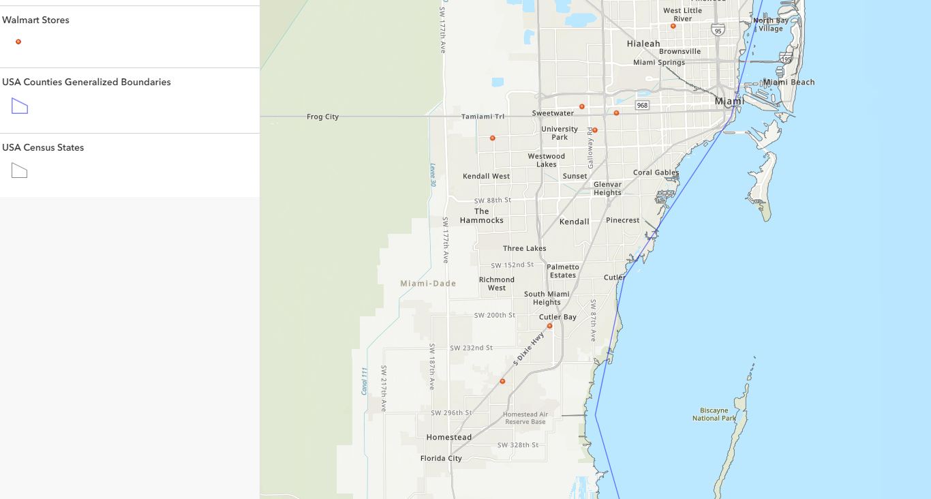
Adding Store and Distribution Center Locations to a Map
Points are created for each store and the map zooms to the layer.
Notes:
These are only the stores for Dade County. Students should be adding stores for all 3 counties, thus the map will be zoomed to those 3 counties, not just Dade.

Slide 24
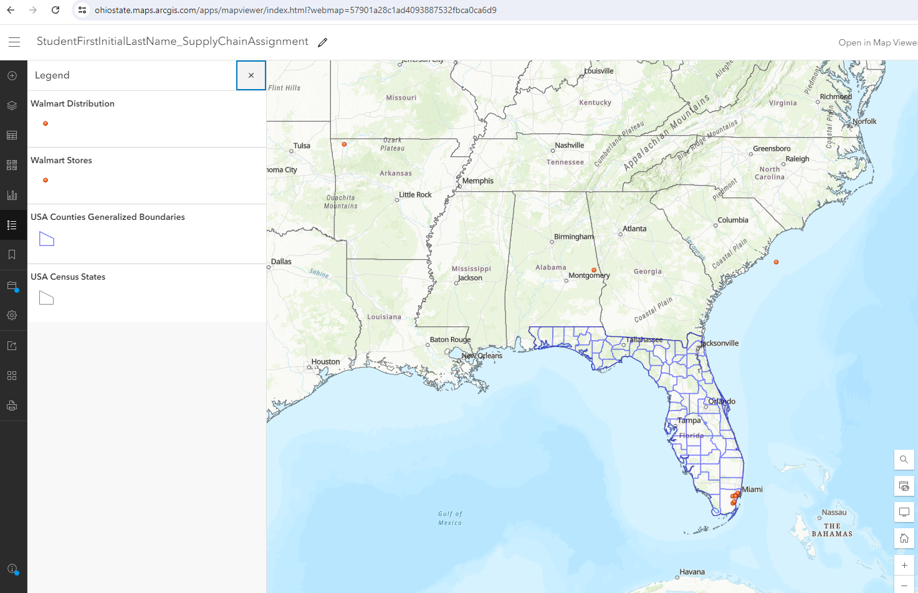
Adding Store and Distribution Center Locations to a Map
Now complete the same process for the Distribution Centers

Slide 25
If you have a location that ends up in the wrong place – you will need to double check your latitude and longitude.
Adding Store and Distribution Center Locations to a Map
Correct it on the Excel, delete the file that was created in GIS, and then redo the process.

Slide 26
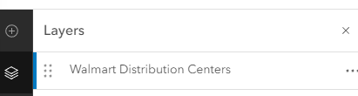
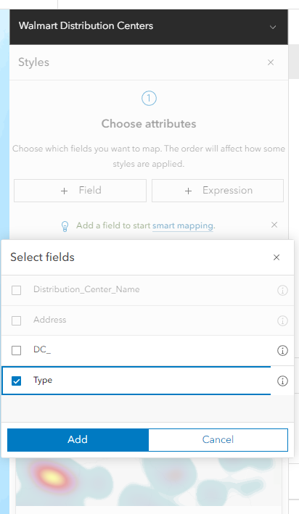
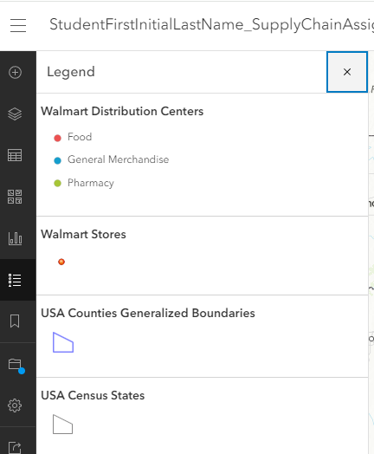
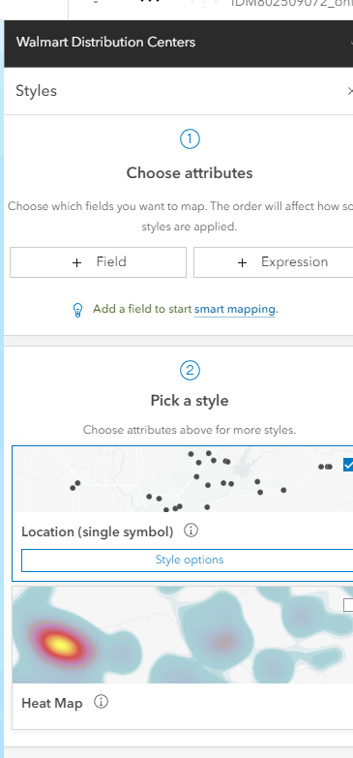
Change the styles to distinguish the stores from the distribution centers.
Changing Styles
1. Chose the layer.
3. Select Type and click Add.
4. Then click Done at the very bottom.
2. On the right, click the style button and under Choose Attributes, click on + Field
Now the Distribution Centers are identified by Type.

Slide 27
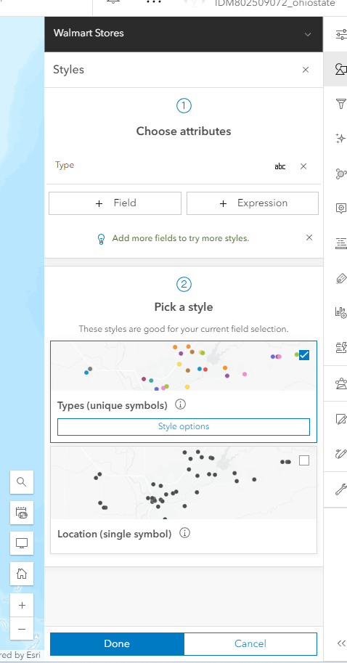
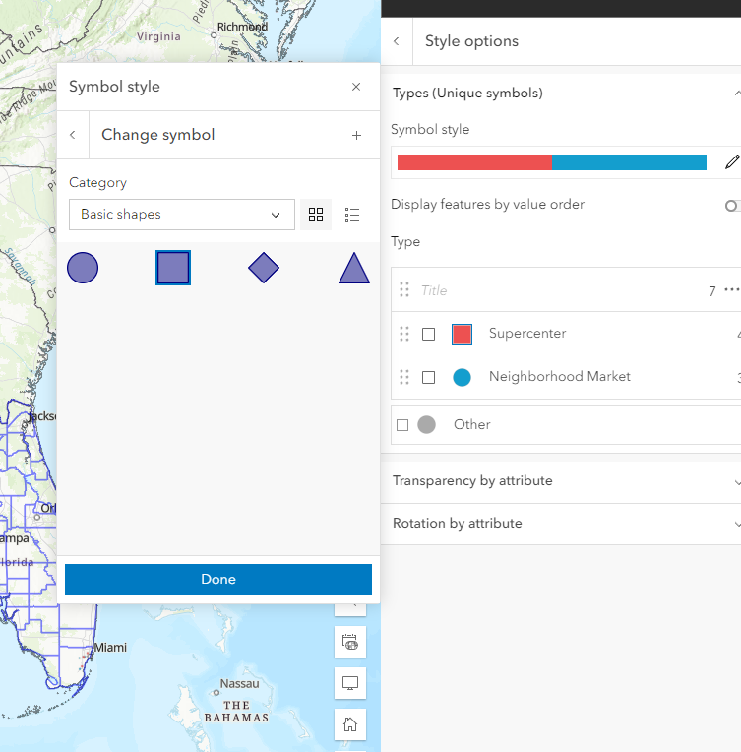
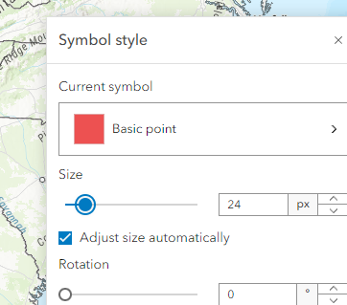
Do the same thing for the stores. You might also need to change the type of symbol (maybe squares) and change the symbol size.
Changing Styles

Slide 28
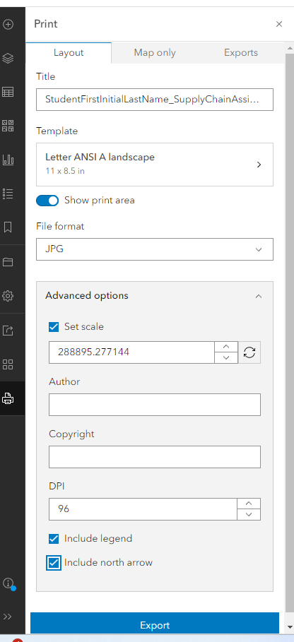
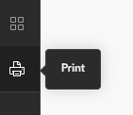
On the left side, the bottom icon is Print.
The print window displays.
Choose the settings as shown.
Then click on Export.
Printing a Map
Your scale setting will not be the same, it is dependent on how zoomed in or out you are
Notes:
You may have the students print a map as a jpeg to embed into a word document. Or you can have a student share a map and provide the link. You, as the instructor can then view their shared map by clicking on the link. Or you may wish the students to create a story map utilizing the maps created. We have included a slide for all 3 options, so you can decide which to use.

Slide 29
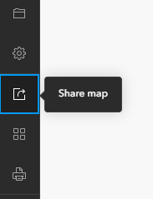
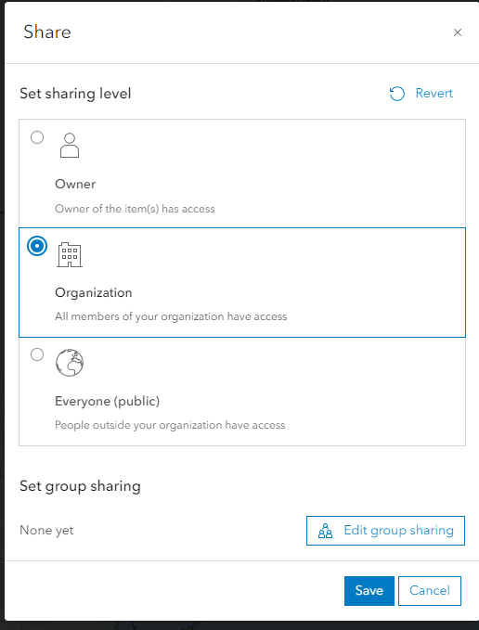
3rd icon from the bottom on the left is Share Map.
Change setting to
Share with
Organization.
Click Save.
ArcGIS Online will next ask for you to confirm the
Sharing.
Sharing a Map through the Organization portal
Notes:
You may have the students print a map as a jpeg to embed into a word document. Or you can have a student share a map and provide the link. You, as the instructor can then view their shared map by clicking on the link. Or you may wish the students to create a story map utilizing the maps created. We have included a slide for all 3 options, so you can decide which to use.

Slide 30
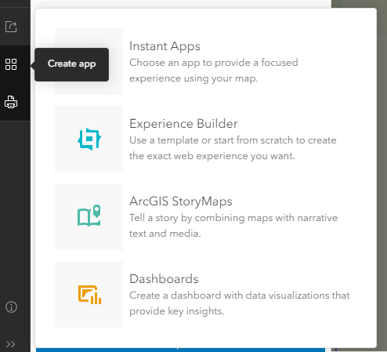
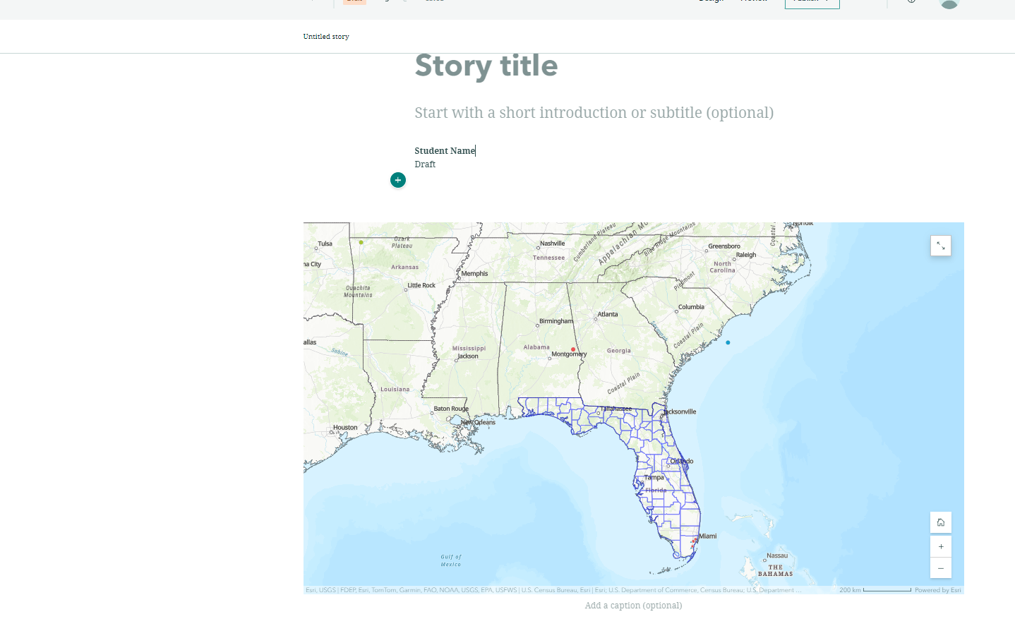
2rd icon from the bottom are Apps.
Click on ArcGIS
Story Maps.
Creating a Story Map
Click this link for additional information on ArcGIS Story Maps
https://storymaps.arcgis.com/stories/cea22a609a1d4cccb8d54c650b595bc4
Notes:
You may have the students print a map as a jpeg to embed into a word document. Or you can have a student share a map and provide the link. You, as the instructor can then view their shared map by clicking on the link. Or you may wish the students to create a story map utilizing the maps created. We have included a slide for all 3 options, so you can decide which to use.
Depending on the make up of your class (freshman, sophomore, grad students, etc.) a Story Map option is a great alternative, easy to create, easy to understand and easy to grade!

Slide 31
Use this final slide to include your final instructions to the students
For your final instructions

