Slide 1
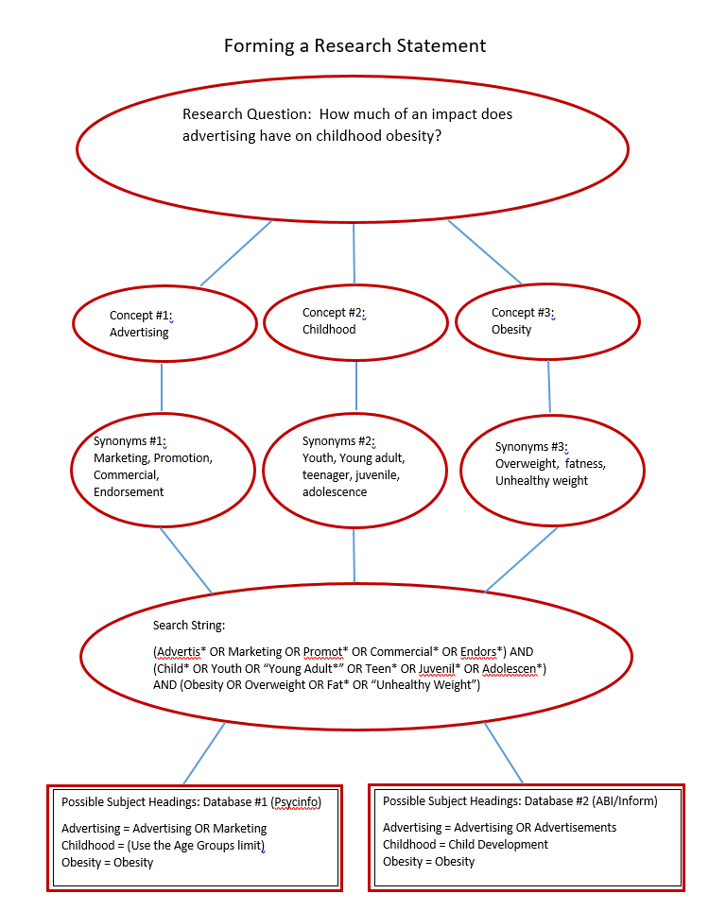
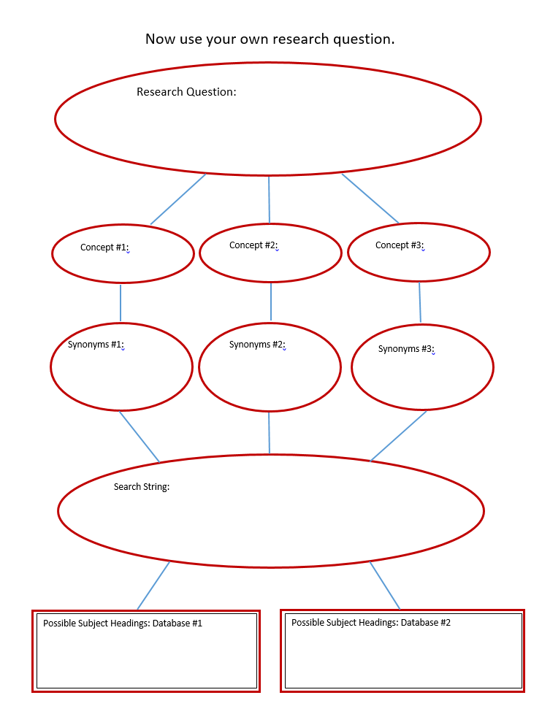
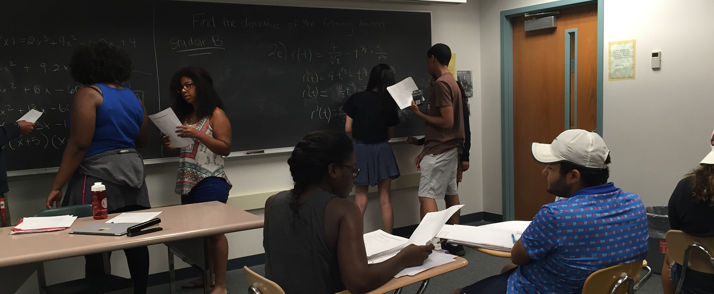
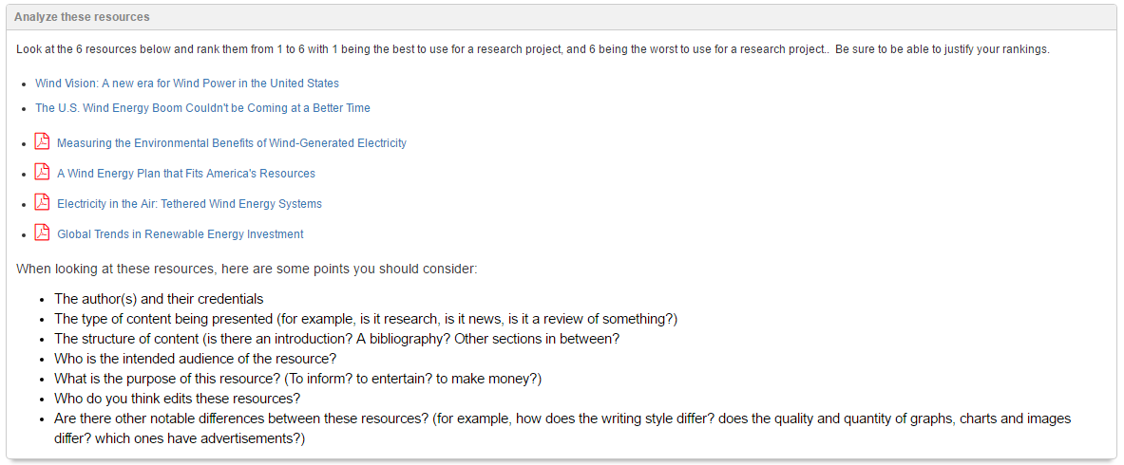
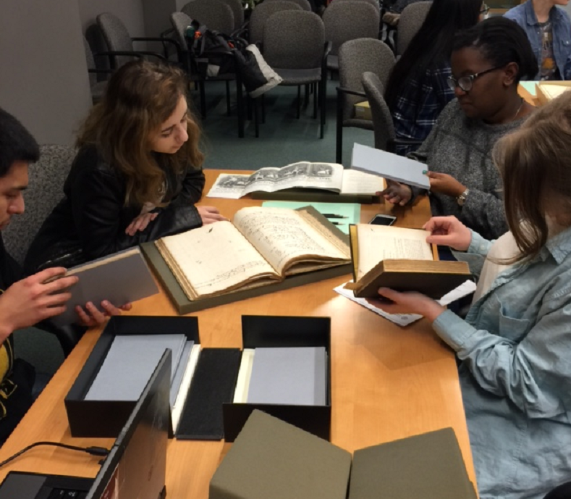
ACRL Framework for Information Literacy for Higher Education helps prepare under represented students for college success. Tony Cosgrave, Instruction Coordinator Tom Ottaviano, Business and Economics Librarian Cornell University Library
Background
During the six-week Prefreshman Summer program, participants take college-level classes, some for credit and some that fulfill college requirements; other classes strengthen their skills in a particular area, such as writing or chemistry. Participants also learn about the many support resources available at Cornell. “The goal is really to help pre-freshmen begin a process of becoming successful Cornell students,” said William Horning, associate director in the Office of Academic Diversity Initiatives. Students who would benefit from PSP are identified by admissions staff during the application process. Some students are invited to participate. For others – including students attending Cornell through the government-funded Educational Opportunity Program or the Higher Education Opportunity Program – participation is required.
Jarvis, Mary. “Prefreshman Summer Program Preps Students.” Cornell Chronicle, 18 Aug. 2015, n.p. http://www.news.cornell.edu/stories/2015 /08/prefreshman-summer-program-preps-students. Accessed 14 Mar. 2017.
“Authority is Constructed and Contextual”
is achieved in part through a group exercise involving reviewing and ranking a wide variety of sources by level of authority. Then students present their rankings and participate in a discussion and informal debate. The sources include a federal and state government publication, a scholarly peer-reviewed journal, an advocacy website, and a website from a respected organization.
In addition, the instructors demonstrate to students how to locate contributors lists in academic encyclopedias in order to identify and appreciate author’s affiliations and academic titles in some instances.
“Information has Value”
is addressed through discussion of information as a commodity and sharing details about the library’s acquisitions budget and individual prices of some journal subscriptions as examples. Students also explore some of the social and legal contexts and are required to provide proper attribution and citation of their sources. We use a series of clicker slides to introduce students to some general information about the Cornell University Library. One slide has them guess the size of the library’s annual acquisitions budget. In some classes we have used sample articles from the New York Times Magazine and an academic journal (Central Asian Survey) and again used clicker slides to ask them to guess the cost of each and the number of subscriptions to each. In these extreme examples students can easily see the range of popularity and cost of different types of publications.
“Research as Inquiry”
was developed over the course of the program rather than through any one individual lesson. Early in the program, students were asked to identify a broad topic of interest and explore that topic by looking through encyclopedia articles and other general reference works. As the program progresses, they slowly refine their topic by looking at popular and then scholarly literature for both commonly studied aspects of that field and for gaps in the literature. At the end of the program, the students were asked to present to the class on what their topic was, how they used the different types of literature, and how their topic evolved based on what they found and what was available.
“Searching as Strategic Exploration”
was also achieved over the course of the program. Part of the purpose of the class is to stress the existence and potential research value of different types of resources, from encyclopedias, to news articles, to scholarly articles, to rare collections and ephemera. In doing this, we introduce students to various research tools and encourage them to think critically about what type of information they need, and which research tool might hold that information. As the program progresses, we gradually introduce more advanced search strategies, and in one lesson in particular, we ask students to break down a research topic, and create an effective search strategy for it using boolean, nesting and truncation. Students are then asked to reflect upon whether each of the search strategies were effective or not for that particular search.
Next Steps:
While we do address each of the frames over the course of the class, our intention is to create lessons and exercises that more deliberately address the other frames not listed in this poster (Information Creation as a Process and Scholarship as Conversation). We’re also planning to address the fake news epidemic. It remains to be seen whether we will do this by integrating the topic in with aforementioned lessons related to the frames (we believe that each of the frames can address fake news), or whether we will create one or more entirely new lessons. Regardless of the changes we make, the goal of the program will continue to be “helping pre-freshmen begin a process of becoming successful Cornell students.” We believe we can continue to do this while using the ACRL Framework as a guiding force.
This lesson was derived from a lesson originally developed by Kim Hoffman who is now at the University of Rochester.

