Slide 1
Spatial Epidemiology: Spatial Clustering and Vulnerability
Mr Bartholomew Hill
Loughborough University
b.e.p.hill@lboro.ac.uk

Slide 2
Tasks Breakdown
Task 1: Perform a cluster analysis using SatScan
Task 2: Visualizing cluster outputs in GIS while overlaying public health related spatial datasets

Slide 4
Task 1: SatScan Cluster Analysis
By the end of this lesson, you should be able to:
Define the term “spatial epidemiology” and understand the concept of clustering.
Recognize the format and types of data required to perform a SatScan cluster analysis
Analyse a set of data within SatScan and perform a Kulldorf spatial cluster analysis
Evaluate clustering and alter parameters to look at a range of cluster outputs

Slide 5
The description and analysis of geographic variations in disease with respect to demographic, environmental, behavioural, socioeconomic, genetic, and infectious risk factors (Elliot and Wartenberg, 2004)
What is “Spatial Epidemiology”?

Slide 6
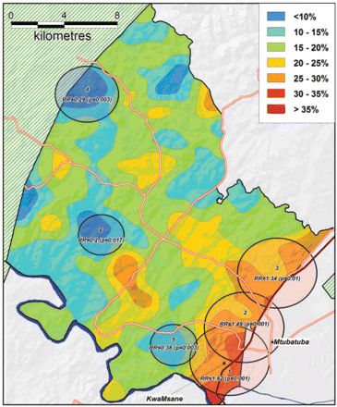
What is “Spatial Clustering”?
A geographic bounded group of occurrences of sufficient size and concentration which are unlikely to have occurred by chance
(Knox, 1989)
(Tanser, 2009)

Slide 7
Why is this important?
Clustering of a new contagion in an area can highlight the factors associated with vulnerability of specific communities.
Links between public health datasets can be used to target other areas that could be at high risk outside of the study area.
Public Health and Contagion Spread Prevention programs can be informed by this analysis to be better targeted at affected communities.

Slide 8
What is SatScan?
Free software that analyses spatial, temporal and space-time data using the spatial, temporal, or space-time scan statistics

Slide 9
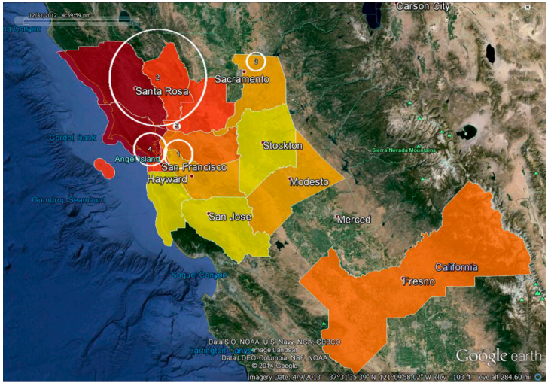
1) Perform geographical surveillance of disease to detect clustering 2) Test for random disease distribution space, time or space-time 3) Test the statistical significance of disease clustering 4) Perform surveillance over a period of time to detect outbreaks earlier
Uses of SatScan
(Liu et al., 2015)

Slide 10
What does SatScan use to work?
Example Spatial File
Example Population File
Example Case File
Input Data Type | Format | Example (# means new column)
Case File | <Location ID>, <Number of Cases>, <Time> (OPTIONAL) | London # 5470 # 2022/5/13 Folkestone # 2068 # 2022/6/13
Population File | <Location ID>, <Population> | Lincoln # 20437 Grantham # 7457
Coordinates file | <Location ID>, <Latitude>, <Longitude> | Birmingham # 52.4862 # 1.8904 Coventry # 52.4068 # 1.5197
Notes:
NOTES FOR TEACHING***
Input Data ranges between the type of modelling performed in SatScan. For the sake of this exercise we are focussing on Discrete Poisson Modelling which requires the above 3 data sets in order to run. If students wish to know more about data inputs for other model types see pages 27 – 34.
- Case File (Contains the location of where cases
Formats for all data can range but for this case we have used .txt files as it is simple to use and easy to find mistakes. When you click again the slide will show an example of a coordinate file in .txt format for students to look at to make it very clear. You could also use the example data that they will use for the activities.
For formatting data ensure they are all spaced, have no titles, and have the same column length.

Slide 11
Task 1a: Produce the first SatScan Output
Find the Task 1 PDF that explains the steps to producing the first SatScan output.
The files used for this task can be found in the same location and will be labelled case, co-ordinate, and population file.
Follow the steps on and begin to manipulate the analysis parameters to see how this impacts clustering.
Use the outputs from this mapping in Task 2 and in presentations.
Time for Task: 1 hours
Task 1b: Manipulate parameters
Time for Task: 45 minutes

Slide 12
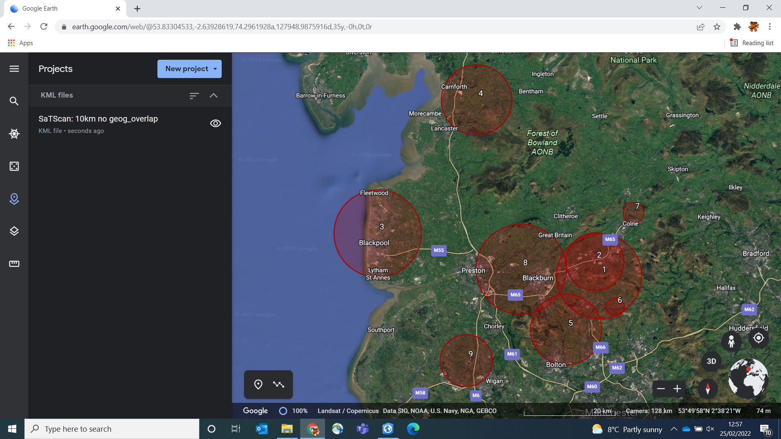
Task: Outputs
Locations included in that cluster
Cluster number
P-Value or Statistical Significance of Cluster
(p<0.05)
what the model expected Number of cases in cluster compared to
Notes:
The output on the left is the .txt file SatScan output.
The output on the right is the .kml cluster file SatScan output.
Explain that the clusters are labelled in order of significance with 1 being the most significant going down in significance.
Click through

Slide 13
Any Questions?

Slide 15
Recap
In Task 1 you produced a .kml/.kmz cluster layer which shall be used in Task 2

Slide 16
Task 2: Visualisation of Cluster Charescteristics
By the end of this lesson, you should be able to:
Import and manipulate .kml/.kmz files in GIS software
Overlay public health spatial datasets over the area to visualise underlying factors relating to clustering
Compare multiple datasets over areas in order to explain cluster membership through intersecting factors

Slide 17
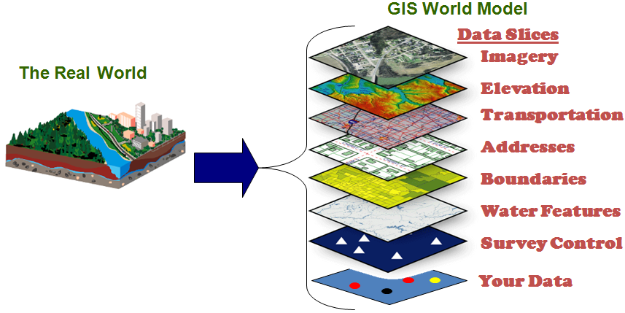
What is a GIS?
A Geographic Information System (GIS) is a system that creates, manages, analyses, and maps all types of data.
(Chang, 2008)
GIS connects data to a map, integrating locational data (where things are) with all types of descriptive information (what things are like there).
(ESRI.com)

Slide 18
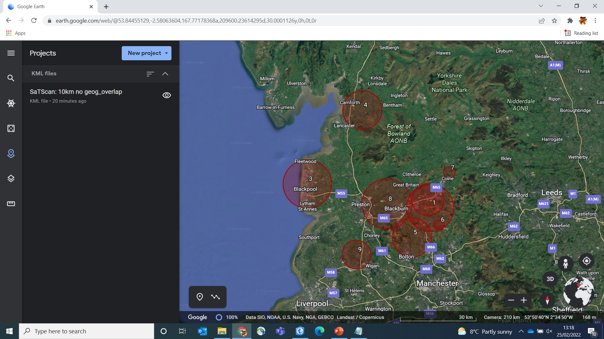
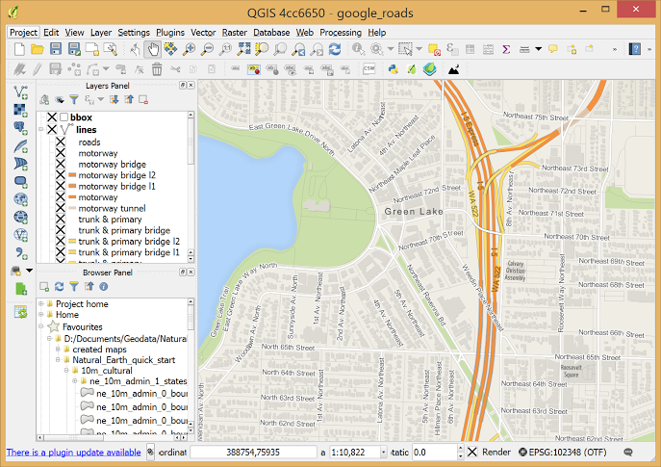
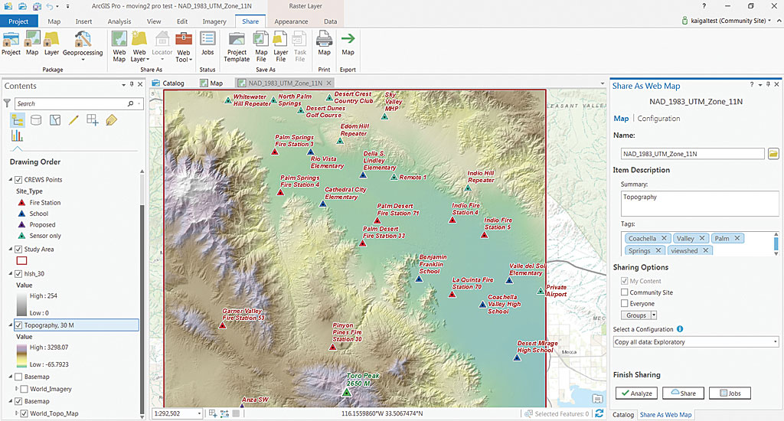
ArcGIS, Q-GIS and Google Earth
Google Earth:
Free online software
Easy to access
Import .kml files for viewing but difficult to manipulate
Cannot change symbology of clusters
ArcGIS Standard or Pro:
Paid software
Support centres, Data hubs, tutorials, and lots of Youtube videos
Many different toolbox packages for different jobs
Slightly more user friendly than Q-GIS but still quite daunting
Widely used in academia and industry more so than Q-GIS
Q-GIS:
Free downloadable software
Lots of support forums and YouTube tutorials
Very powerful GIS software with an extensive library of GIS tools
Can be quite daunting to use and a little confusing for beginners
Widely used in academia and industry

Slide 19
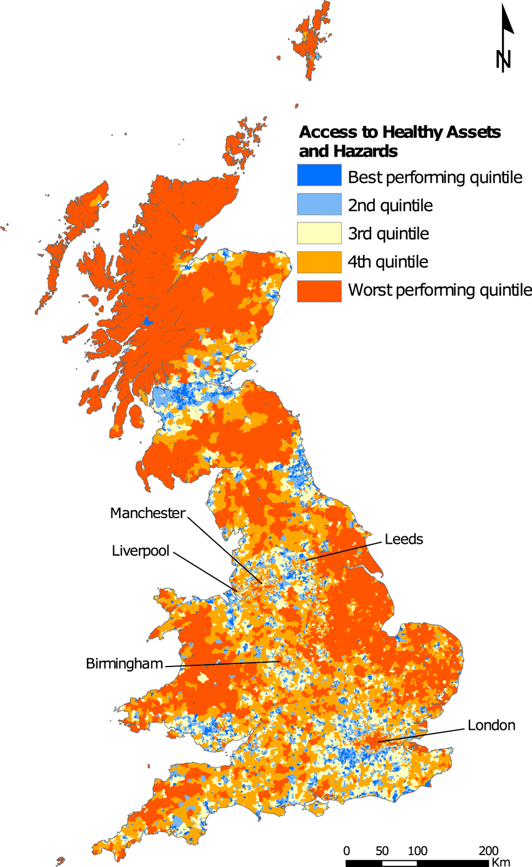
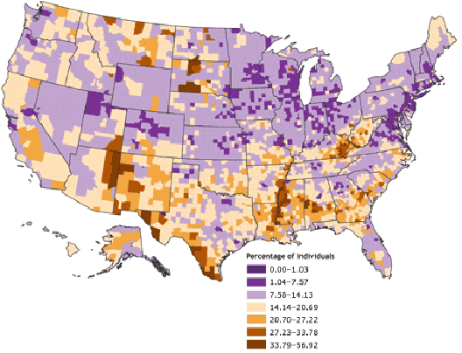
Public Health Spatial Datasets
Public Health Data can be shown spatially by aggregating data to an area level.
Areas can be as fine as <1km² or larger aggregating at county or country level.
Indicators of public health come in a range of factors such as; poverty/ deprivation, air pollution, access to unhealthy assets such as tobacconists or fast-food, etc.
Community Health Status Indicators (CHSI), US example
Access to Healthy Assets and Hazard (AHAHI), UK example

Slide 20
Limitations and Benefits
What do you think some of the limitations and benefits of using these types of datasets are?
Benefits | Limitations
Notes:
Get students to call out here and add to this blank table… Next slide is a complete table.

Slide 21
Public Health Spatial Datasets
Benefits | Limitations
Shows community level indicators that reflect public health Designed to be multi-use with lots of applications outside epidemiology Becoming more widely available with improving data collection Useful for benchmarking areas with aims to bring about equity | Not reflective of exact individual behaviour but can be a good proxy Can mix small-scale complexities with poor data resolution Missing data points and misrepresentation of areas for example Census data Can be easily misinterpreted and taken out of context

Slide 22
Task 2: Visualising Cluster Outputs
Find the Task 2 PDF that explains the steps to visualising the cluster outputs
This task will involve the outputs from Task 1a, .txt and .kml files
Output maps form Task 2 shall be used for visualising the data and presentations on potential reasons why we see clustering in these locations

Slide 23
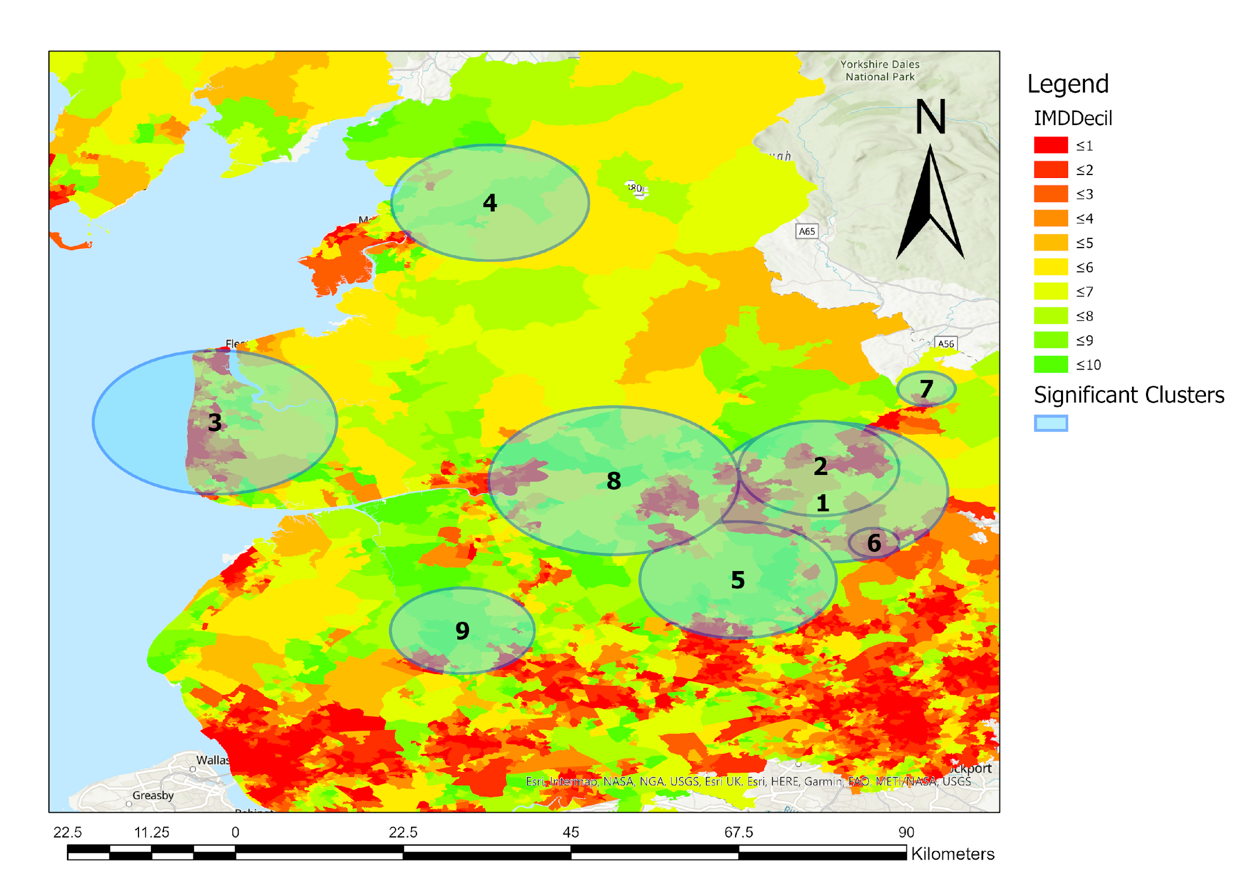
Task: Outputs
On the left is an example of the outputs from this task showing 10km clusters overlayed onto an map showing varying levels of deprivation.
1 is the most affluent areas and 10 being the least.
Notes:
- Important development of students familiarity with the concept of the social determinants of public health
- Outputs to be used in presentation and theories of why students see clusters should be supported by literature both grey and academic.

Slide 25
References:
Chang, K.T., 2008. Introduction to geographic information systems (Vol. 4). Boston: McGraw-Hill.
Elliot P., and Wartenberg D., (2004). Spatial Epidemiology: Current Approaches and Future Challenges. Mini-Monograph Environmental Health Perspectives Vol. 112 No. 9.
Tanser, F., Bärnighausen, T., Cooke, G.S. and Newell, M.L., 2009. Localized spatial clustering of HIV infections in a widely disseminated rural South African epidemic. International journal of epidemiology, 38(4), pp.1008-1016.
Knox, E.G., 1989. Detection of clusters. Methodology of enquiries into disease clustering. London: Small Area Health Statistics Unit, 17, p.20.
Lieu, T.A., Ray, G.T., Klein, N.P., Chung, C. and Kulldorff, M., 2015. Geographic clusters in underimmunization and vaccine refusal. Pediatrics, 135(2), pp.280-289.

